Slide 1
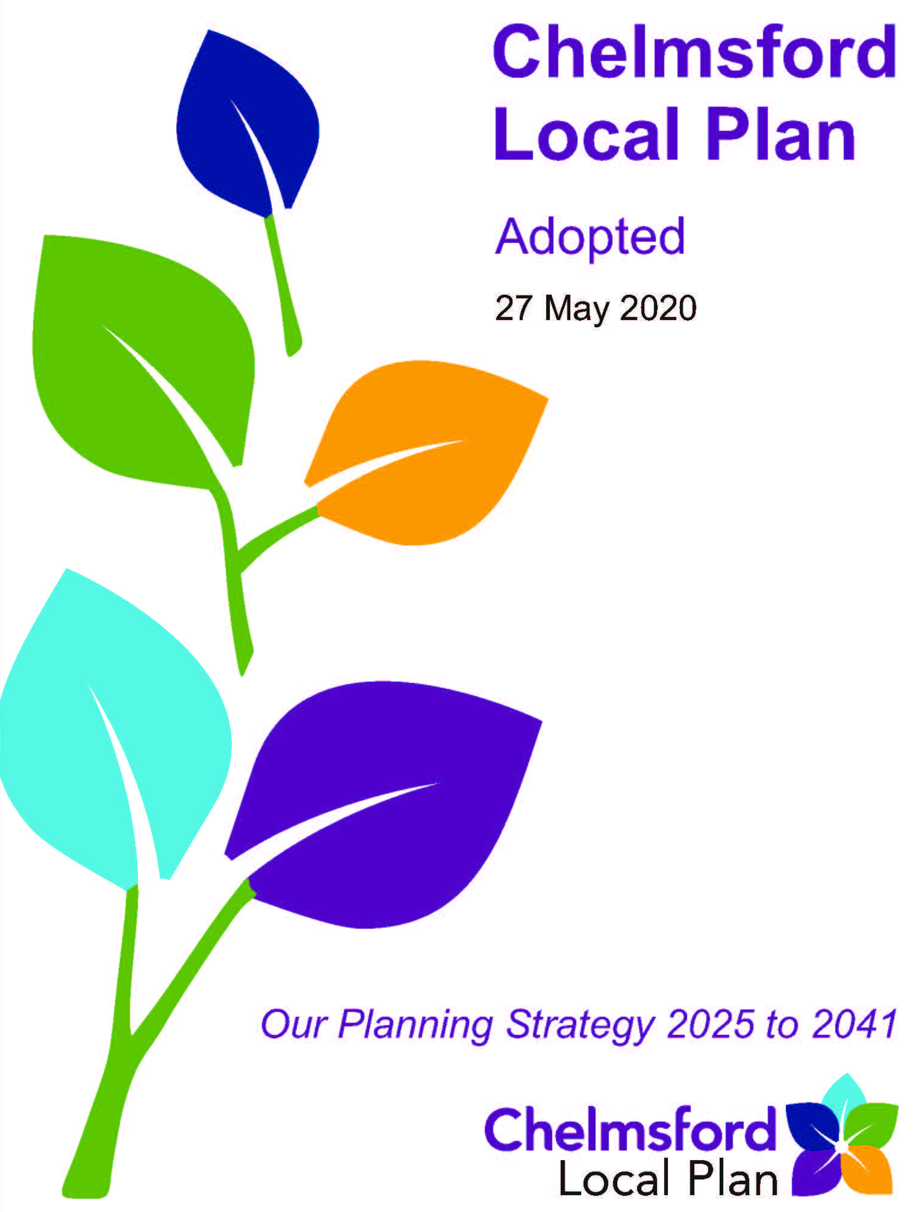
Review of the Chelmsford Local Plan Preferred Options
Chelmsford Policy Board
14 March 2024

Slide 2
Purpose of Report
To present the Chelmsford Local Plan Preferred Options Document and Integrated Impact Assessment (IIA) and to seek the Board’s approval to publish them for public consultation for eight weeks starting in May 2024​.

Slide 3
The need to review
Local Plans are required to be reviewed every 5 years
Meet the Council’s new ambitions and aspirations, such as addressing the climate change/ecological emergency, housing crisis and creating high-value new jobs
Existing commitment to commence review in 2022
Ensure remains consistent with current national planning policy requirements and legislation
Extend plan period to meet development requirements to 2041
Addressing Monitoring Framework

Slide 4
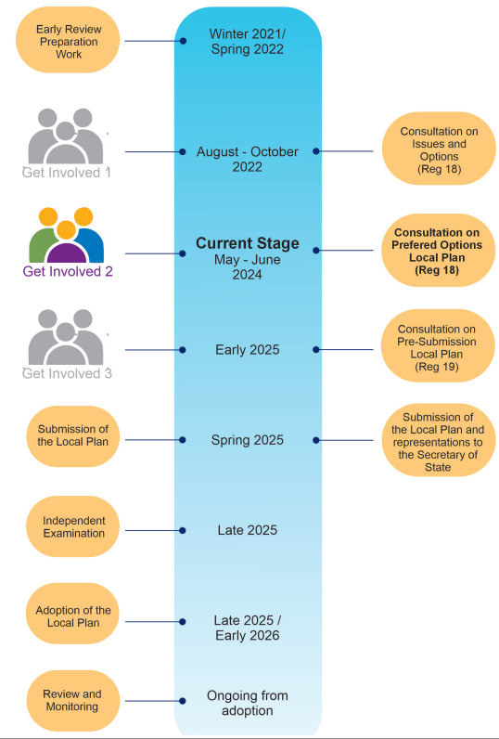
Preparation Stage
We are at the second of at least three stages of public consultation

Slide 5
Development Needs - Housing
Assessment Date | I&O April 2022 | April 2023 | Sept 2023 | PO Feb 2024
Housing Requirement 2022-2041 | Dwellings | Dwellings | Dwellings | Dwellings
19 years x 1,000 homes | 19,000 | 19,000 | 19,000 | 19,000
+ 20% buffer | 3,800 | 3,800 | 3,800 | 3,800
Total requirement | 22,800 | 22,800 | 22,800 | 22,800
Existing Supply 2022-2041
Total completions, allocations, permissions and windfall | 14,834 | 16,662 | 18,176 | 18,705
Shortfall | 7,966 | 6,138 | 4,624 | 3,862*
* Proposed allocations = 19% Buffer

Slide 6
Housing Number Breakdown

Slide 7
Historic Housing Performance
Based on 16-18% Supply Buffer in Local Plan Periods
Delivery Plan Period | Target | Supply | Difference | Actual Performance %
2001-2013 (16% Buffer) | 8400 | 6435 | -1965 | 77%
2013-2023 (18% Buffer) | 8050 | 8703 | +653 | 108%
2001-2023 | 16450 | 15138 | -1312 | 92%

Slide 8
Provisional Development Needs - Travellers
 | Indicative Requirement* | Not implemented in adopted Plan | Net new allocations required
Gypsies and Travellers (pitches) | Between 36 and 77 | 0 | Between 36 and 77
Travelling Showpeople (plots) | 25 | 24 | 1
*Awaiting final result of the Gypsy and Traveller Accommodation Assessment

Slide 9
Development Needs - Employment Need (sqm)
Notes:
1 Labour Demand 2) Past Development Rates 3) Labour Supply – TOTAL nearly 108,000sqm +12.5% 12,500 jobs

Slide 10
Updated Strategic Priorities
Priorities for climate
1. Addressing the Climate and Ecological Emergency
2. Promoting smart, active travel and sustainable transport
3. Protecting and enhancing the natural and historic environment, and support an increase in biodiversity and ecological networks
Priorities for growth
4. Ensuring sustainable patterns of development and protecting the Green Belt
5. Meeting the needs for new homes
6. Fostering growth and investment and providing new jobs
Priorities for place
7. Creating well designed and attractive places, and promoting the health and social wellbeing of communities
8. Delivering new and improved strategic and local infrastructure
9. Encouraging resilience in retail, leisure, commercial and cultural development

Slide 11
New Vision
Guiding Chelmsford’s growth towards a greener, fairer and more connected community

Slide 12
New Strategic and Development Management Policies
S14 Health and Wellbeing – promotes improvements in the health and wellbeing of residents and communities, promotes more active and healthier lifestyles and a reduction in health inequalities
S15 Creating Successful Places – supports creation of successful new places where people want to live, work, visit and study and for developments to make a positive contribution to the character and appearance of the locality
S16 Connectivity and Travel – maximises opportunities for active and sustainable travel, facilitates a shift away from fossil fuelled powered vehicles and a reduction in the need for travel
S17 Future of Chelmsford City Centre – promotes a new vibrancy for the City Centre through diversification, regeneration, and improvement
DM31 Net Zero Carbon Development (In Operation) – requires all new buildings to be designed and built to net zero carbon in operation, designed to be ultra-low energy, fossil fuel free, and generate renewable energy on-site to at least match annual energy use.

Slide 13
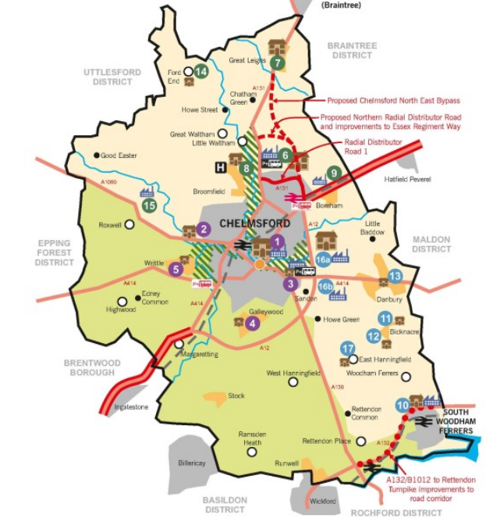
Spatial Strategy (SP7) Key Diagram
3 Growth Areas retained
Green Belt unchanged
Green Wedges maintained
New development focus in Chelmsford City Centre, East Chelmsford and sustainable villages

Slide 14
Growth Area 1 – New Development Sites
Chelmsford City Centre and Urban Area | Proposal
Meadows Shopping Centre (Site 1w) | 350 new homes and mixed uses
Former Kay-Metzeler Premises, New Street (Site 1x) | 185 new homes
Marriages Mill, Hoffmans Way (Site 1y) | 100 new homes
Granary Car Park, Victoria Road (Site 1z) | 60 new homes
Coval Lane Car Park (Site 1aa) | 40 new homes
Glebe Road Car Park (Site 1bb) | 12 new homes
Location/Settlement

Slide 15
Growth Area 1 - New Sites
Chelmsford City Centre
Existing housing site
New housing site

Slide 16
Growth Area 2 – New and Extended Development Sites
North Chelmsford | Proposal
Land West of Back Lane, Ford End (Site 14a) | 20 new homes
Land South of Ford End Primary School (Site 14b) | 20 new homes
Waltham Road Employment Area, Boreham (Site 9a) | Extension of 3,500sqm employment floorspace
Little Boyton Hall Employment Area, Roxwell | Extension of 6,000sqm employment floorspace
Chelmsford Garden Community, North East Chelmsford | x1 10 pitch Gypsy and Traveller Site (Policy Requirement)

Slide 17
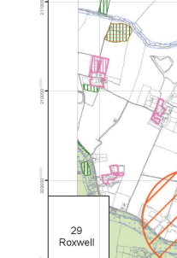
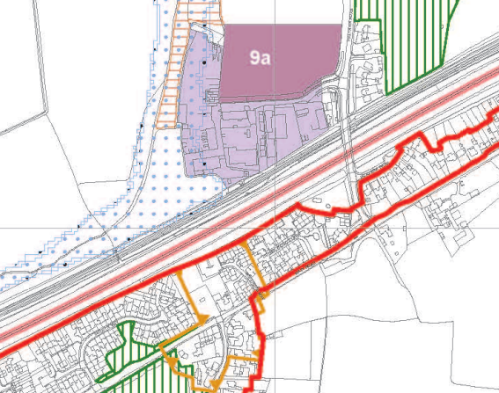
Growth Area 2 - New Sites
Little Boyton Hall
Proposed extensions
Waltham Road
Existing site allocations
A12
A1060

Slide 18
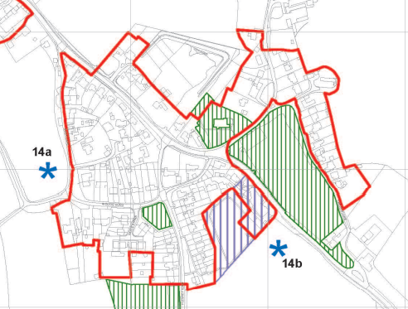
Growth Area 2 - New Sites
Ford End

Slide 19
Growth Area 3 – New Development Sites
Site | Proposal
East Chelmsford Garden Community (Hammonds Farm) (Site 16a) | 3,000 new homes to 2041 and 1,500 new homes beyond 2041 43,000 sqm new employment space x2 10 pitch Gypsy and Traveller Site
Land adjacent to A12 Junction 18 (Site 16b) | 43,000sqm new employment floorspace
Land at Kingsgate, Bicknacre (Site 11b) | 20 new homes
Land west of Barbrook Way, Bicknacre (Site 11c) | 20 new homes
Land north of Abbey Fields, East Hanningfield (Site 17a) | 15 new homes
Land east of Highfield Mead, East Hanningfield (Site 17b) | 20 new homes

Slide 20
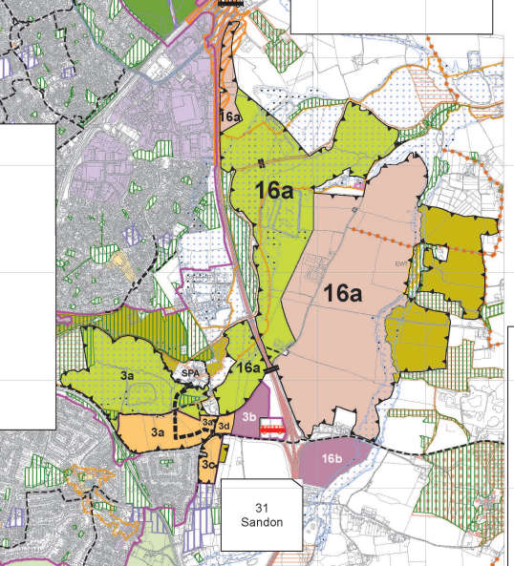
East Chelmsford Garden Community (Hammonds Farm)
Sustainable, comprehensively planned, landscape-led development based on Garden City Principles
New sustainable and active travel links over and under the A12 and through the Green Wedge
Highway access from A414 (to south) and A12 J19 (to north)
Capacity improvements to A414 and A12 J18 and J19 required
New all-through school, two new primary schools and six early years and childcare nurseries
Open spaces, recreation, sport and play facilities, community facilities and mixed use neighbourhood centres
174ha new country park providing improved public access and recreational opportunities along the Chelmer Valley river corridor
20% biodiversity net gain
Reinstatement of lost historic landscape features.
Land adjacent to A12 Junction 18

Slide 21
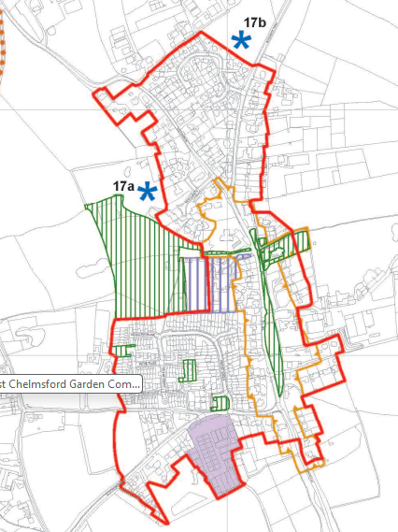
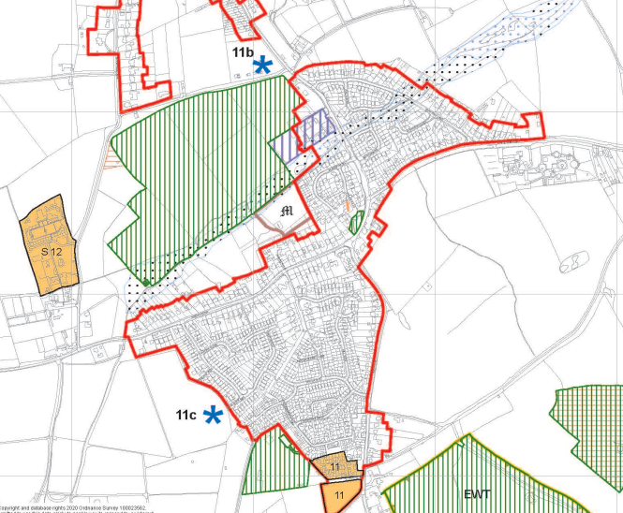
Growth Area 3 – Other New Sites
East Hanningfield
Bicknacre

Slide 22
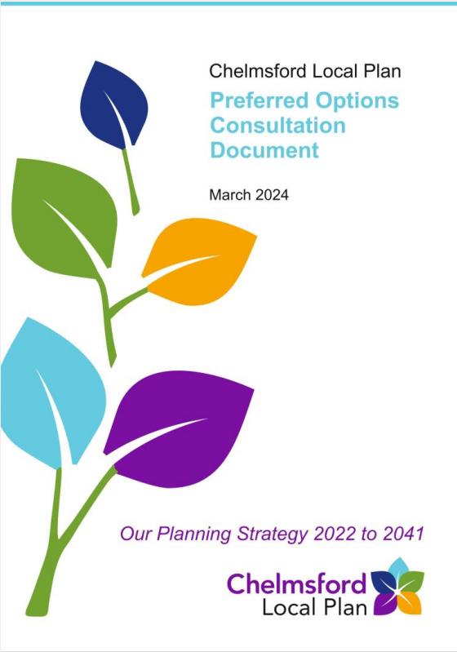
Preferred Options 2024 Consultation Document
Full updated draft Local Plan document
Draft policy wording and site allocations
Draft Monitoring Schedule
Draft Policies Map
Reasonable Alternatives

Slide 23
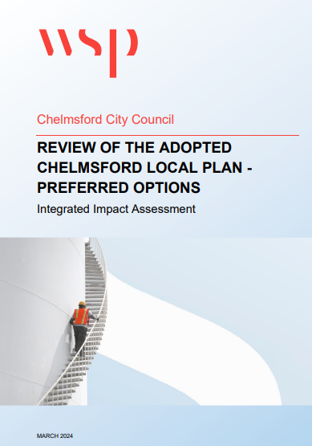
Integrated Impact Assessment Consultation Document
Draws together environmental, equality and health assessments of the Preferred Options Local Plan
Seeks to maximise policy benefits and promote sustainable development
Finds that the Preferred Spatial Strategy performs better than the five alternative approaches, and will focus new housing and employment growth to the most sustainable locations

Slide 24
Intended Consultation
Early May – Mid-June 2024 (exact date TBC)
Consultation notifications sent to all on Local Plan database
Web page with links to key materials
Adverts in local publications
Pop-up displays for the whole consultation period
Posters circulated to Parish/Town Councils, main Council buildings, and community facilities such as post offices, libraries and GP surgeries
Site Notices around proposed new site allocation boundaries
Staffed and unstaffed public exhibitions, and a 24/7 online virtual exhibition
Social media campaign​
Track changed version, summary leaflets, FAQs, ‘You Said We Did’ Feedback Report
Parish/Town Council information pack.

Slide 25
Recommendations
That the Board approves the publication of the Chelmsford Local Plan Preferred Options Consultation Document and the Preferred Options Integrated Impact Assessment attached at Appendices 2 and 3 of this report for public consultation in accordance with the requirements of The Town and Country Planning (Local Planning) (England) Regulations 2012.
That the Board notes the contents of the Issues and Options ‘You Said, We Did’ Consultation Feedback Report Appendix 1 and approves it for publication.
To give delegated authority to the Director of Sustainable Communities in consultation with the Cabinet Member for a Growing Chelmsford to: (i) make any necessary minor amendments to the Chelmsford Local Plan Preferred Options Consultation Document, the Preferred Options Integrated Impact Assessment and the Issues and Options ‘You Said, We Did’ Consultation Feedback Report before publication; and (ii) prepare all necessary documentation to support the planned programme of public consultation including publishing the 2023 – 2024 Strategic Housing Land Availability Assessment (SHELAA).
That the Board endorses the proposed approach to the Local Plan Preferred Options consultation arrangements set out in Appendix 4.

