Slide 1

Before your group visits Chelmsford Museum for our World War II session take time to use this powerpoint with your pupils.
As you go through the presentation our robot ‘Sparky’ will help your pupils develop the skills and knowledge that will enable them to gain the most from the session and inspire questions to explore when they visit.
Encourage your pupils to share ideas with ‘a neighbour’ before you click to reveal answers.
Enjoy

Slide 2

World War 2 and the
Home Front

Slide 3
What do you know about World War 2?
Hello, my name is Sparky. Welcome to Chelmsford Museum.
When you visit you will be able find out how World War 2 affected the lives of people living in Britain and especially in Chelmsford.
What do you know about World War 2?
Children from cities that were at risk of aerial bombing raids were evacuated to the countryside to protect them.
Why were some children evacuated from their homes?
You had to cover windows and doors so no light showed at night that could help
guide enemy planes.
What was the black out?
Britain was known as the ‘Home Front’ because everyone helped fight the war in some way.
What was the Home front?

Slide 4
There were two main sides in WW2 –
the Axis Powers and the Allied powers.
The main Axis Powers were Germany, Italy, and Japan. They wanted to become more powerful.
The major Allied Powers were: Britain, France, Russia and the United States. They joined together to form a stronger defence against attacks by the Axis Powers.
What countries were involved in the war?
What led to the start
of World War 2?
A variety of different factors led to World War 2, but the main event that sparked it all was Germany's invasion of Poland in September 1939.

Slide 5
Some important events in World War II
1 September 1939 Germany invades Poland and World War II begins.
3 September 1939 France and Great Britain declare war on Germany.
May to June 1940 Germany takes over much of Western Europe.
30 May 1940 Winston Churchill becomes leader of the British government.
10 June 1940 Italy enters the war as a member of the Axis Powers.
July – October 1940 Germany launches air attacks on Great Britain, known as the Battle of Britain.
6 June 1944 The D-Day landings by Allied forces on Normandy beaches are a turning point in the war
May 7 1945 Germany surrenders to the Allies and VE day is celebrated across Europe.

Slide 6
What different historical sources or ways have you used to find out about World War 2?
Newspaper articles
?
?
Objects
?
Books
Photographs
Letters
?
?
?
Internet
These are a mixture of primary and secondary historical sources, but which are which?
A Primary sources is any source of information that was created during the period you are studying.
A Secondary Sources is any information written later by people who did not experience the events or period first-hand. They use and interpret primary sources to write about the past.

Slide 7
When you visit the museum
we will use a variety of historical sources to investigate the big question
‘What was life like in Chelmsford during World War 2?’

Slide 8
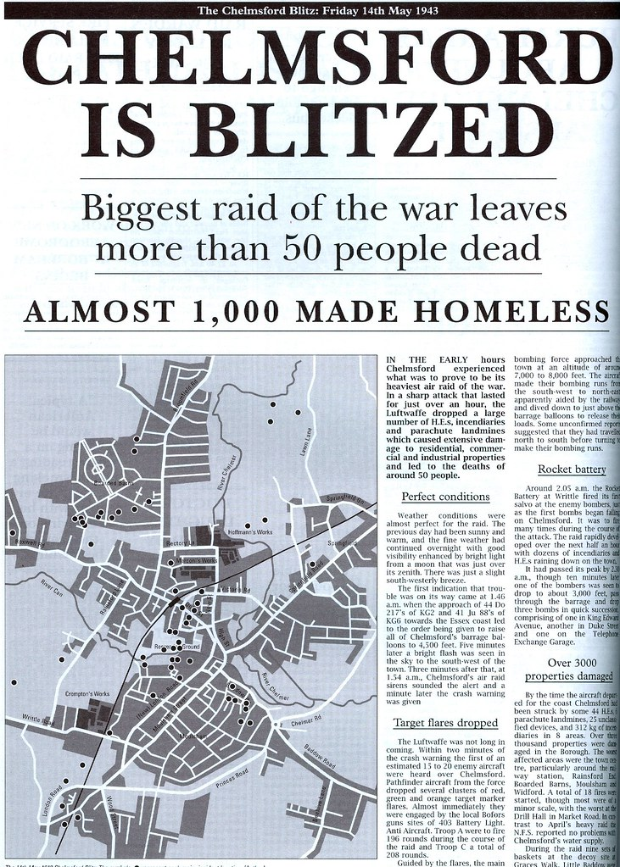
Post visit resources for
World War 2 session
Life on the Home front

Slide 9
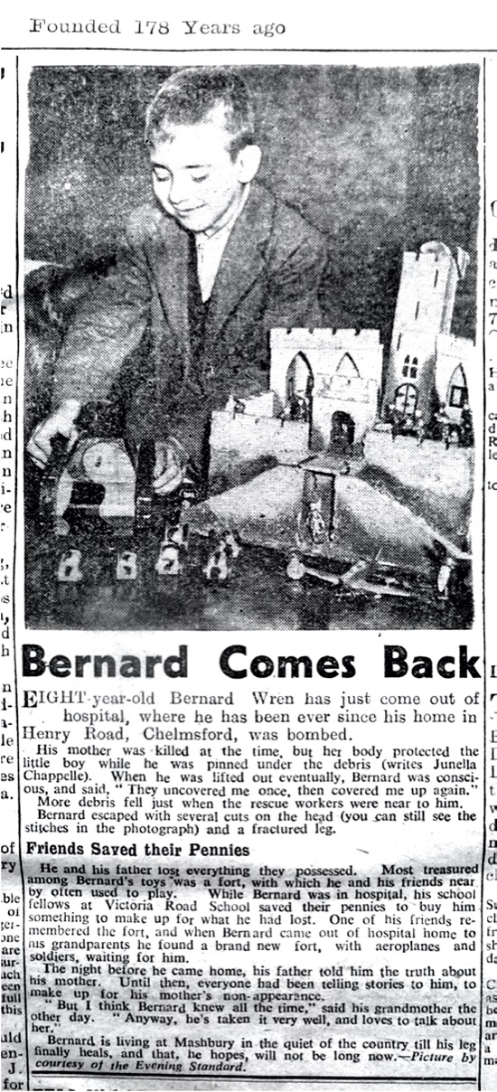
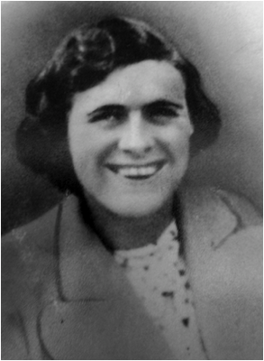
Bernard’s War
This is Bernard’s mother Ellen May Wrenn.
Bernard was born in 1934. He was only 6 years old when World War 2 began.
Bernard lived with his parents in a terrace house in Henry Road.
He went to Church Street National School which was near to Chelmsford Cathedral (the school no longer exists today)
His Father, Robert Wrenn, worked at Hoffmans factory, which manufactured ball bearings.

Slide 10
How did everyday life change for Bernard and his family living on the Home Front in Chelmsford during World War 2? war?
Did anything stay the same?

Slide 11
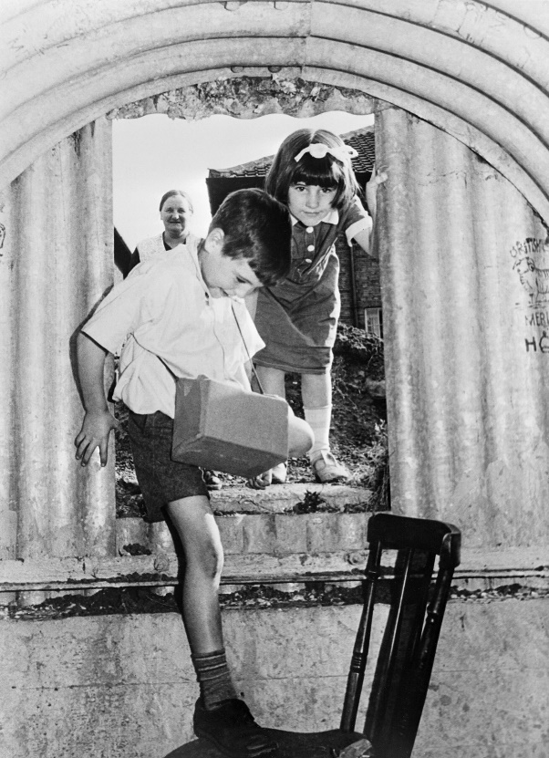
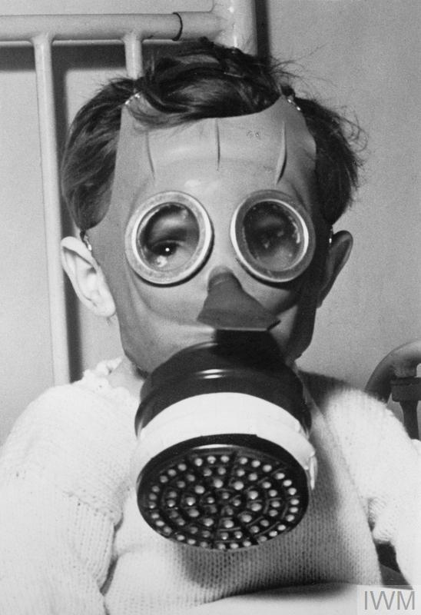
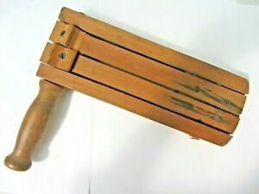
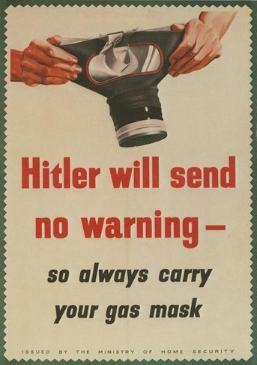
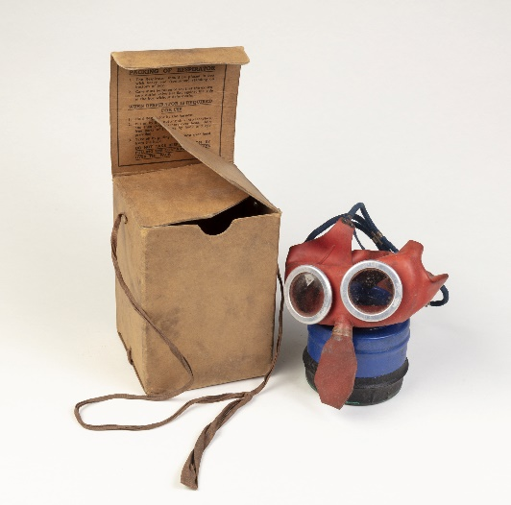
Gas masks and air raid shelters
What was
What did it feel like wearing a gas mask?
What happened when air raid siren sounded?

Slide 12
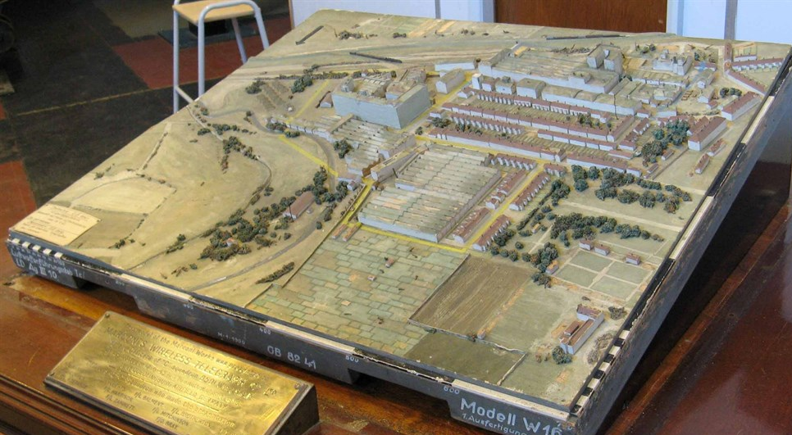
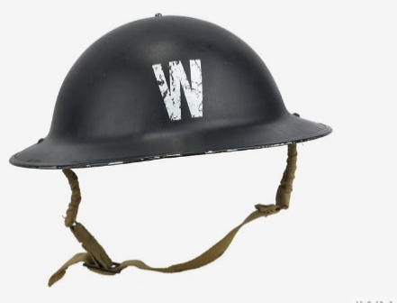
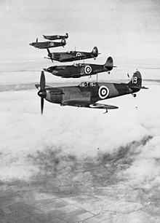
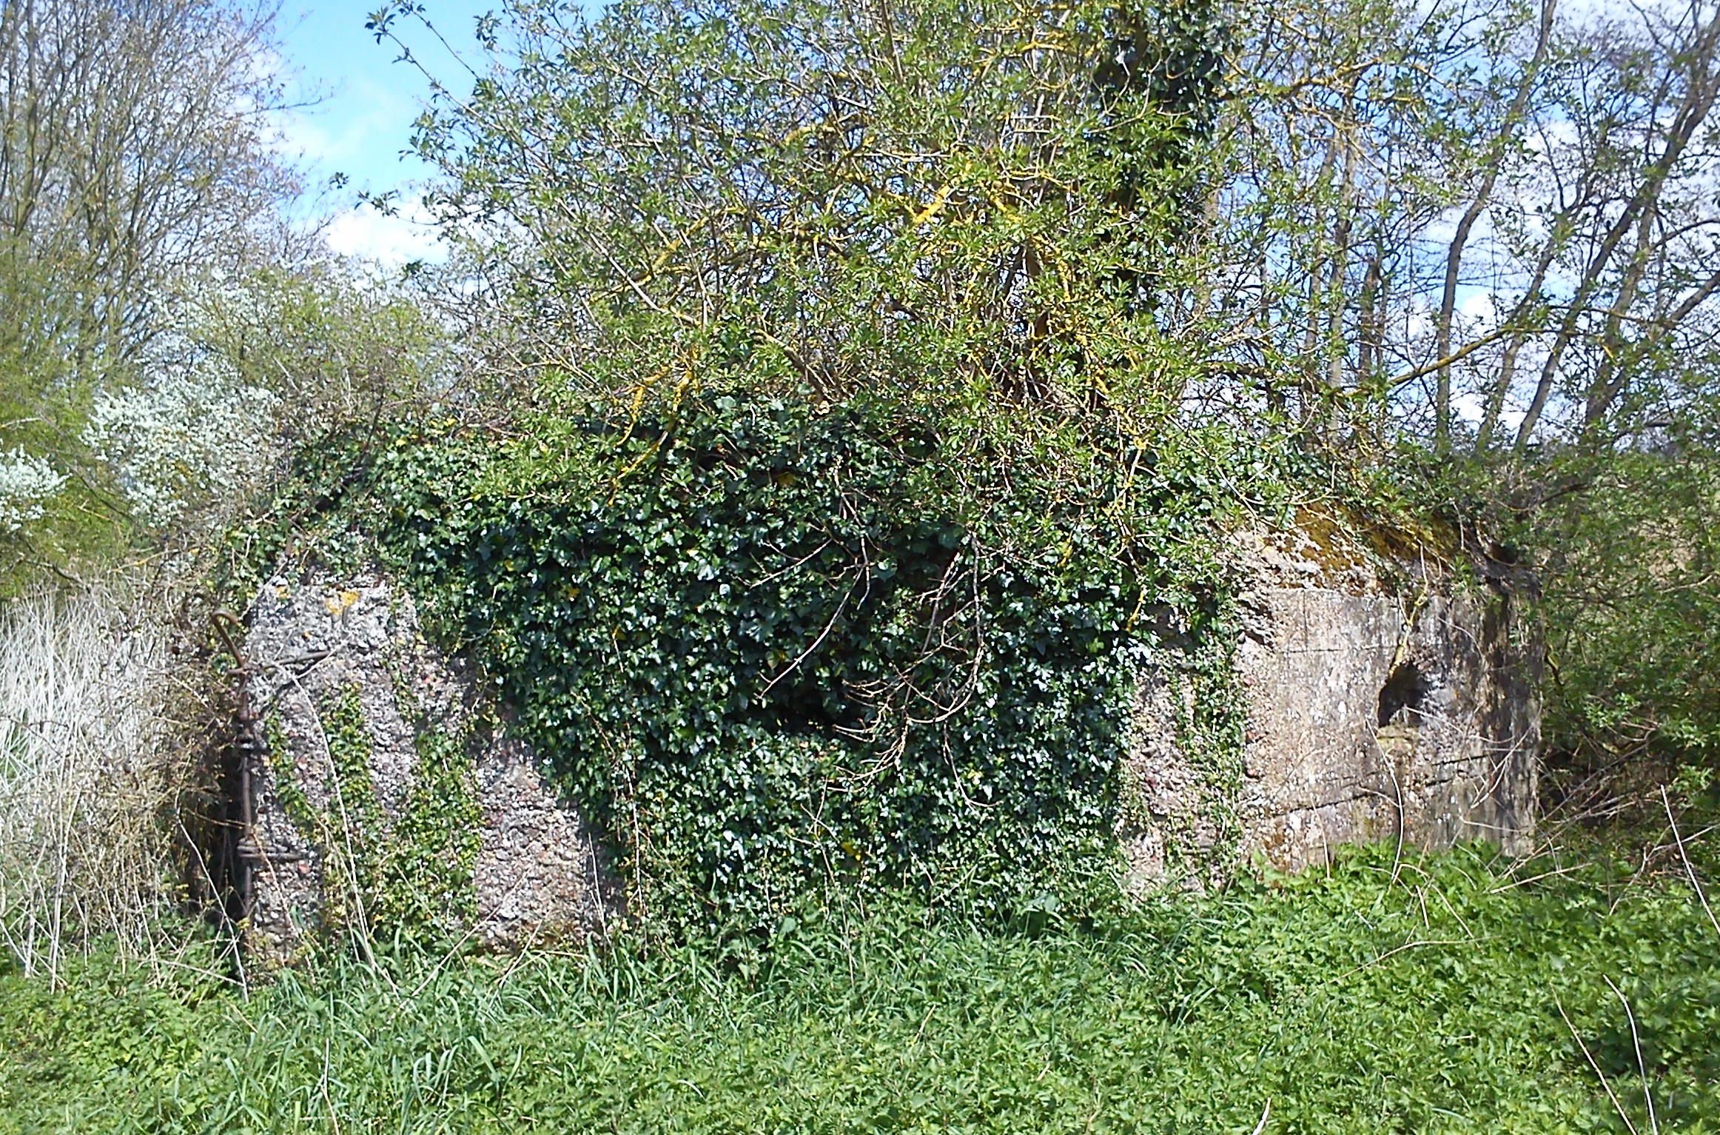
Air raids and bombings….
Why was Chelmsford a bombing target for the German Luftwaffe?
What did the air raid wardens do?
Surviving pill box which housed anti air craft guns on land behind B + Q.

Slide 13
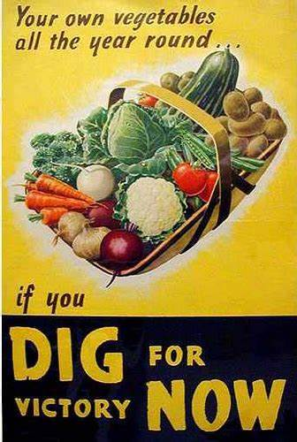
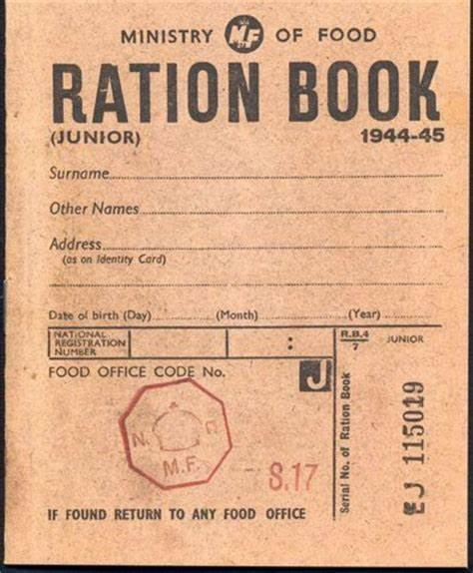
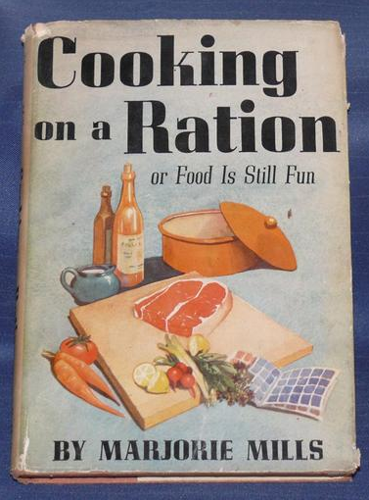
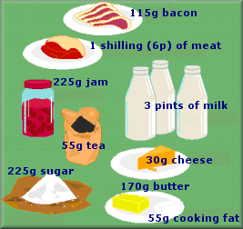
Food rationing
What was food rationing?
Why was food in short supply during the war?
How did people make their food go further?
A weeks food ration for one person.

Slide 14
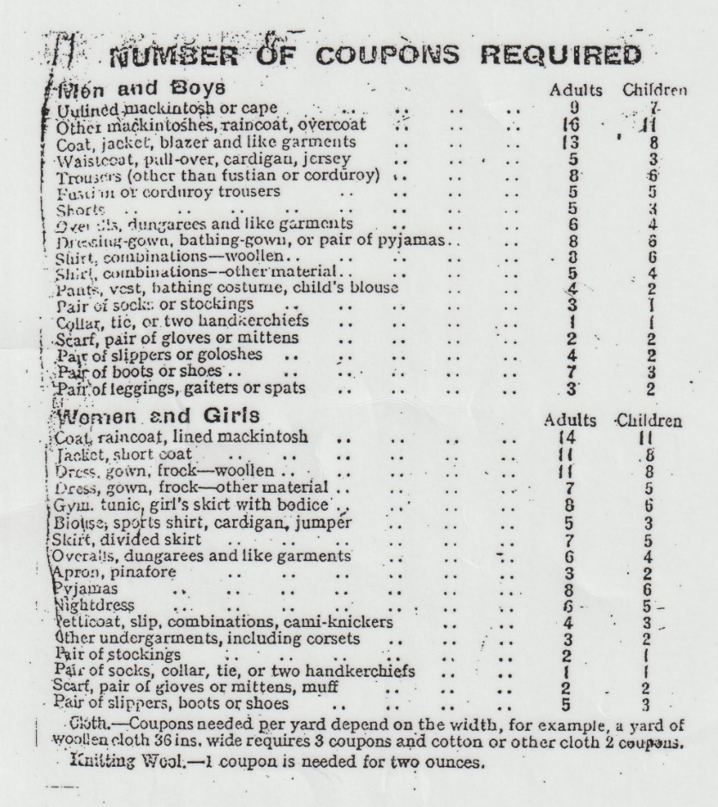
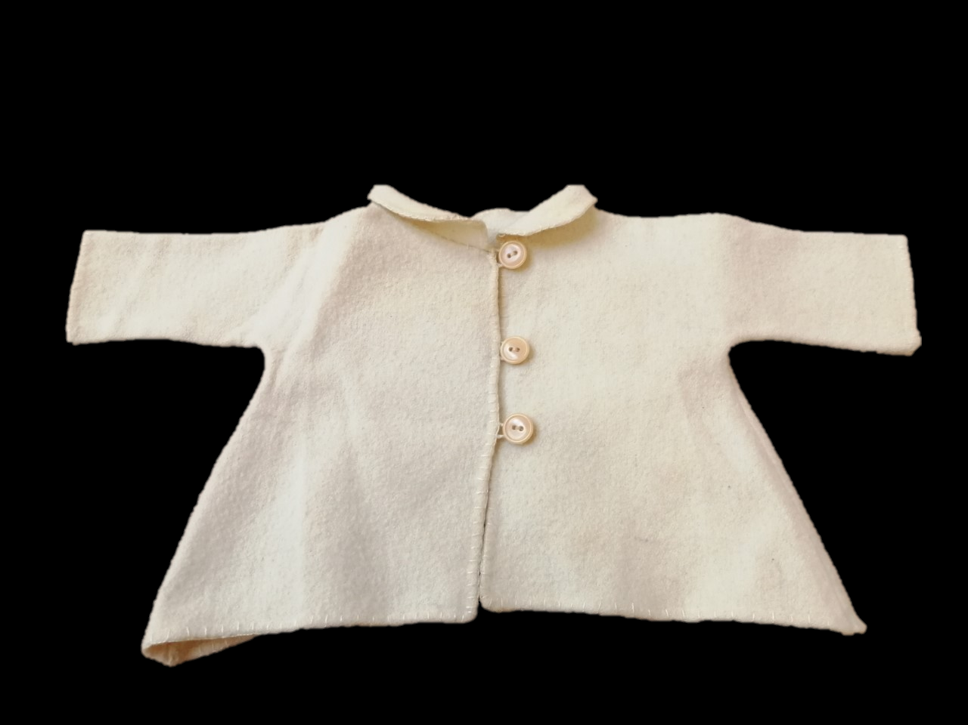
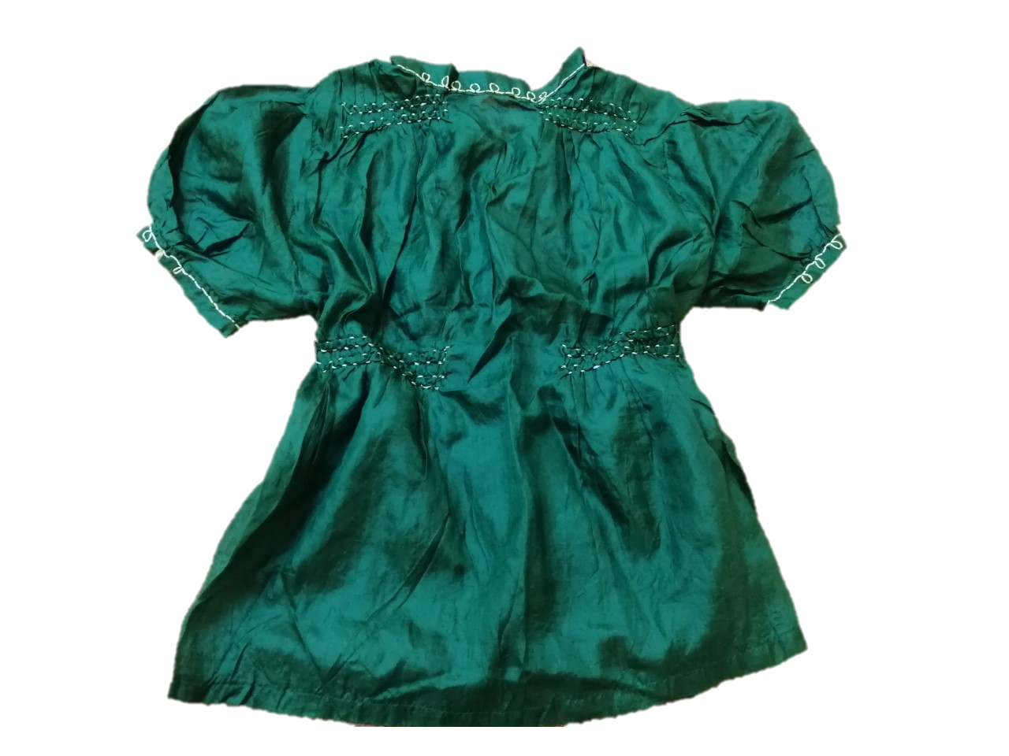
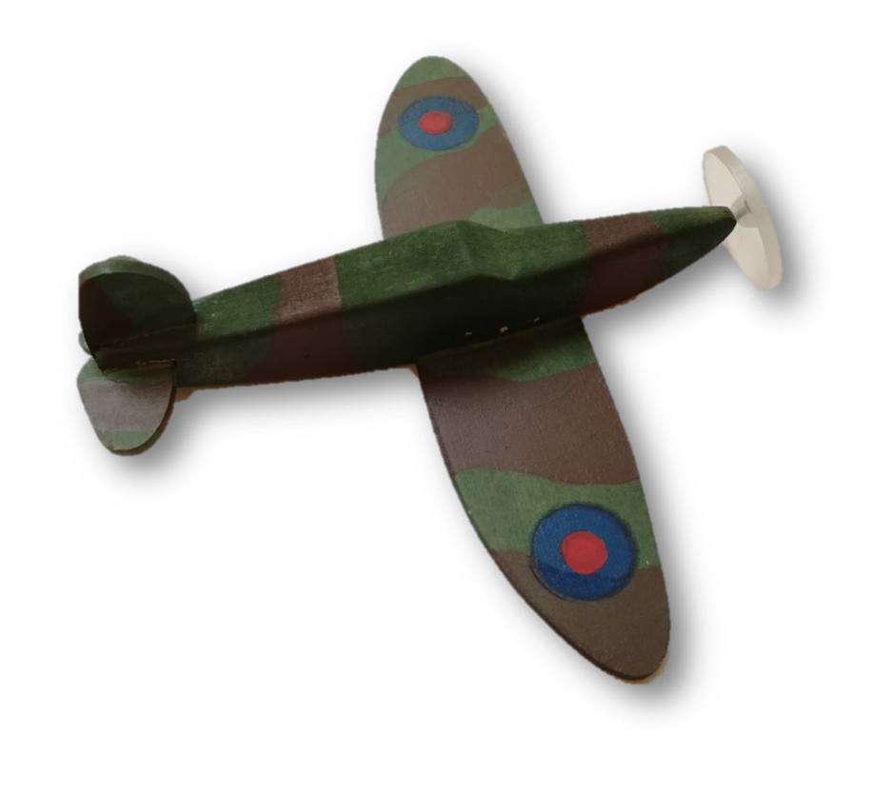
‘Make do and Mend’
Why were clothes in short supply and had to be rationed?
How did people ‘make do and mend’?
Babies coat made from an old blanket.
Blouse made from a piece of material from a parachute.

Slide 15
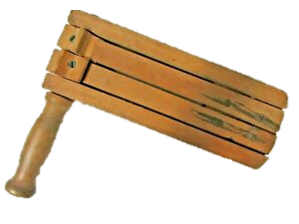
The day that changed Bernard’s life
On 19 October 1942 Bernard’s father went to work at Hoffmanns factory as usual. His mother dropped him off at school and went shopping for groceries and visited her mother in Railway Street.
At 10.59am an air raid siren sounded as a German aircraft was spotted approaching Chelmsford and the Hoffmann factory defensive guns were immediately fired.
Bernard’s mum collected him from school. Hurrying home, they put the shopping down as they went through the house to reach the Anderson shelter in their neighbour’s garden.
Under cover of low cloud the plane released its bombs. One hit Hoffmanns factory killing 4 people and injuring 65 others. A second bomb bounced off the factory roof, travelling 60 feet along Henry Road.

Slide 16
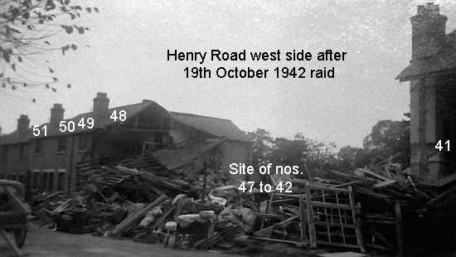
The bomb exploded in the front garden of 45 Henry Road destroying a number of houses including Bernard’s.
Bernard’s mother, their neighbour Dennis Locke and 3 other people were killed in the explosion. Bernard’s mother protected him and amazingly he escaped mostly unharmed.
His father arrived home from work at dinner time to discover what had happened.

Slide 17
Bernard hurt his leg in the blast and spent some time in hospital while it healed.
His family lost had lost all their possessions when their house was destroyed. Benard’s friends saved up their pennies to buy him his favourite toy – a fort.
Bernard’s quote looking back on his life?

Slide 18
Sew together some folded pages of sugar paper to create a book. Your pupils can stick all their work about World War 2 into it to create their own scrapbook of Bernard’s War, just as he may have.
You could include:
An air raid warden’s instructions about what to do when you hear the air raid siren.
A letter from Bernard to his grandparents about a night in their neighbours air raid shelter.
Bernards’ mothers favourite wartime recipes – and pictures if you cook them!
Foods Bernard missed during the war.
A ‘Make do and mend’ challenge to make a toy or game from scraps. Include a picture of what is made in the scrapbook.
Silhouettes of planes and an identification chart.
A page from Bernard’s diary – fears of being evacuated?
A newspaper article about the bombing of Henry Street.
An interview with Bernard’s friends.
Write on different size and colour paper and include drawings and black and white photos. Encourage your pupils to be creative about how they display their work in their scrapbook.
Activity suggestion
Create a scrapbook of Bernard’s War

