Slide 1

Before you visit Chelmsford Museum for our Marconi session please use this powerpoint with your pupils.
As you go through the slides our robot ‘Sparky’ will help your pupils develop the skills and knowledge that will enable them to gain the most from their visit and will inspire questions they want to investigate.
Give your pupils an opportunity to share their ideas with ‘a neighbour’ before you click to reveal answers. Enjoy

Slide 2

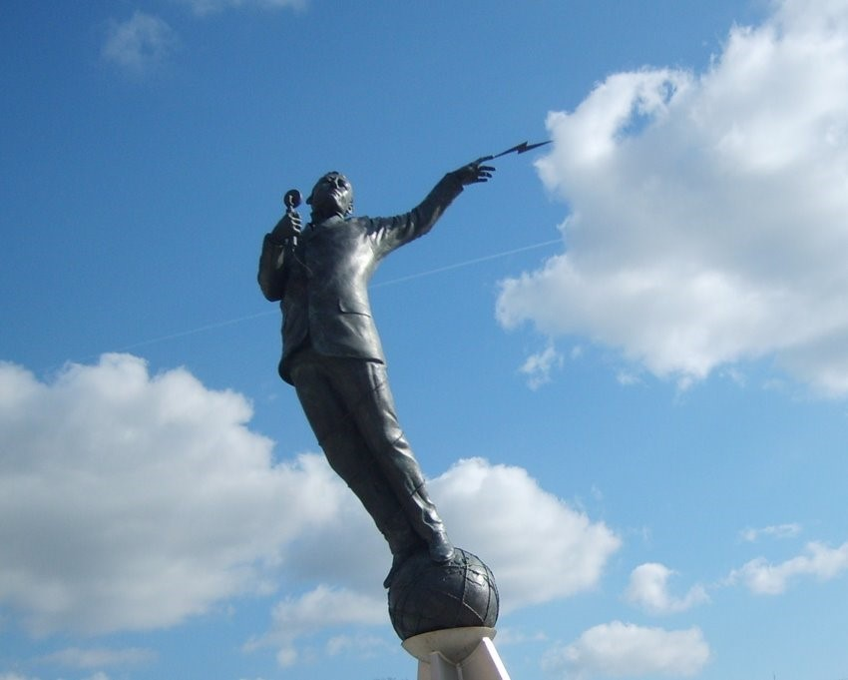
‘Marconi’s Magic Messages’
Hello, my name is Sparky. Welcome to Chelmsford Museum.
When you visit you will be able to find out more about Marconi and gather evidence to help you answer the question:
‘Is Marconi an extraordinary or significant person?
Before you come think about these questions…..

Slide 3
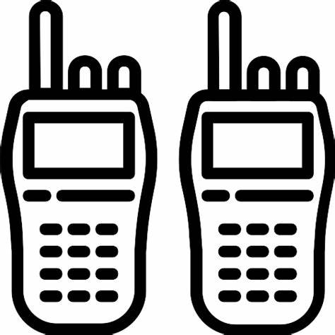
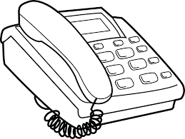
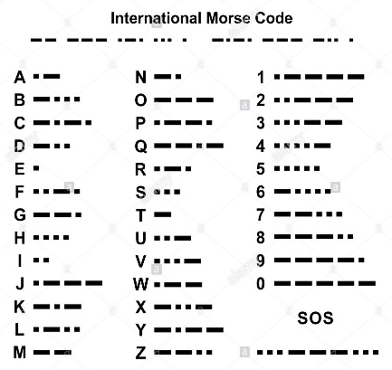
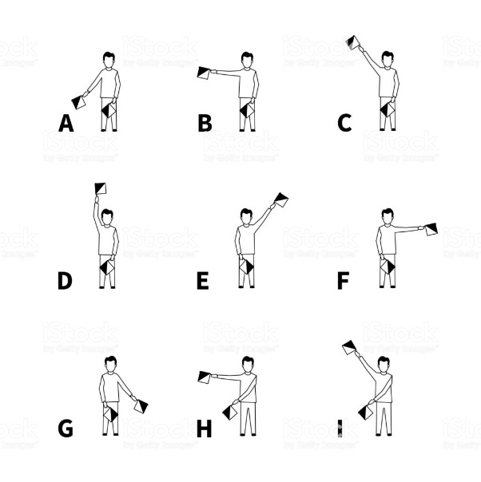


What different ways can you think of to send a message to someone else when you are not face to face?
Walkie talkies
Telephone
Morse code
Semaphore
Letters

Slide 4
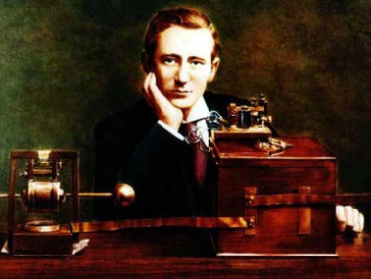
This is Marconi. He was born in 1874.
When he was young these were the only ways to send messages over a long distance.
Marconi loved science and did lots of experiments with electricity. He wanted to find a way to send messages through the air without needing to be joined by wires.

Slide 5
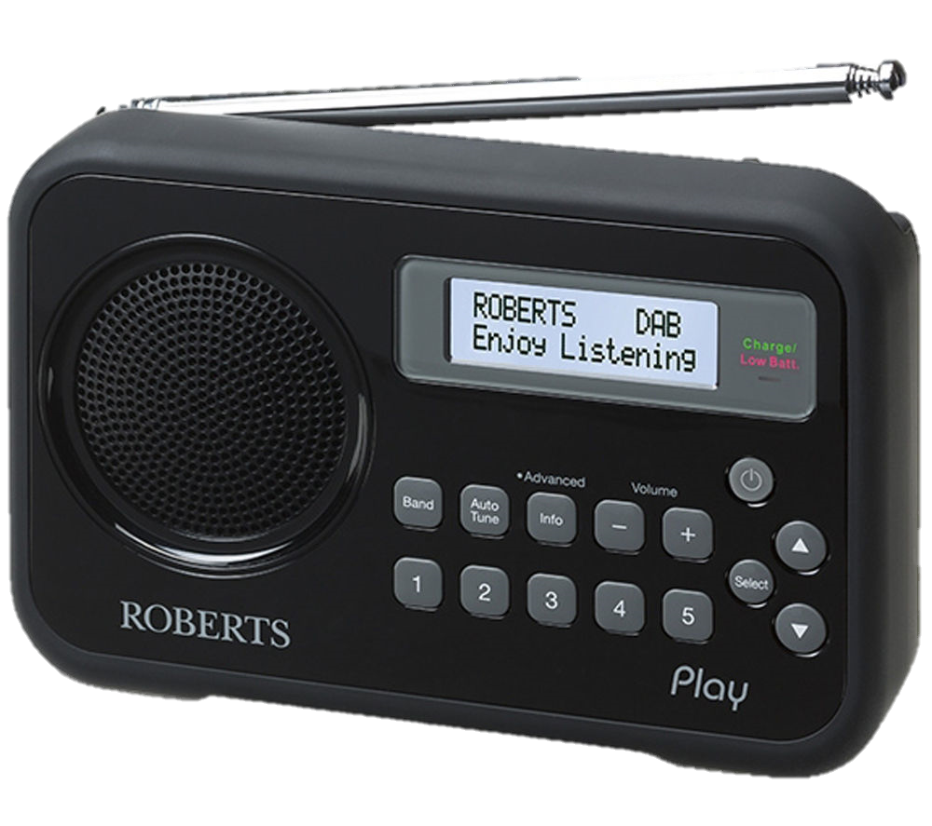
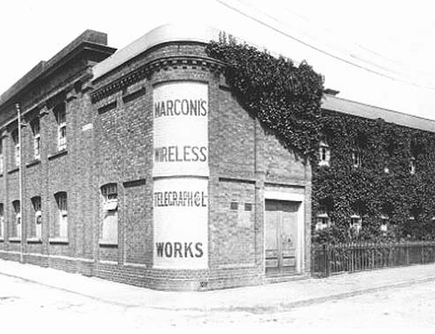
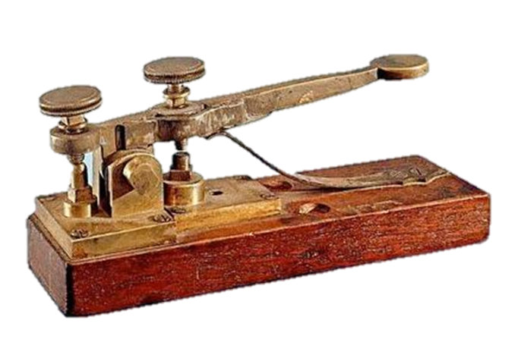
A radio
Marconi
Radio factory
Marconi invented radio. He used radio waves to send Morse code messages through the air. He built his first radio factory in Chelmsford.
What are these 4 things?
How do you think they are connected?
A Morse key tapper

Slide 6
Can you think of someone who is significant or extraordinary?
What do you think makes them significant or extraordinary?
Howard Carter who discovered
Tutankhamun's tomb
Florence Nightingale who transformed nursing and care of patients
?
Thomas Edison who invented
the telephone
Emily Pankhurst who campaigned
for women to be able to vote
A significant or extraordinary person is someone who has done something that has had a positive, lasting change or impact on a community, nation or the world.

Slide 7
What would you like to find out about Marconi and radio when you visit the museum?
Bring all your questions and ideas with you.
?
?
?

Slide 8
Post visit resources
Marconi’s Story
Use the Marconi timeline to help you retell Marconi’s story and his key achievements.

Slide 9
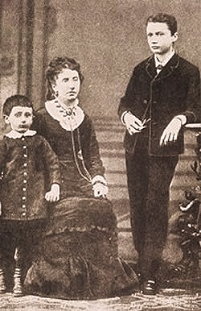
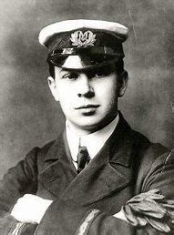

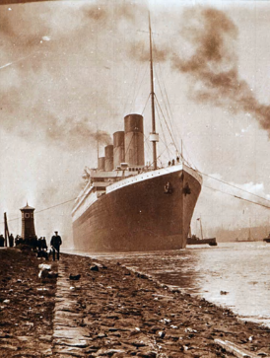
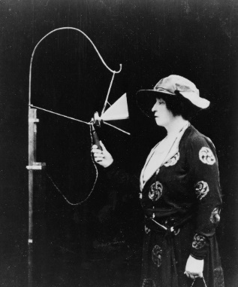
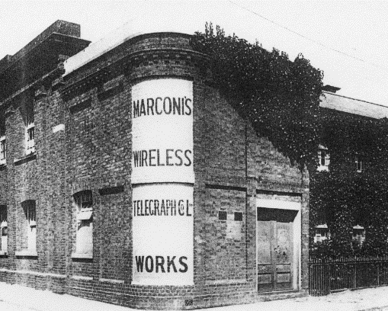
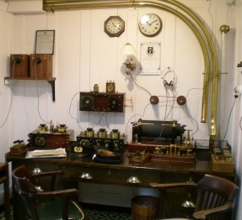
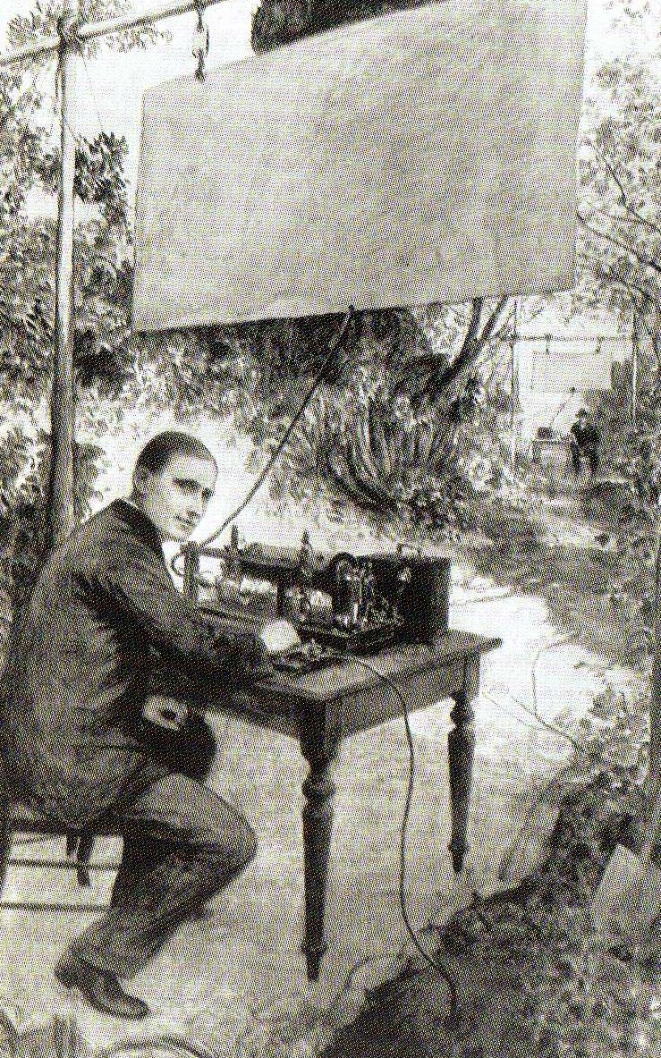
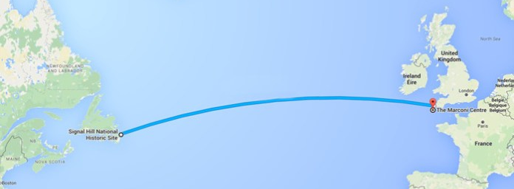
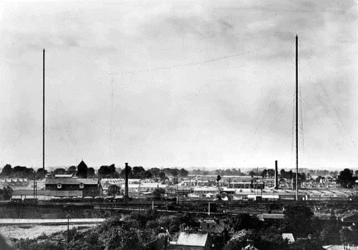
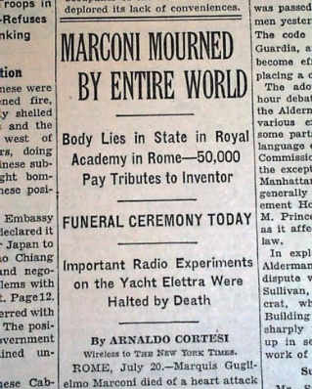
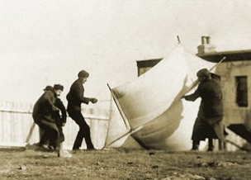
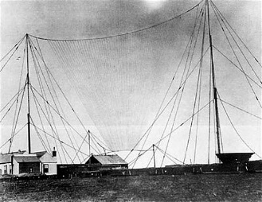
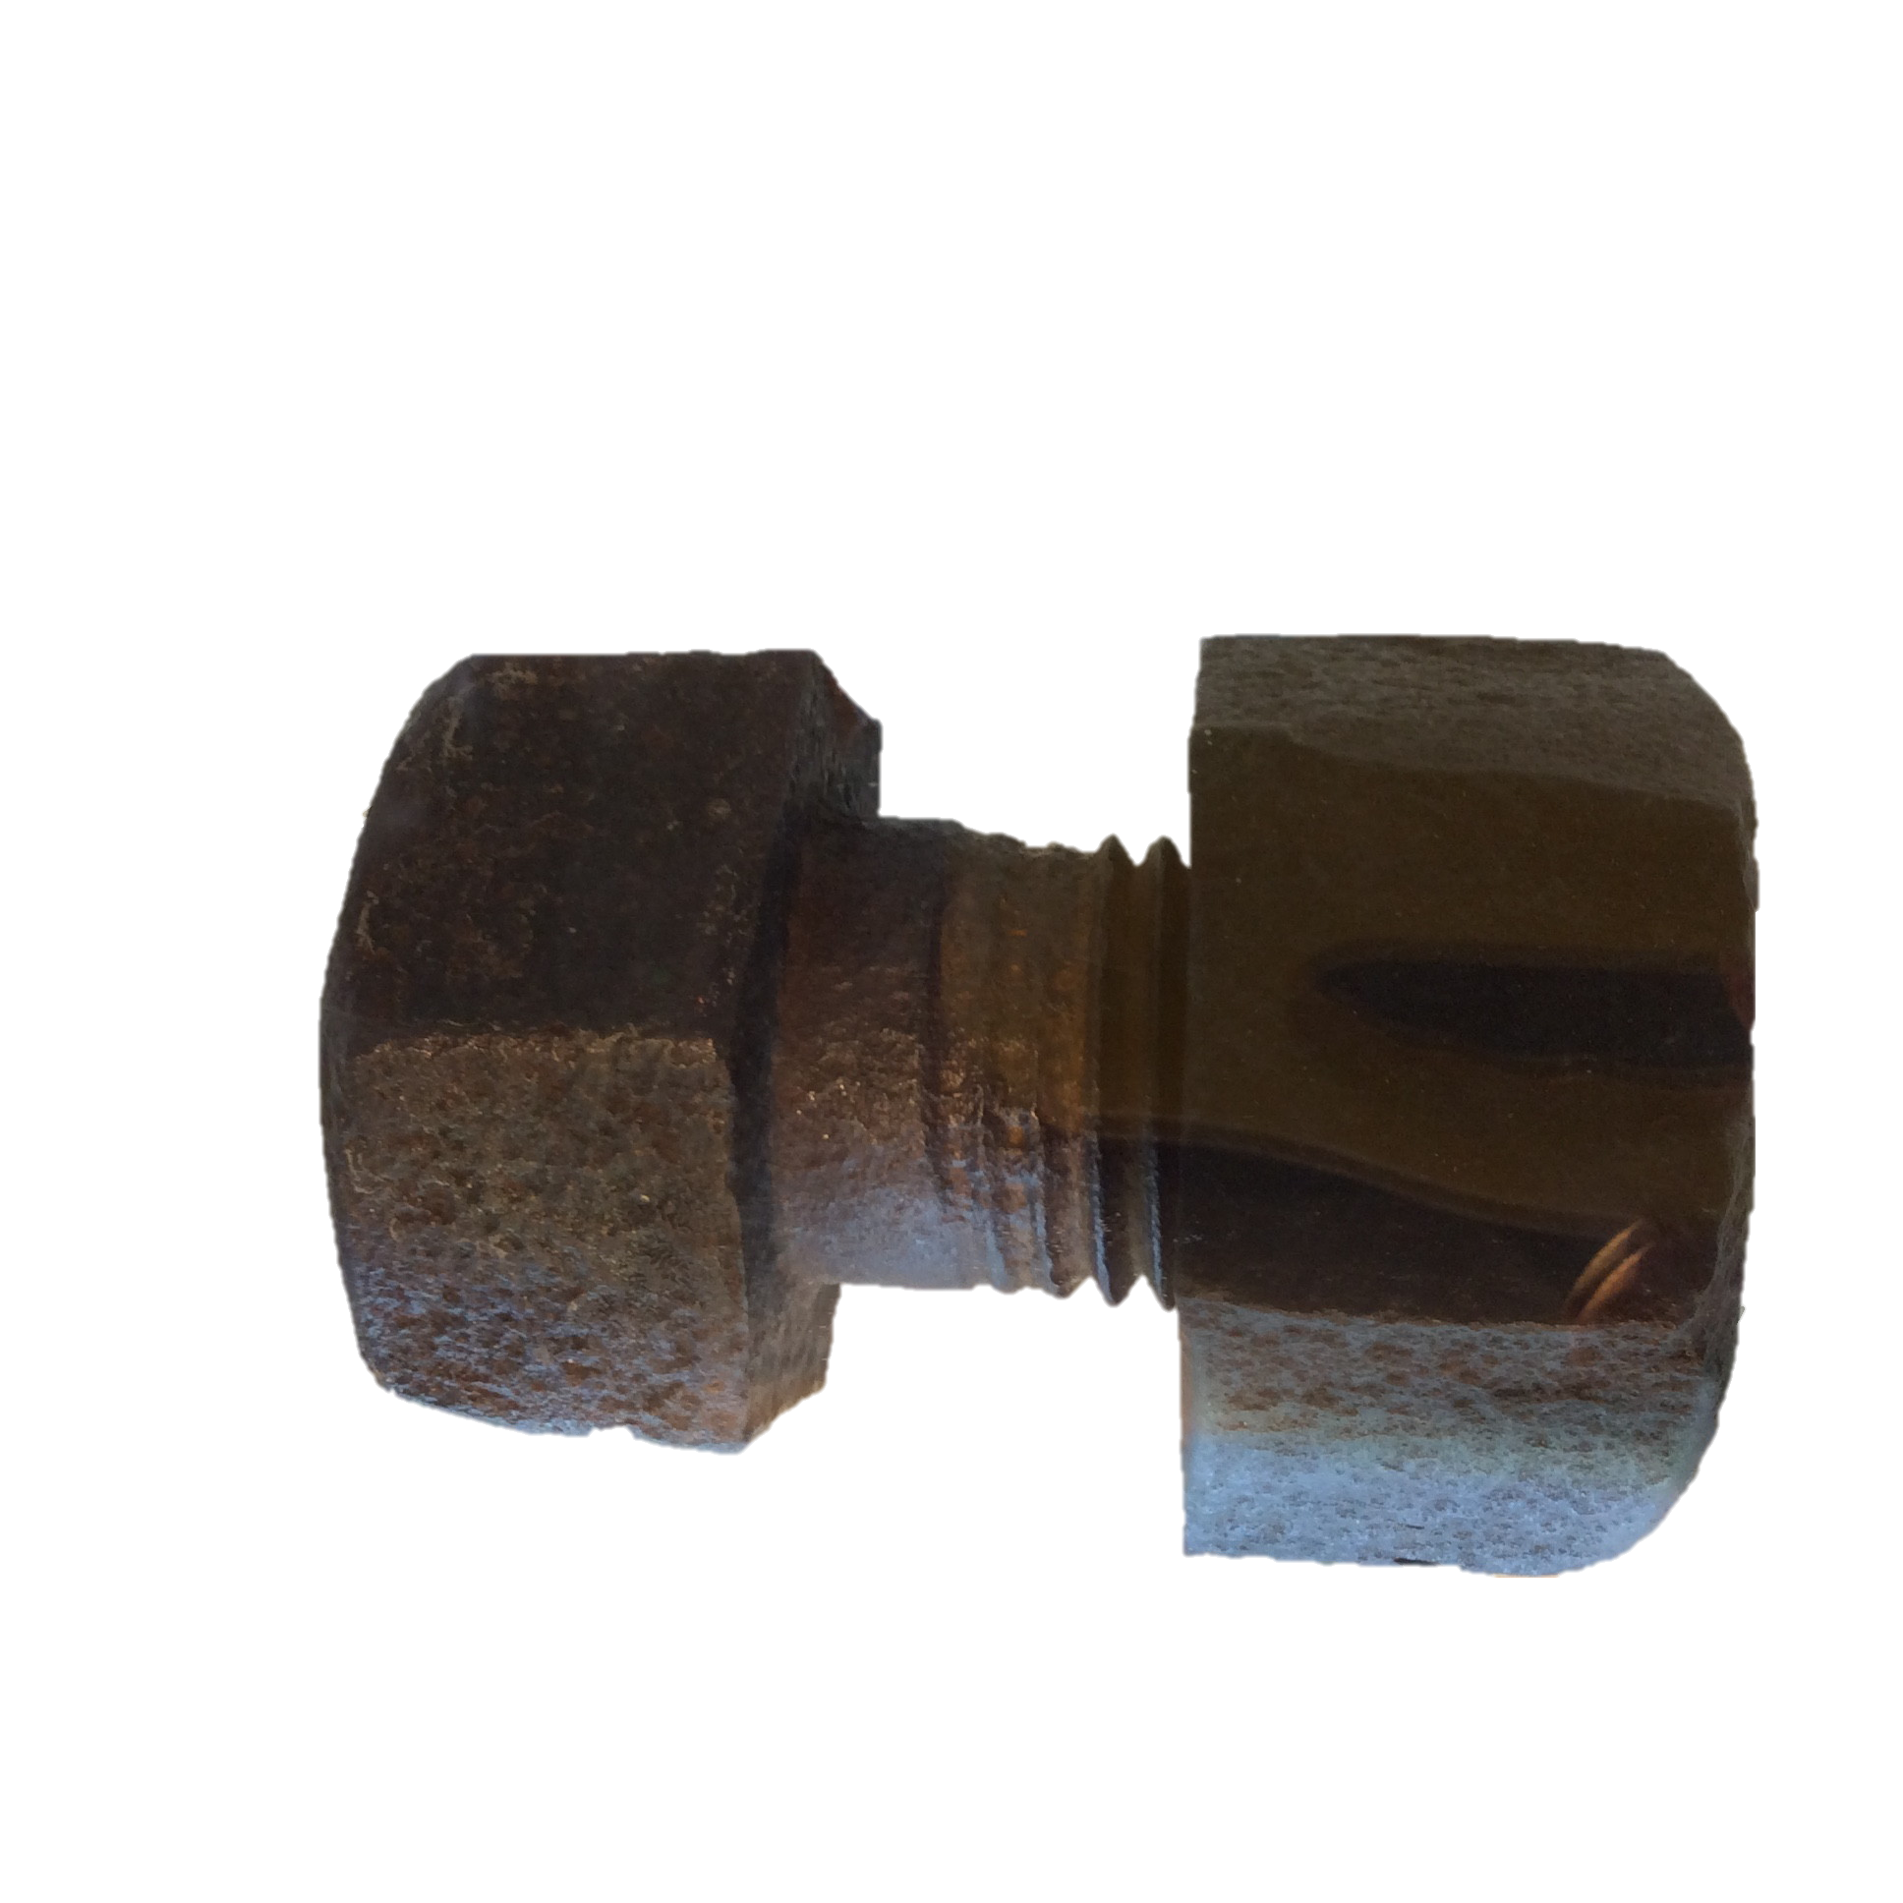
  MARCONI STORY TIMELINE
25 April 1874 Marconi was born in Italy
14 April 1912
The Titanic hit an iceberg. Marconi radio operators alerted other ships and 705 people were saved.
15 June 1920
Dame Nellie Melba made world’s first music broadcast from New Street factory
1899
Marconi opened Hall Street radio factory in Chelmsford
Well done
1895
Marconi experimented using radio waves to send a message wirelessly
June 1912
A new, bigger Marconi radio factory built at New Street
20 July 1937
Marconi died. There was a minute radio silence.
12 December 1901
Marconi sent the first wireless message across the Atlantic Ocean
Notes:
See final 2 slides for additional notes.

Slide 10
What made Marconi such
a successful inventor?
He wanted his equipment to work perfectly before he let other people see it.
He was careful to chose people to help him who had different, but useful skills.
?
.
He tried hard and didn’t give up, even when people said it was impossible.
He was able to talk about his ideas and persuade people to help him.

Slide 11
How did Marconi’s work change the world?
Wireless communication
Safety at sea
Entertainment
Air traffic control and communication with pilots
Marconi worked out how to send messages using radio waves.
What technology do we have today that uses radio waves?
Television
Mobile phones
Remote control toys and equipment………
X rays
Computers

Slide 12
Do you think Marconi is a significant or extraordinary person?
Why do you think this?

Slide 13
Additional notes for Marconi Timeline Story slide
25th April 1874 Marconi’s father was a rich Italian and his mother was Irish-Scottish. He had an older brother called Alfonso.
1895 Marconi did not do well at school but was very interested in science and did lots of experiments with electricity and radio waves at home. He wanted to find a way to send messages without using wires. He called this wireless telegraphy.
1899 Marconi came to England because the Italian Government was not interested in his work and would not give him financial support with his wireless telegraphy experiments. Marconi presented his experiments to the British Post Office (which was responsible for all communications) and successfully secured funding for his work. His cousin helped him find a building in Hall Street in Chelmsford, where he set up the the world’s first wireless telegraphy factory in 1899.
12 December 1901 Marconi set up a transmitter aerial in Poldhu, England and aerial and receiver in Newfoundland, Canada, to send and receive a morse signal wirelessly across the Atlantic. People said that it couldn’t be done, but Marconi was determined. Disaster struck when gales in Newfoundland blew down the masts holding up the aerial. With no time to rebuild them, the aerial wire was attached to a large kite and on 12 December Marconi heard the faint Morse code for the letter “S” (dot dot dot). Newspapers said, Marconi and his assistants “flew a kite and changed the world”.
Notes:
25th April 1874 Marconi’s father was a rich Italian and his mother Irish-Scottish. He has an older brother called Alfonso.
1895 Marconi did not do well at school but was very interested in science and did lots of experiments with electricity and radio waves, to find a way to send morse code messages without using wires. He called this wireless telegraphy.
1899 Marconi has come to England because the Italian Government did not support him with his wireless telegraphy experiments. Marconi presented his discovery to the British Post Office (responsible for all communications) and secured funding. His cousin helped him a building in Hall Street in Chelmsford, which becames the world’s first wireless telegraphy factory in 1899.
12 December 1901 Marconi set up a transmitter aerial in Poldhu, England and aerial and receiver in Newfoundland, Canada, to send and receive a morse signal wirelessly across the Atlantic. People said that it couldn’t be done, but Marconi was determined. Disaster struck when gales in Newfoundland blew down the masts holding up the aerial. With no time to rebuild them, the aerial wire attached to a large kite and on 12 December Marconi hears the faint Morse code for the letter “S” (dot dot dot). Newspapers said, Marconi and his assistants “flew a kite and changed the world”.

Slide 14
Additional notes for Marconi Timeline Story slide
14 April 1912 Marconi supplied wireless equipment for ships including the ‘Titanic’. The wireless room was staffed by two Marconi trained radio officers. Harold Bride and Jack Phillips. Their role was to enable passengers to send and receive news from home while at sea. When the Titanic hit an iceberg at 11.40pm on 14 April 1912, they sent messages for help. Passengers were only rescued because these radio signals were picked up by other ships in the area. Without Marconi’s radio equipment on board the Titanic would have just ‘vanished’. After this it became law for all ships to have a radio room and trained radio officers.
June 1912 Following the Titanic tragedy demand for radio equipment increased dramatically. This coincided with the building of a new bigger radio factory at New Street, Chelmsford. The New street factory employed hundreds of workers and was the first purpose built radio factory in the world. The two masts that held up the aerial were 450 feet (133 metres) high. They had to be taken down in 1935 as they become a danger to aircraft.
June 15 1920, Dame Nellie came to Marconi’s New Street factory and gave the world’s first radio entertainment broadcast. The programme was heard all over the world.
20 July 1937 Marconi died aged 63. The world’s wireless went silent for two minutes as a mark of respect.
Notes:
25th April 1874 Marconi’s father was a rich Italian and his mother Irish-Scottish. He has an older brother called Alfonso.
1895 Marconi did not do well at school but was very interested in science and did lots of experiments with electricity and radio waves, to find a way to send morse code messages without using wires. He called this wireless telegraphy.
1899 Marconi has come to England because the Italian Government did not support him with his wireless telegraphy experiments. Marconi presented his discovery to the British Post Office (responsible for all communications) and secured funding. His cousin helped him a building in Hall Street in Chelmsford, which becames the world’s first wireless telegraphy factory in 1899.
12 December 1901 Marconi set up a transmitter aerial in Poldhu, England and aerial and receiver in Newfoundland, Canada, to send and receive a morse signal wirelessly across the Atlantic. People said that it couldn’t be done, but Marconi was determined. Disaster struck when gales in Newfoundland blew down the masts holding up the aerial. With no time to rebuild them, the aerial wire attached to a large kite and on 12 December Marconi hears the faint Morse code for the letter “S” (dot dot dot). Newspapers said, Marconi and his assistants “flew a kite and changed the world”.

