Slide 1
Victorian Home session at Chelmsford Museum
Before your visit to Chelmsford Museum for our ‘Victorian Home’ session use this presentation with your children so they can gain the most their trip. As you go through the slides our robot ‘Sparky’ will ask questions to encourage your children to start thinking about their own home and introduce them to Oakland’s House (now Chelmsford Museum), where the Wells family lived in Victorian times. Enjoy

Slide 2
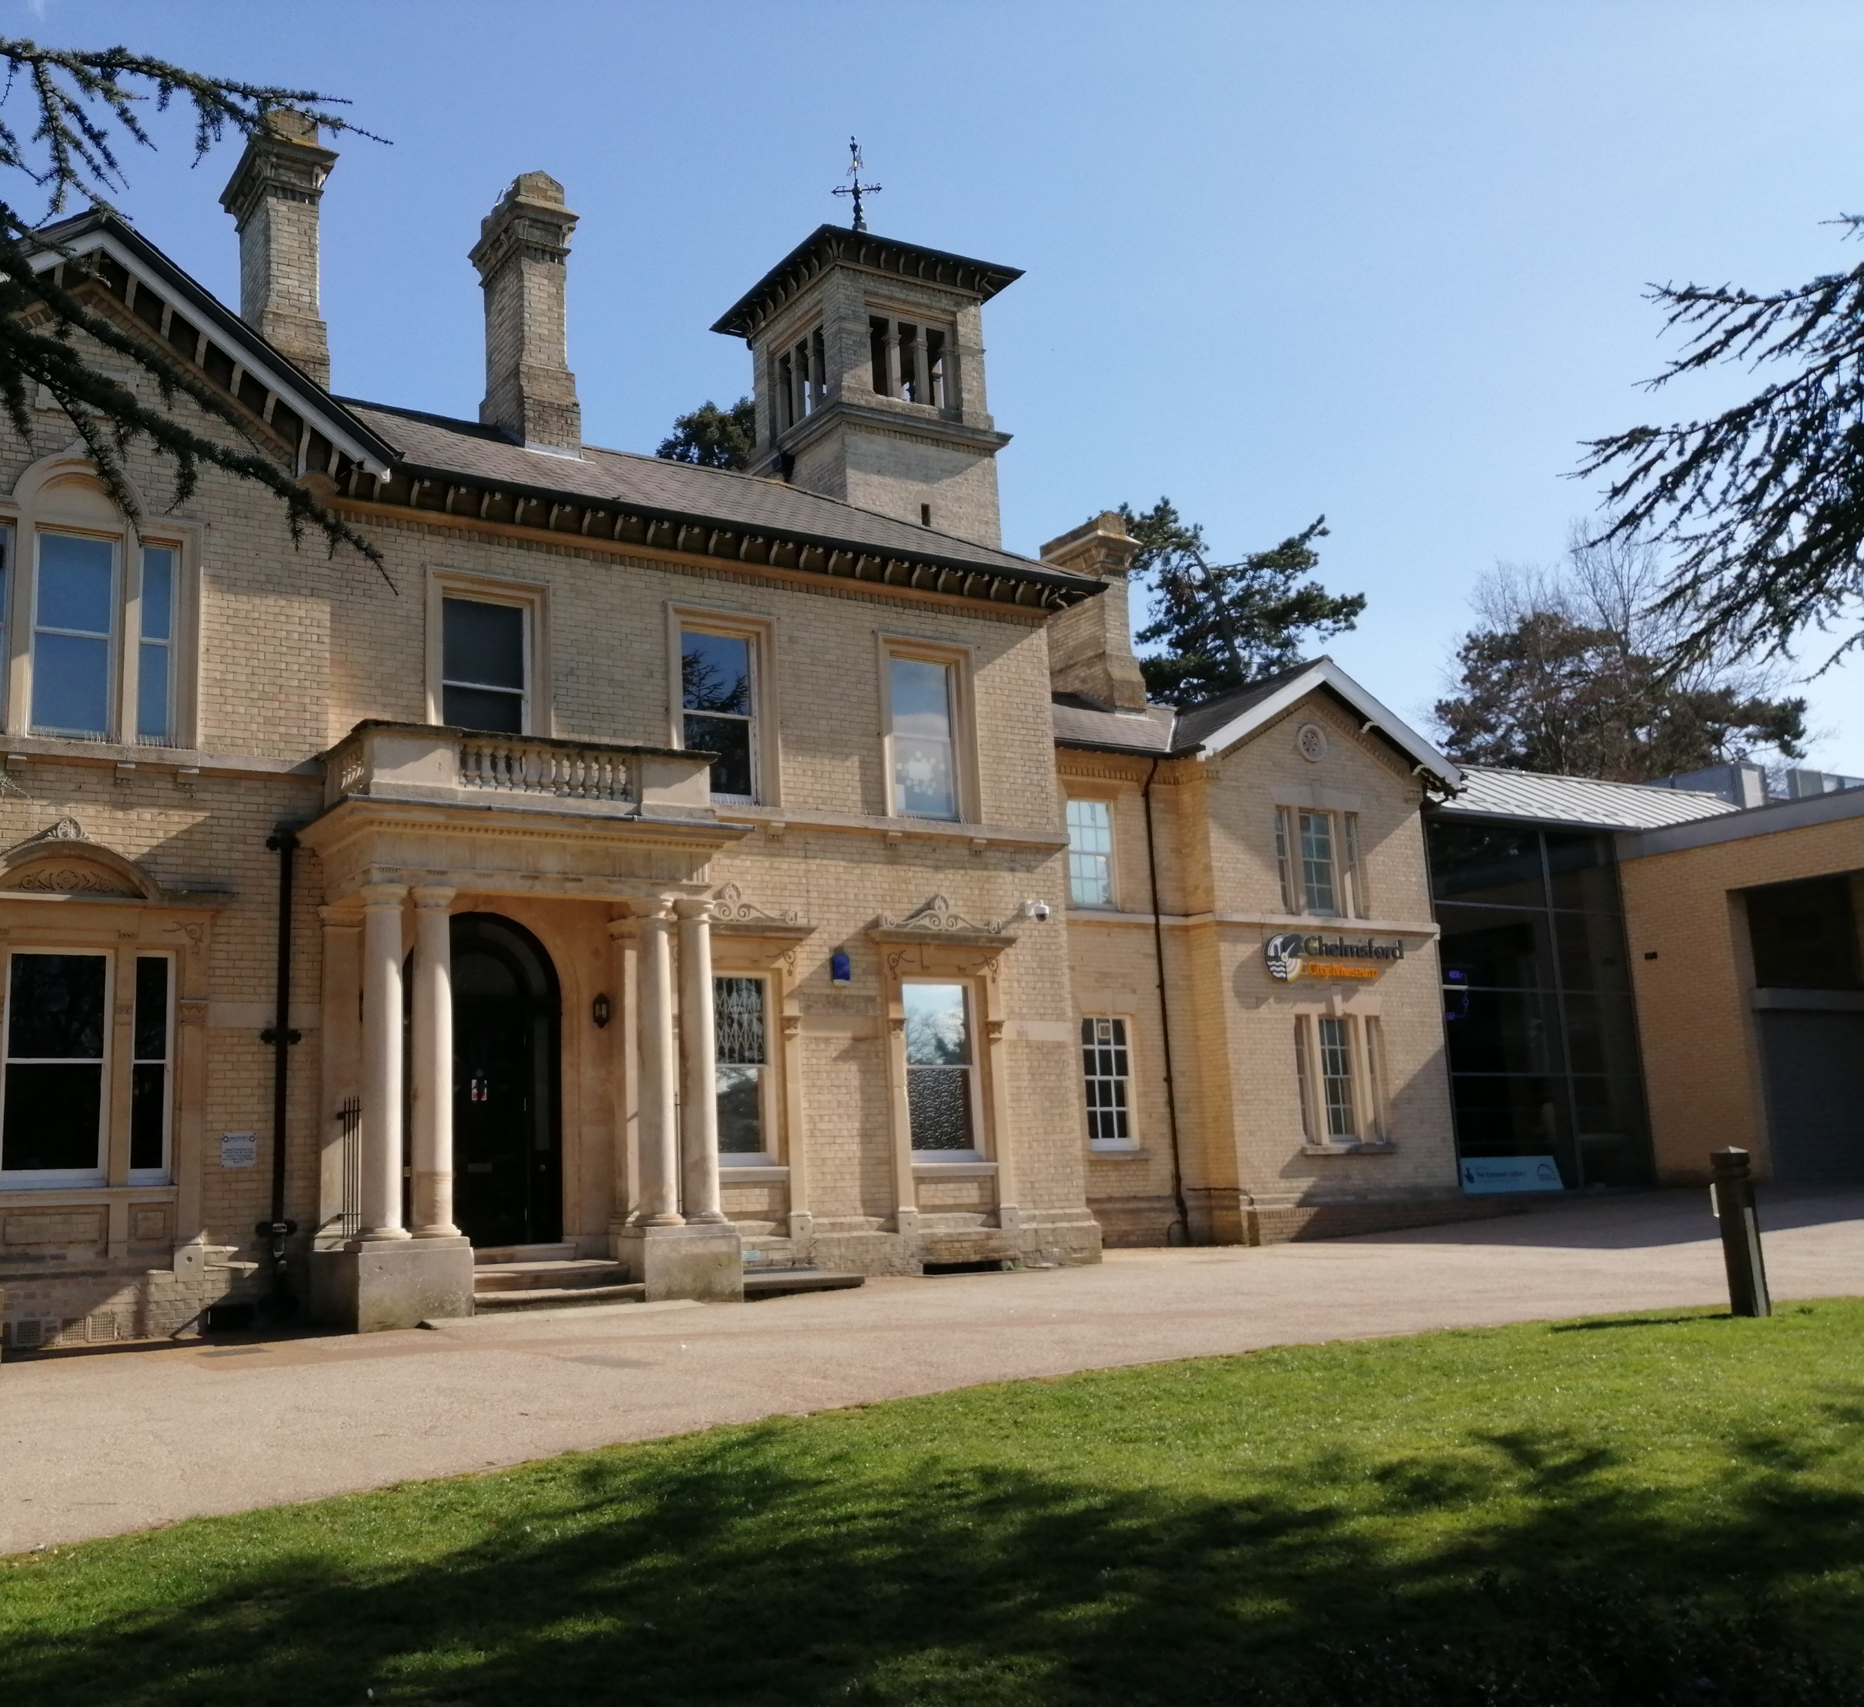
Chelmsford Museum
This is Chelmsford Museum. Over150 years ago, in the Victorian period, the old part that you can see, was called Oakland’s House. The Wells family lived here.
Let’s see what we can find out about the Wells family just by looking at the outside of their house.

Slide 3
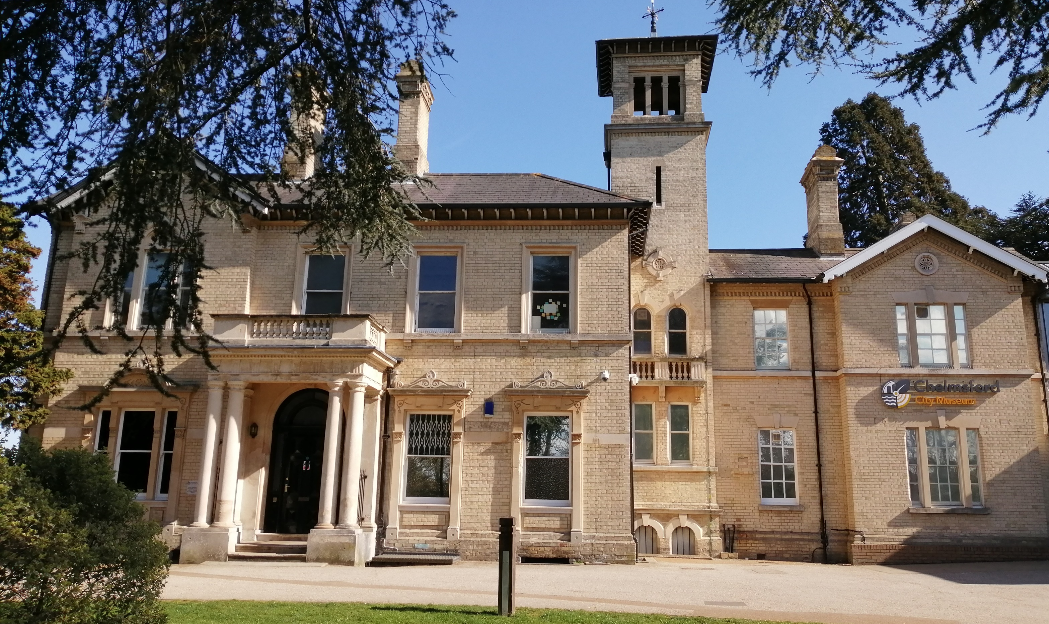
Do you think the Wells family were rich or poor?
What makes you think this?
How many windows can you count?
Why do you think there are so many?
Clue: what is at the bottom of a chimney?
Does Oaklands house look like your house?
What is different?
How many chimneys can you see?
What can you see around the front door?

Slide 4
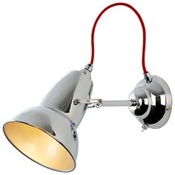
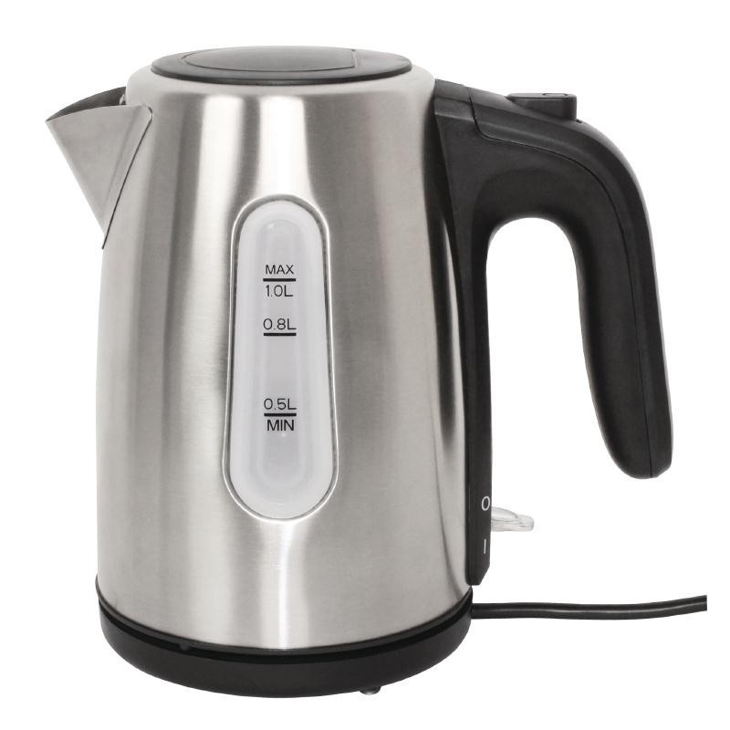
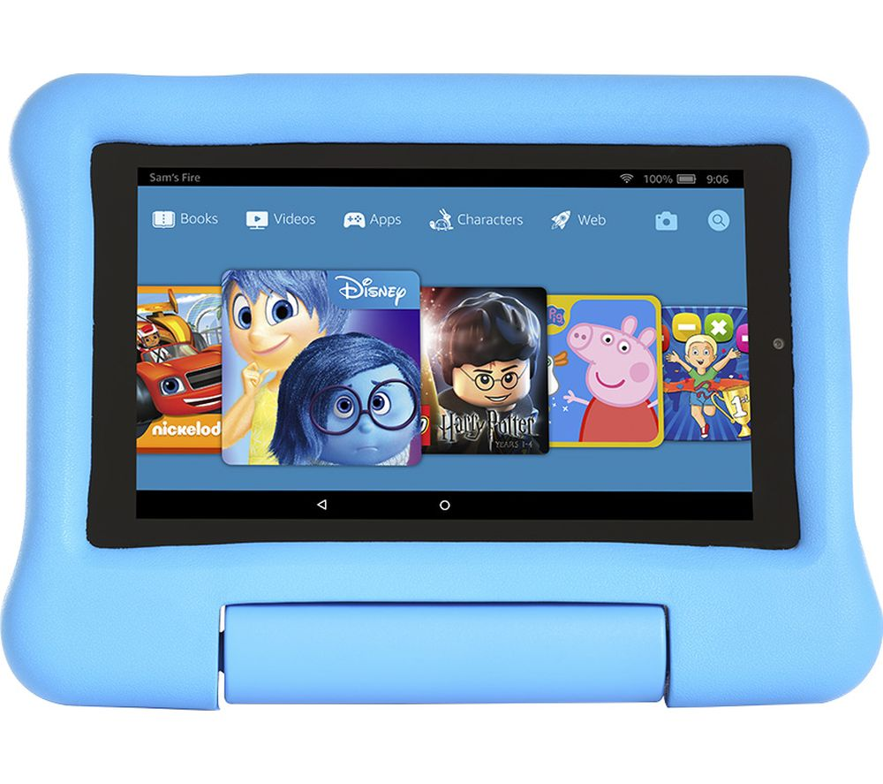
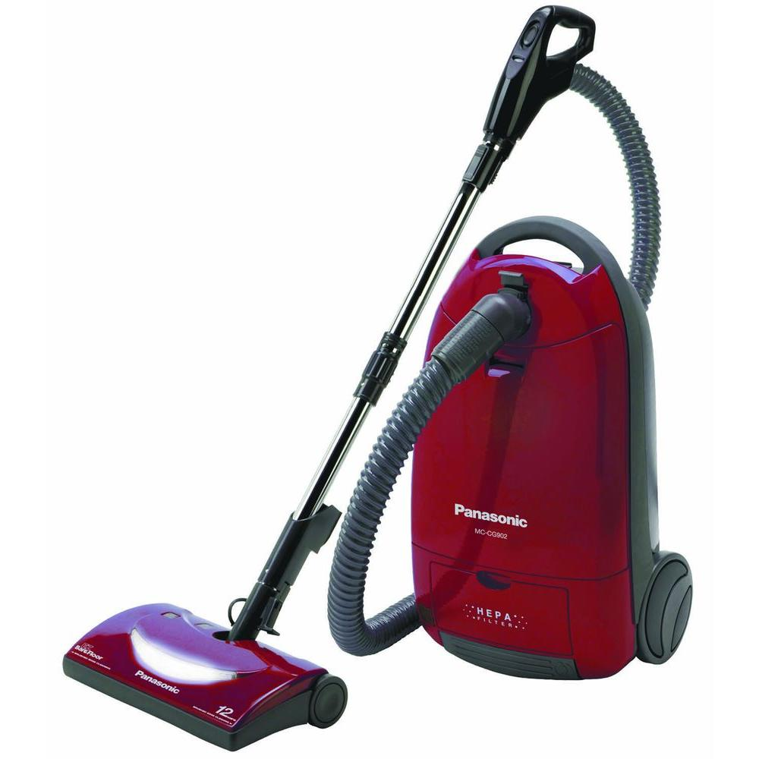
Can you put them in the order they were used to do the washing?
At the bottom of each chimney was a fireplace. The house has lots of chimneys because there was a fireplace in every room. When the Wells family lived here over 100 years ago, there was no electricity and so they had to light fires to keep the rooms warm.
What things in your house need electricity to work?
?
How would your life be different without electricity?

Slide 5
Well done, you had lots of great ideas.
When you visit Chelmsford Museum you will be able to explore inside the house and find out more about the Wells family. See you soon.
Bye.

Slide 6
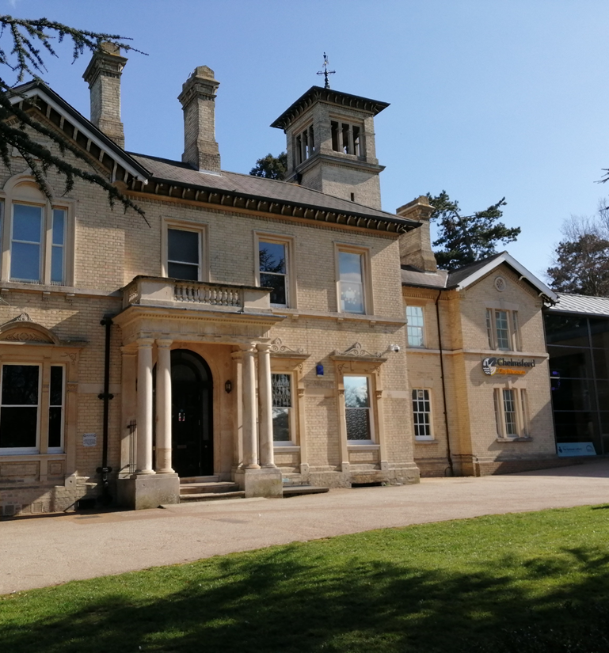
Victorian Home session
Post visit resources

Slide 7
This is Oaklands House. Over100 years ago, in Victorian times it belonged to Mr Wells.

Slide 8
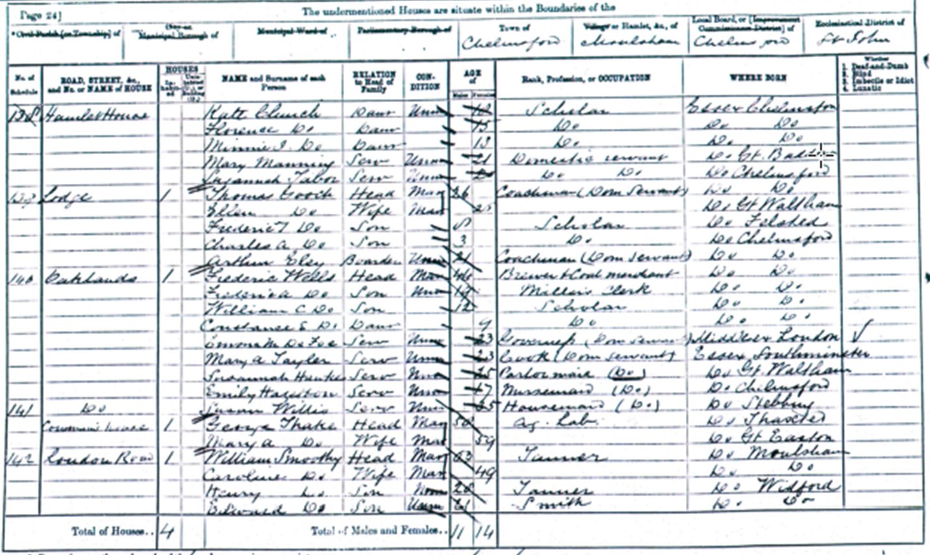
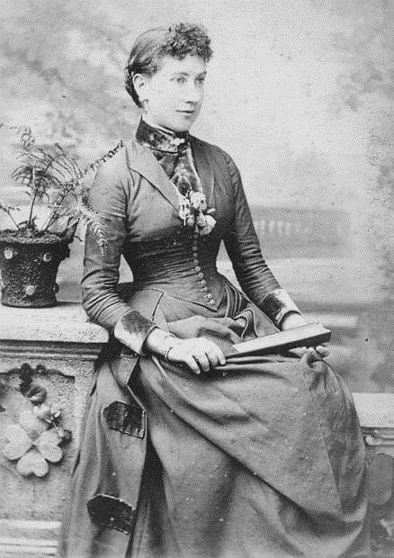
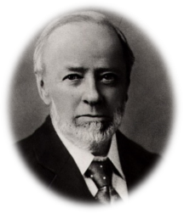
This is the 1890 census from the basket found in the attic at Oaklands House.
It is like a special register that tell us the names of the people who lived here.
Can you remember who was living in Oaklands? Click the census to see some of them.
Mrs Wells
Cook
Governess
Mr Wells
Why did the Wells family have servants?
Scullery maid
Douglas Wells
Dorothy Wells

Slide 9
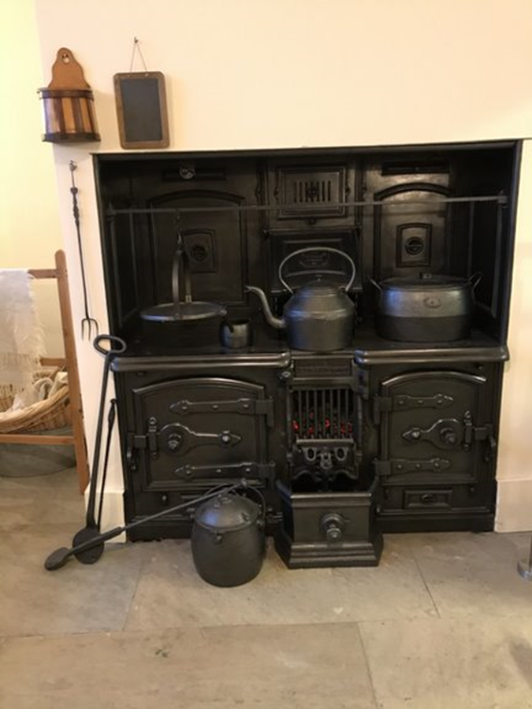
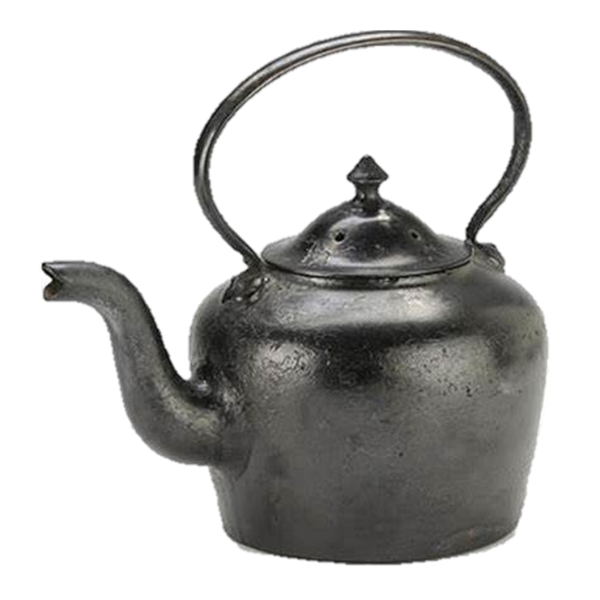
How is this kitchen different to the one in your house?
The scullery maid got up very early. Her first job was to light the stove and put the kettle on it.
your cooker at home?
Why did she need to do this?

Slide 10
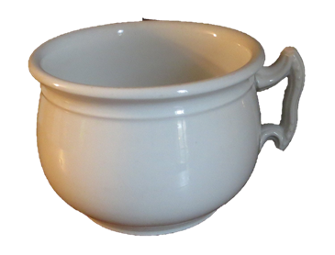
What did the scullery maid have to do?
What is this?

Slide 11
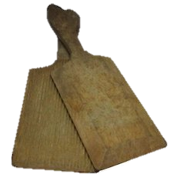
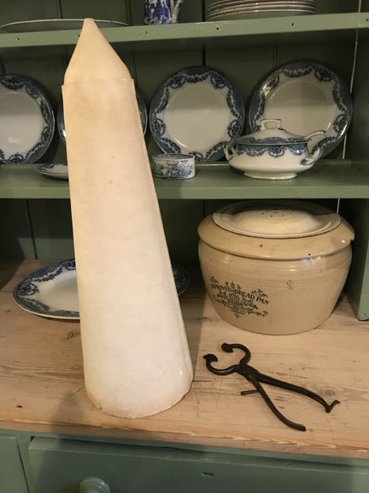
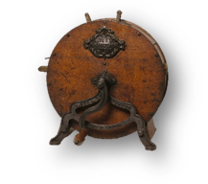
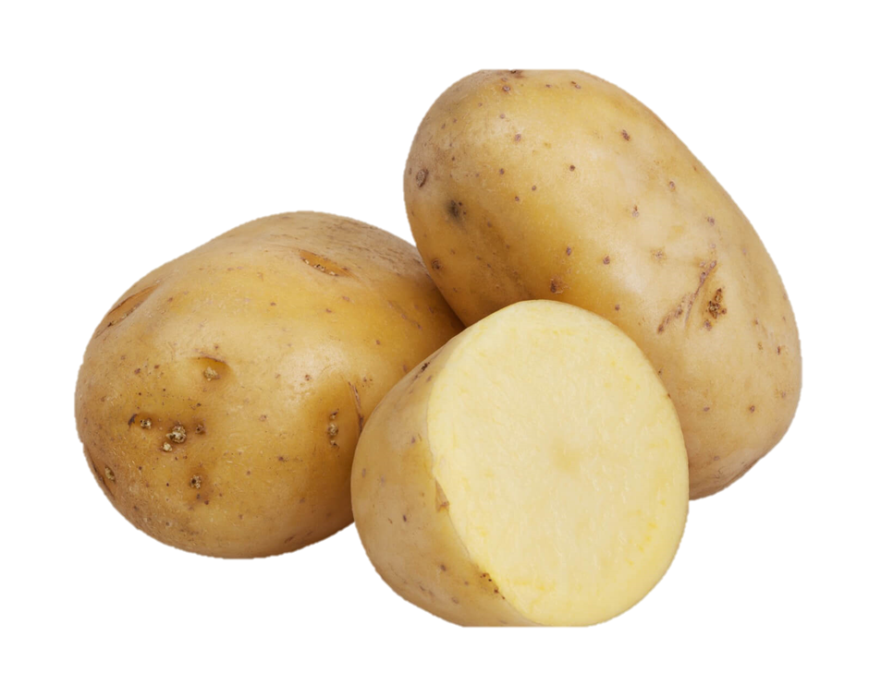
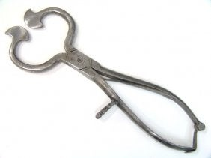
Butter pats
Potato ricer
Cook made all the meals for the family and the servants.
Knife polisher
Sugar nipppers
Can you put them in the order they were used to do the washing?
What were each of these things used for?
(click if you need a clue)

Slide 12
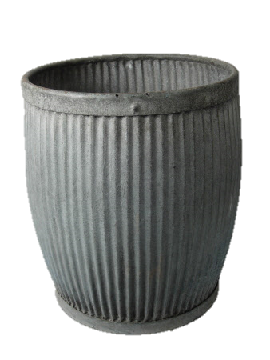
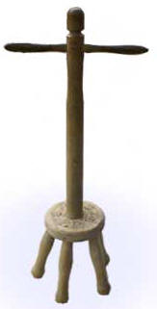
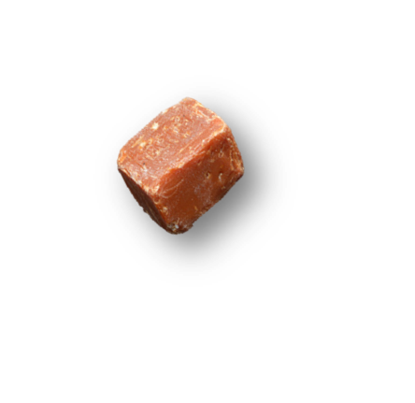
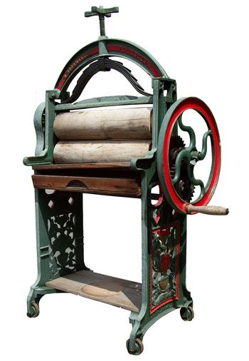
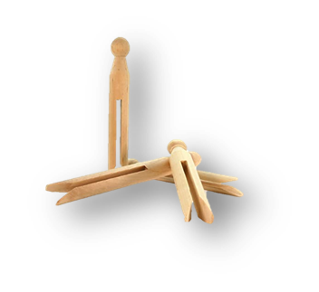
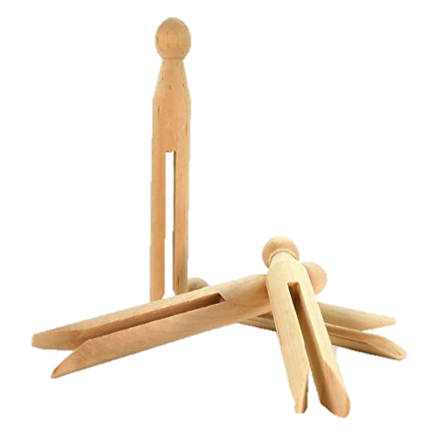
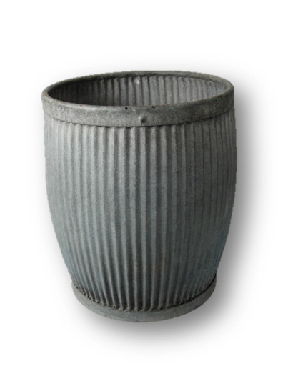
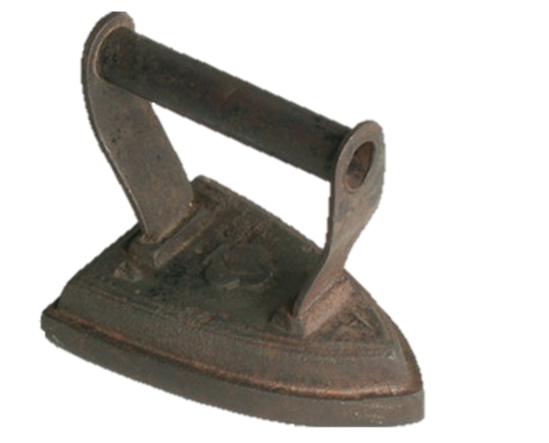
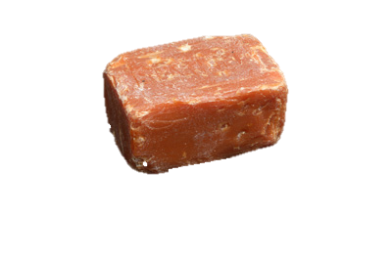
The laundry maid washed all the clothes..
Can you put them in the order they were used to do the washing?
What was each of these things for?
Can you put them in the order they were used to do the washing?
How long did the washing take?

Slide 13
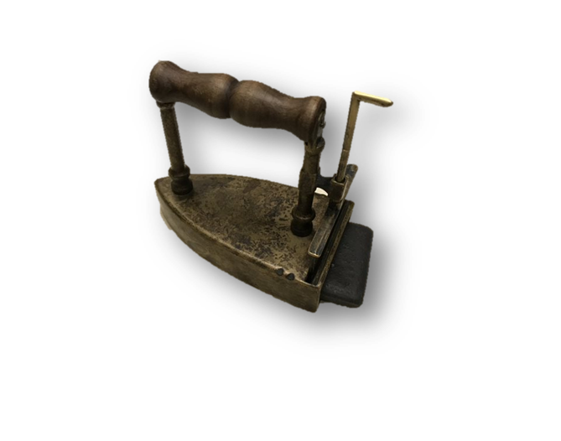
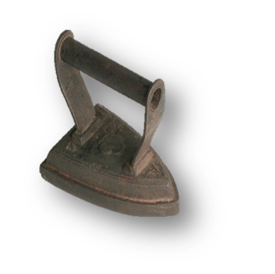
How did you make these irons hot?
Which do you think is the best?

Slide 14
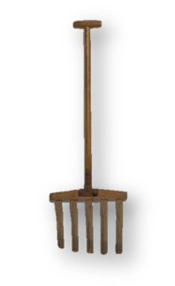
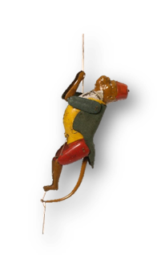
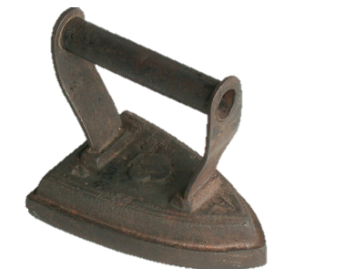
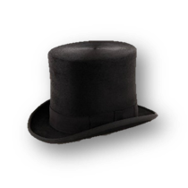
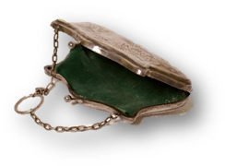
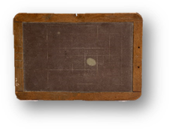
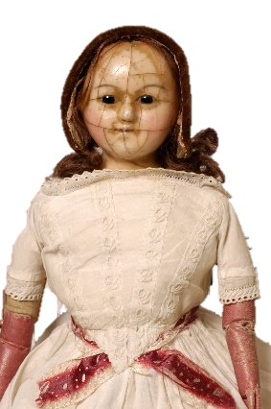
What belonged to who?

Slide 15
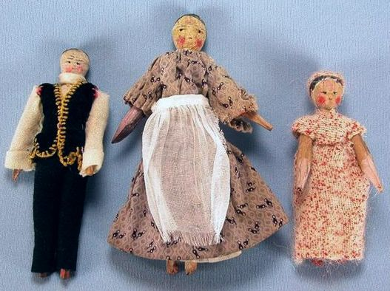
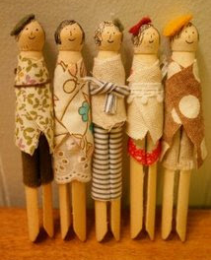
Suggested follow up activities...
Make a Museum in your Classroom
Print pictures of objects on the slides below or let your children draw their favourite object and then and write labels to put with them to create a ‘Museum in your classroom’.
‘Dolly peg’ dolls
Use felt pens, crayons, tissue paper and pipe cleaners to turn ‘dolly pegs’ into people who lived in Oaklands House. You could use your dolls to tell stories about life in Oaklands park.
Kitchen colouring sheets
Print out copies from slide below.

Slide 16
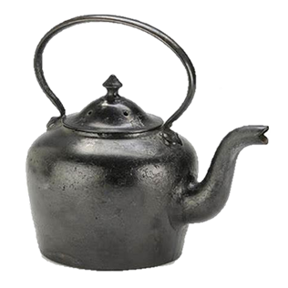

Slide 18
