Slide 1
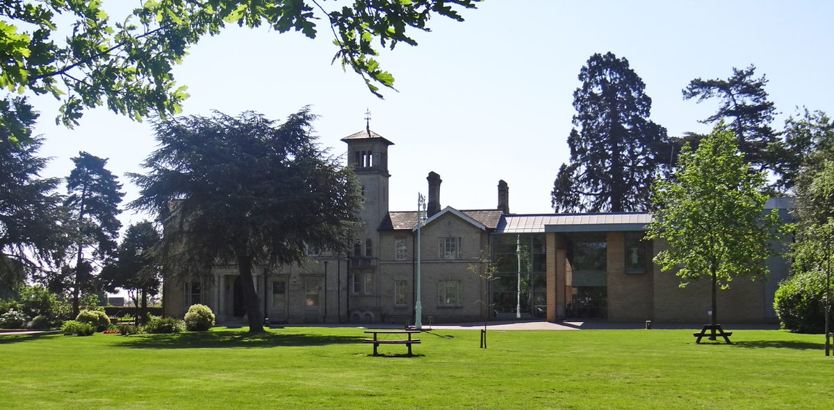
Welcome to Chelmsford Museum
Chelmsford Museum is in a Victorian house in a beautiful park.
Look through the pictures before you visit to see what you will find in the museum and park.

Slide 2
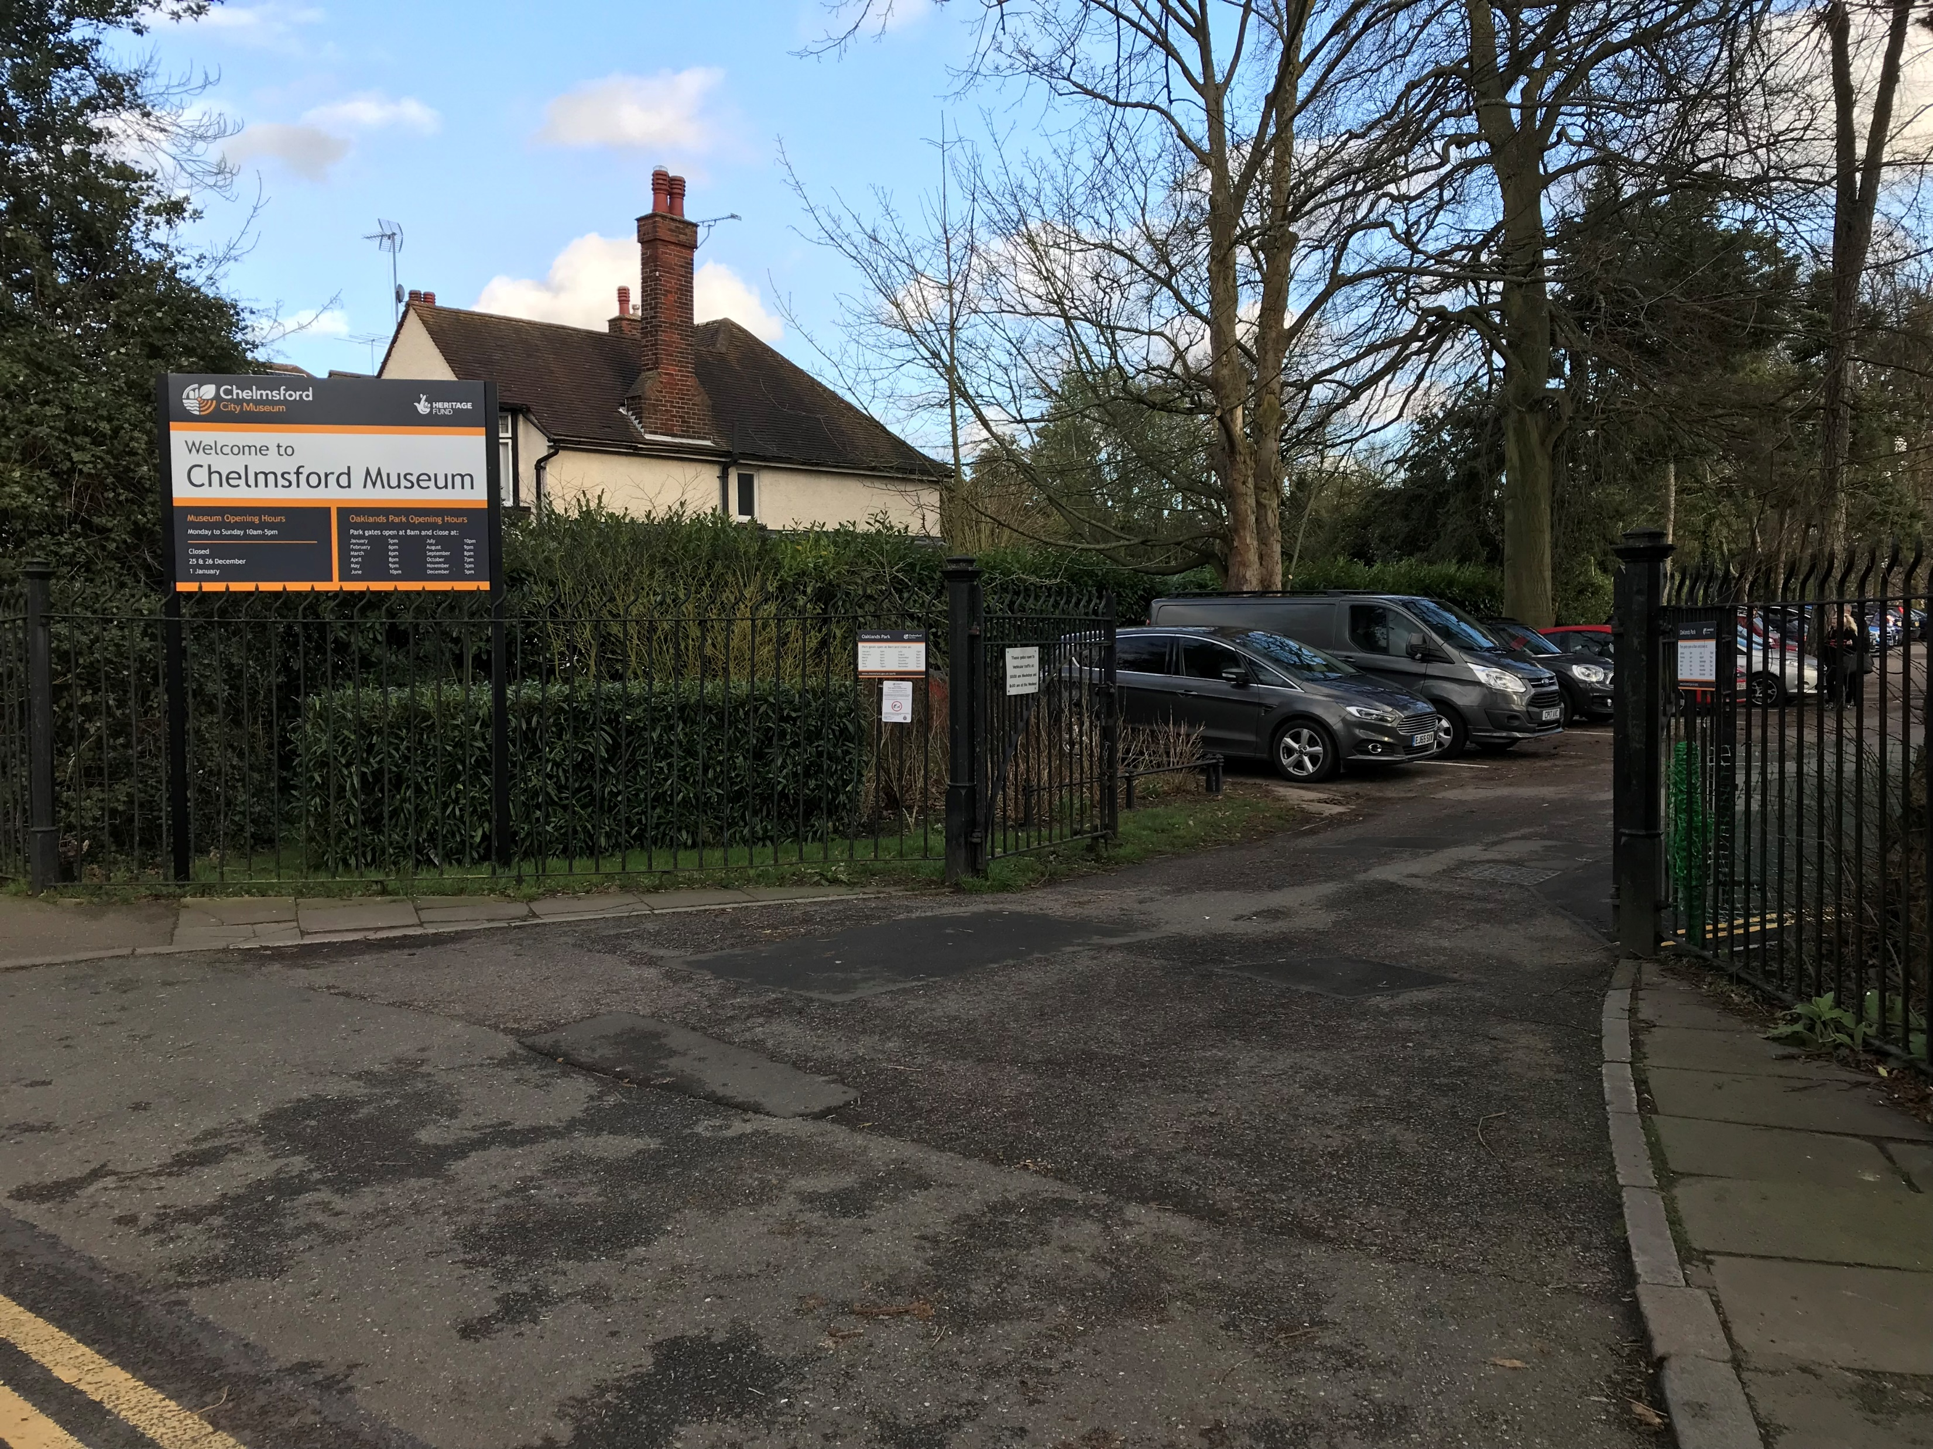
The main entrance to the park. There is a small gate and path next to this for pedestrians.

Slide 3
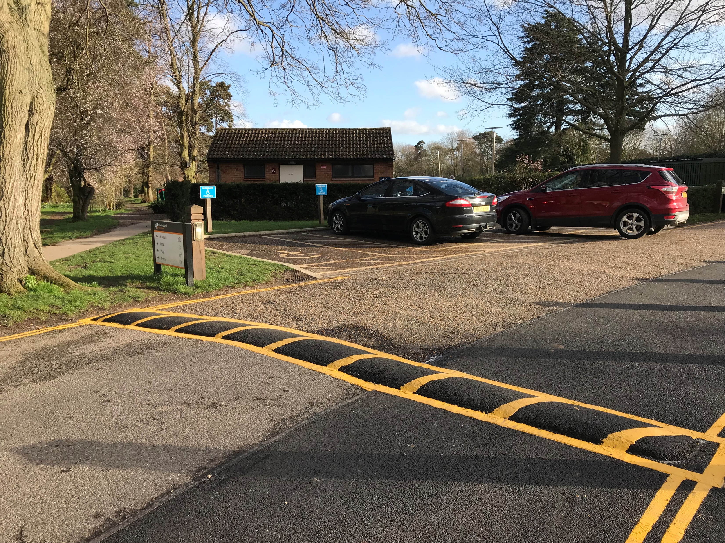
Parking spaces for ‘blue badge’ visitors.

Slide 4
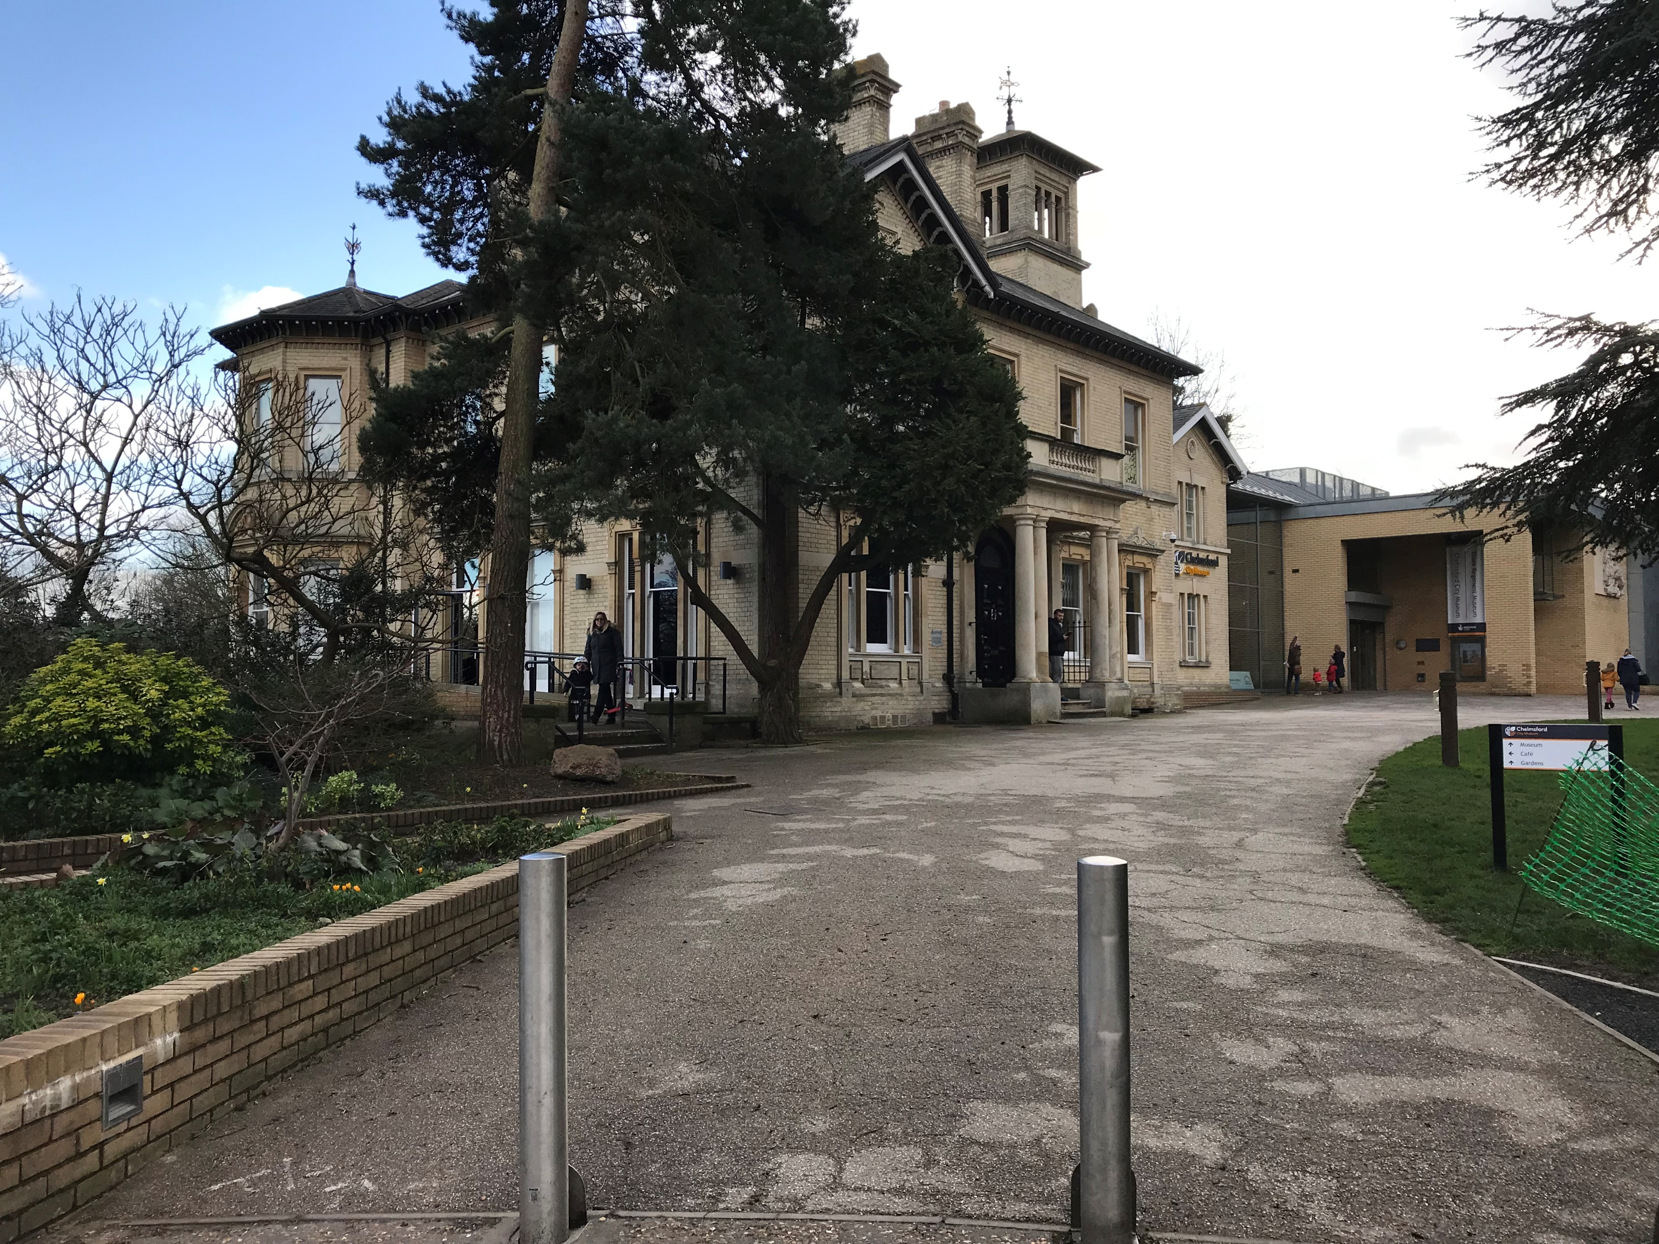
Chelmsford museum is in an old Victorian house.

Slide 5
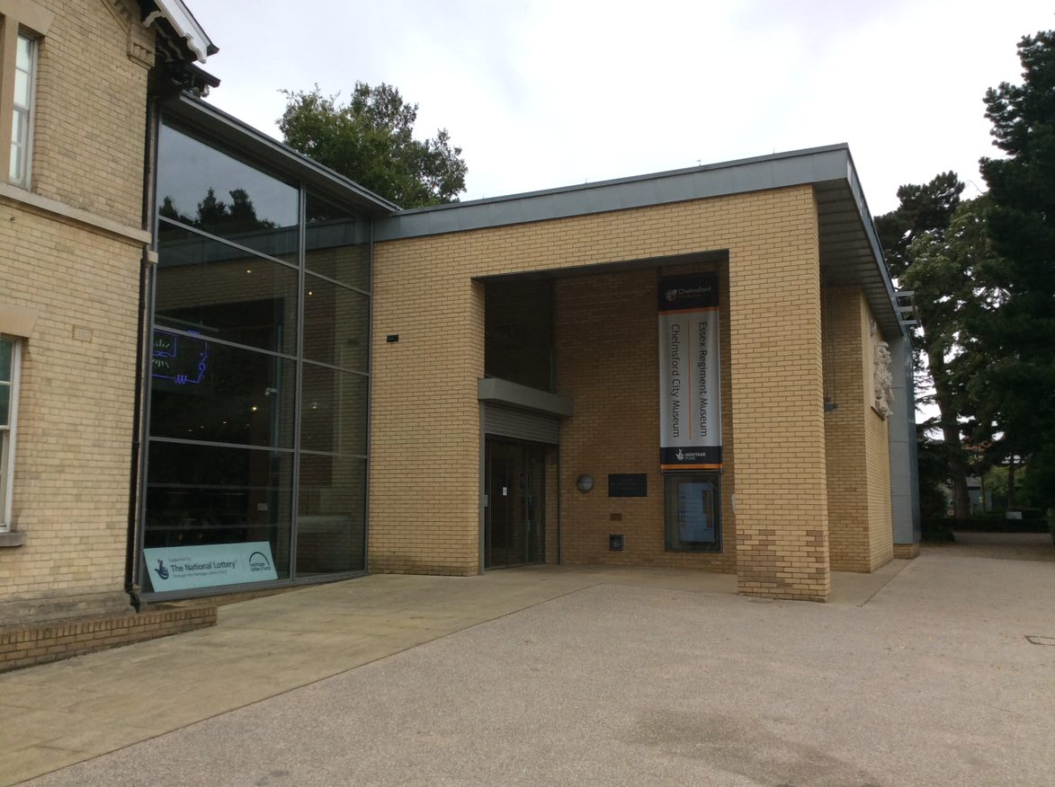
The museum entrance is in the new brick extension.

Slide 6
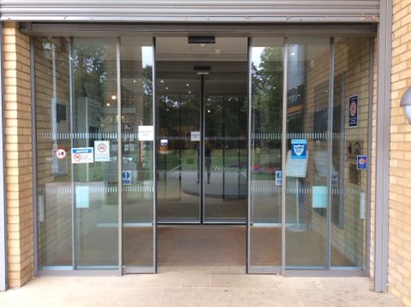
There are automatic sliding doors at the entrance.

Slide 7
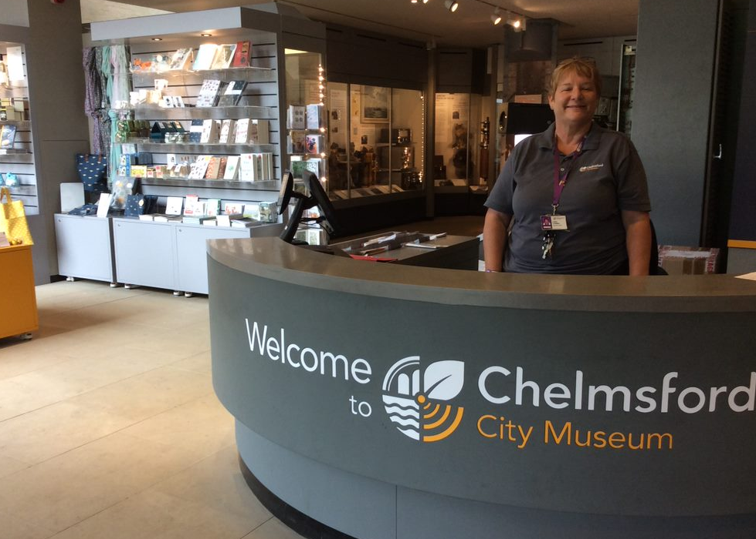
A member of staff is always on the front desk to welcome you and answer any questions.
You can pick up a free eye spy trail, sensory trail bag and ear defenders if you want to.

Slide 8
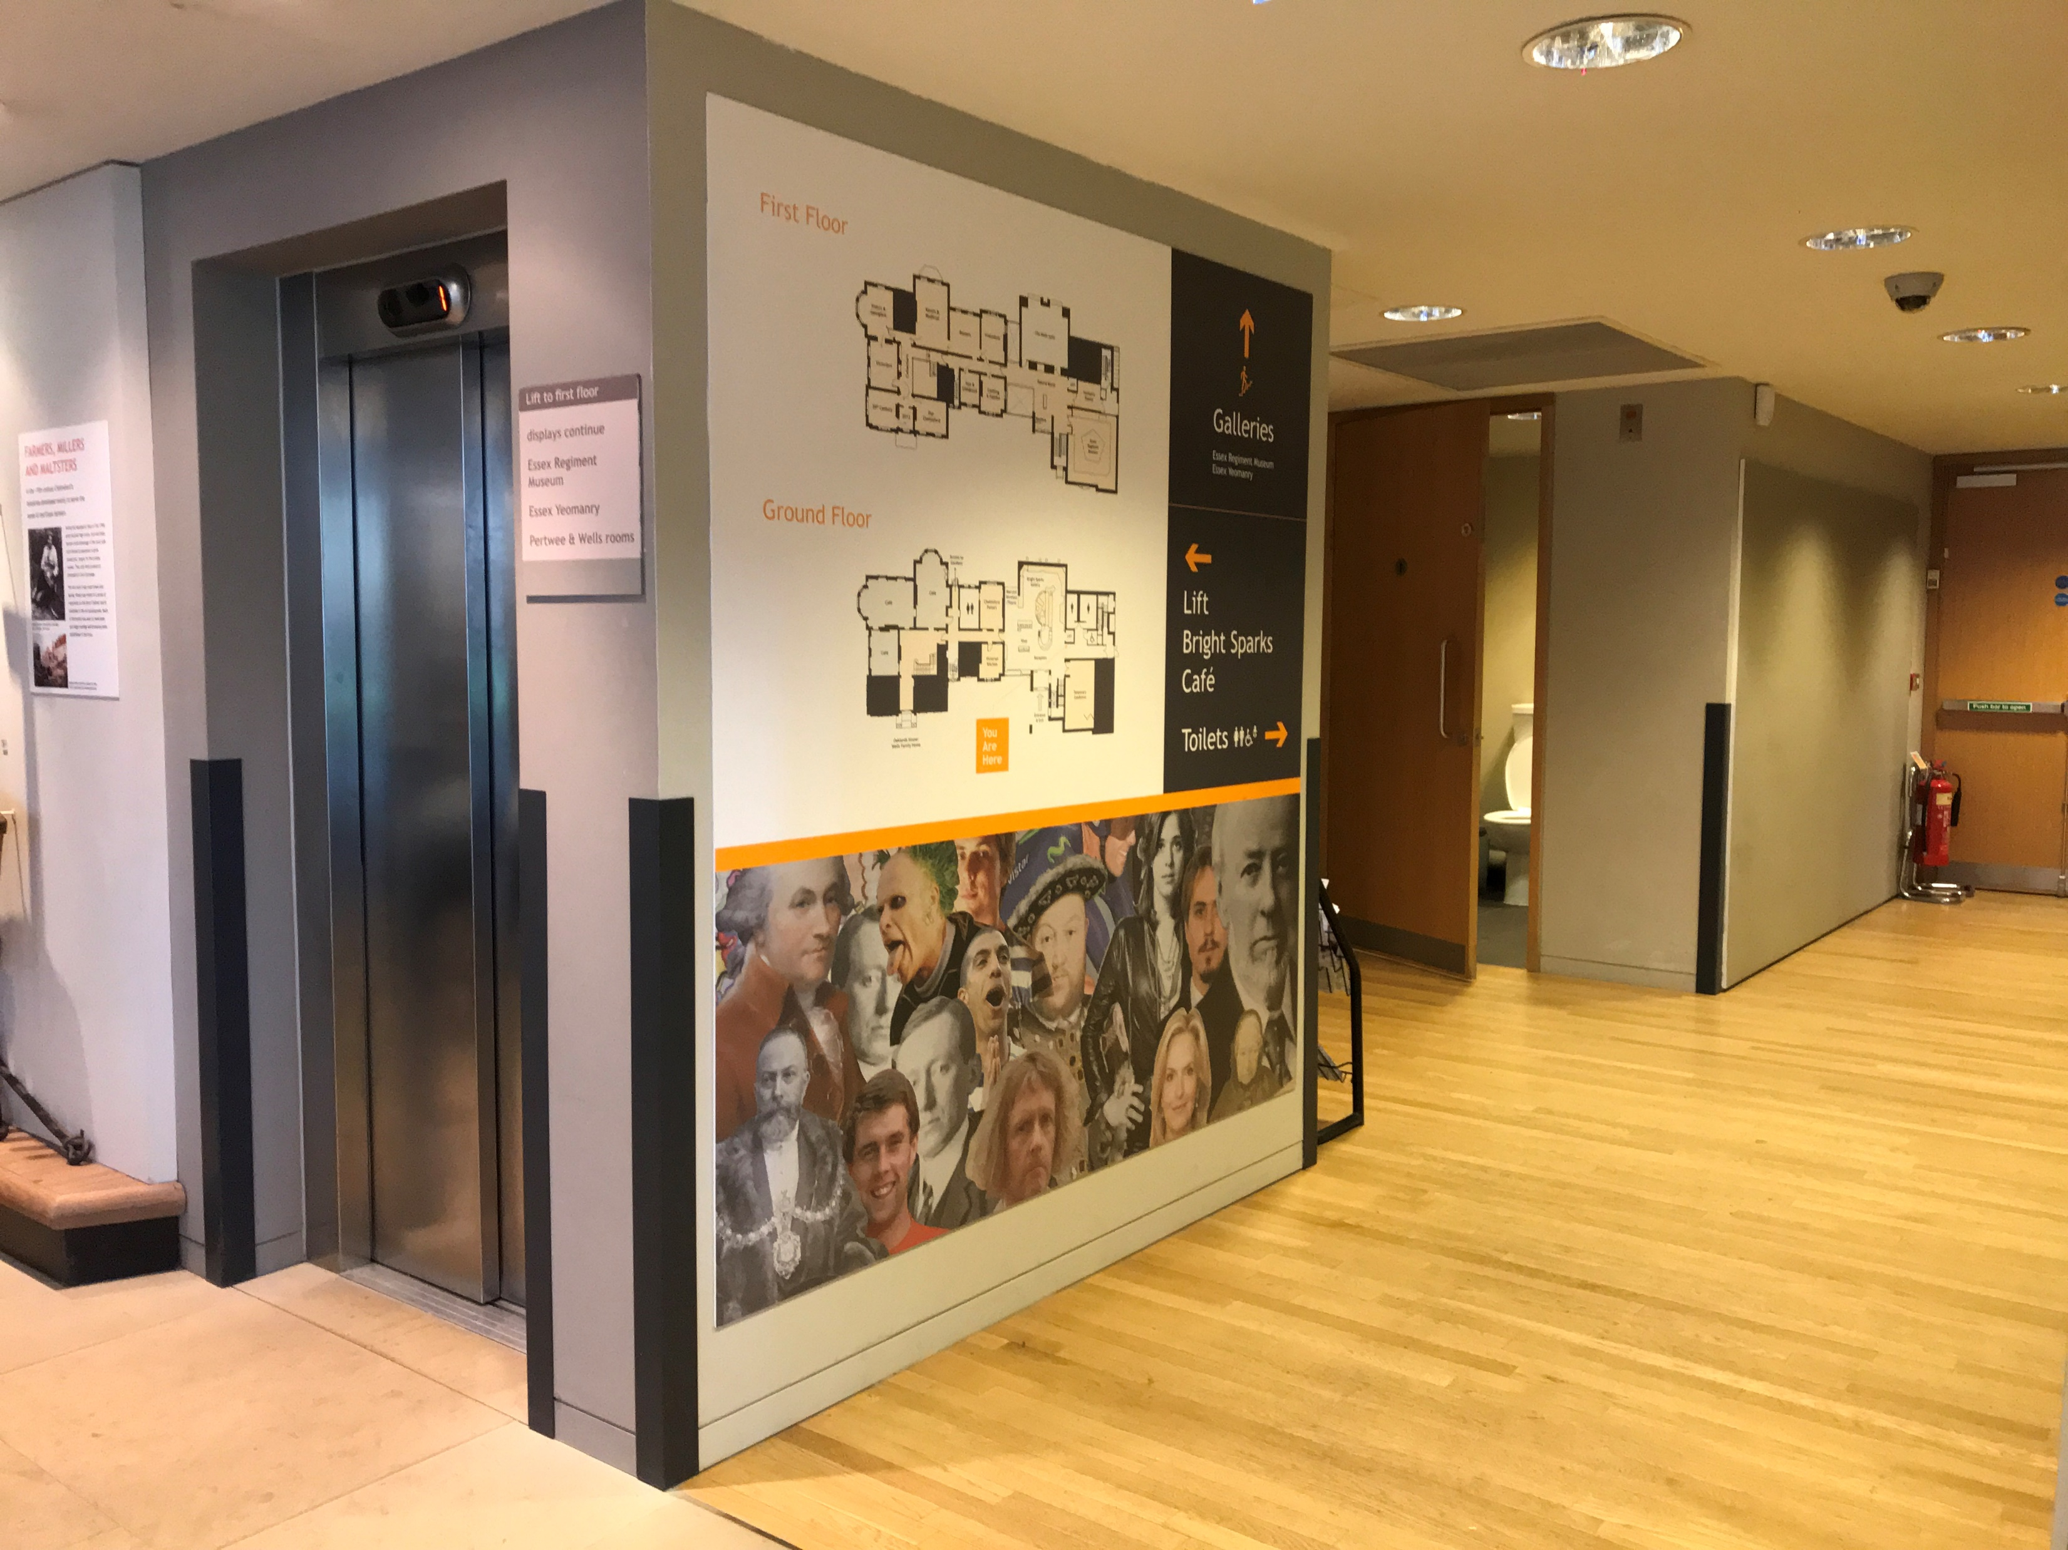
The lift and toilets are by the front desk. There is an accessible toilet.

Slide 9
The displays behind the front desk tell the story of Chelmsford’s industries.

Slide 10
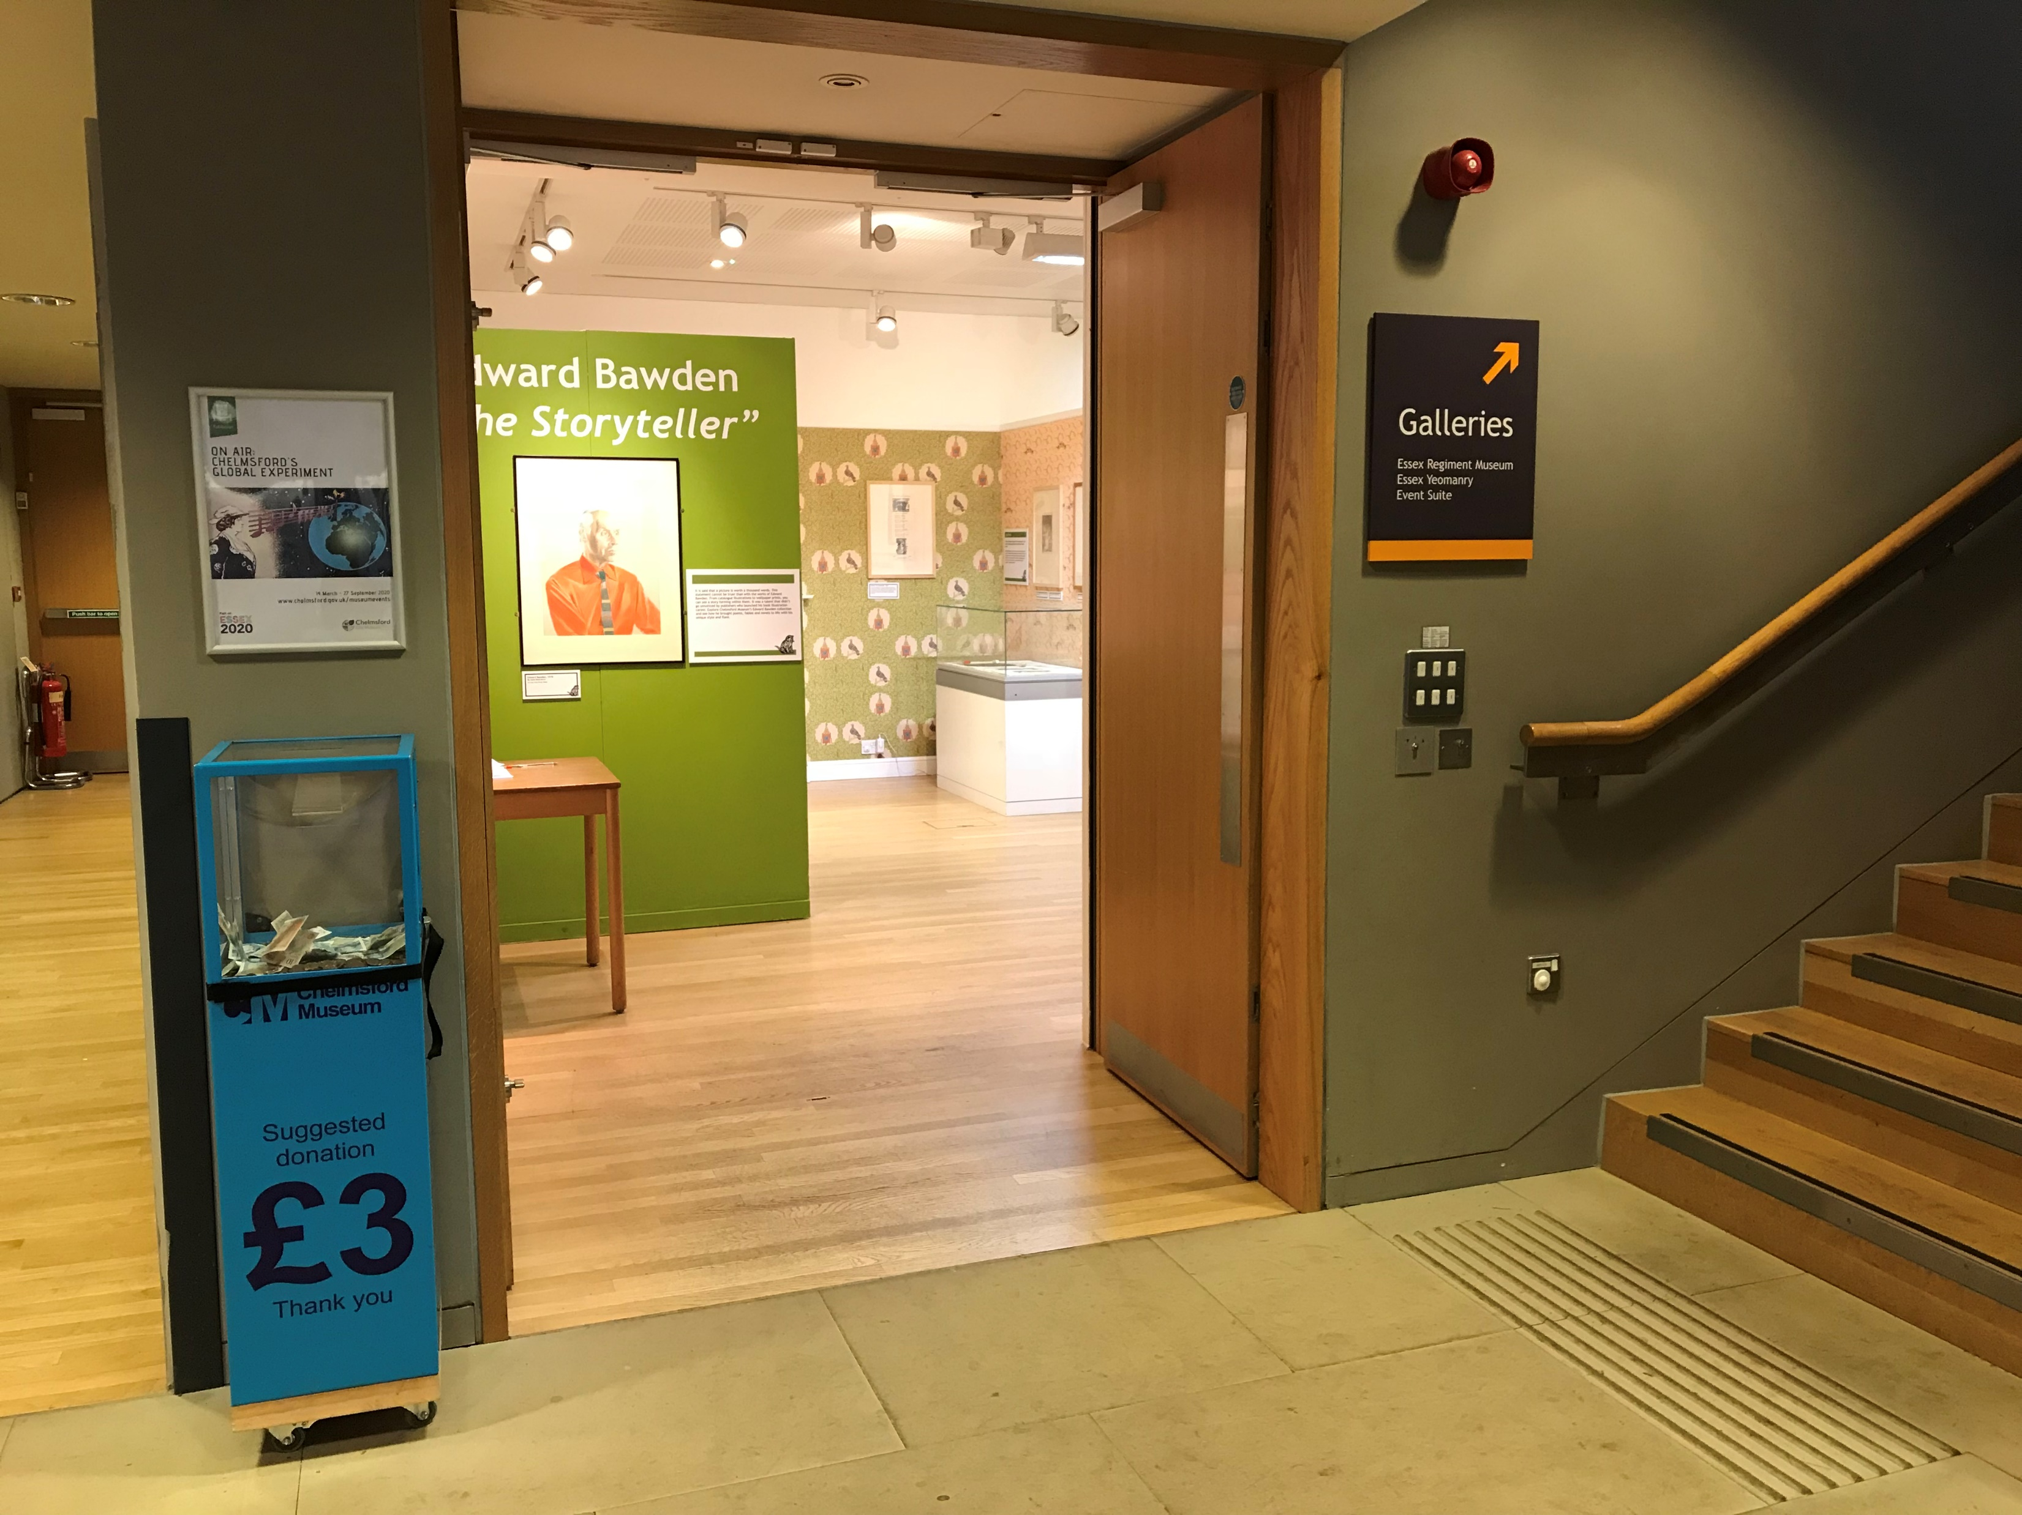
This is the Temporary exhibition room. The displays change so it will look different
when you come. The room is dark, but the lights turn on when you go in.

Slide 11
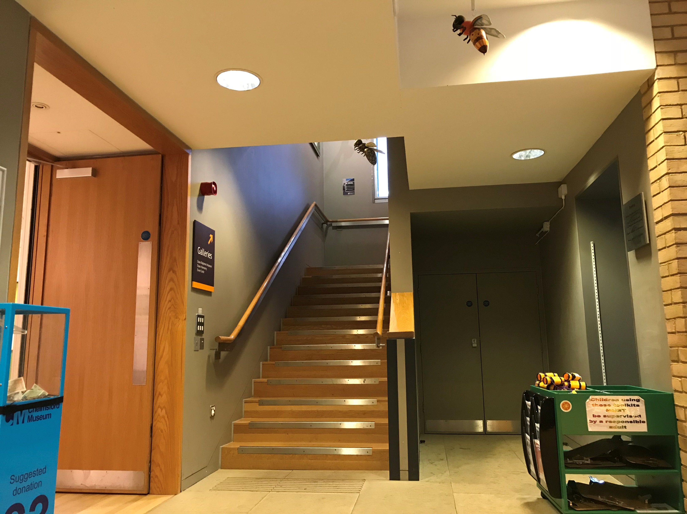
Take the lift or follow the bees up the stairs.

Slide 12
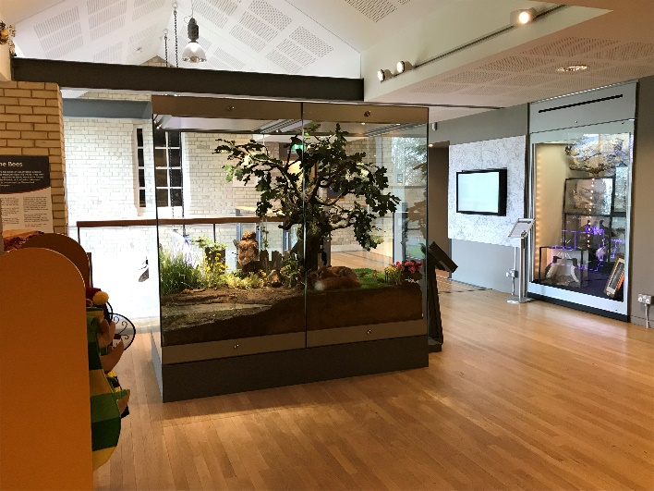
The lift and stairs take you to the landing. The big glass case has animals that live in the park.
The orange boxes in the museum mean they are ‘hands-on’ activities. Try dressing up here.

Slide 13
This is the entrance to the Essex Regiment museum. There are lots of mannequins in here..

Slide 14
It is quite dark in the Essex Regiment museum room.

Slide 15
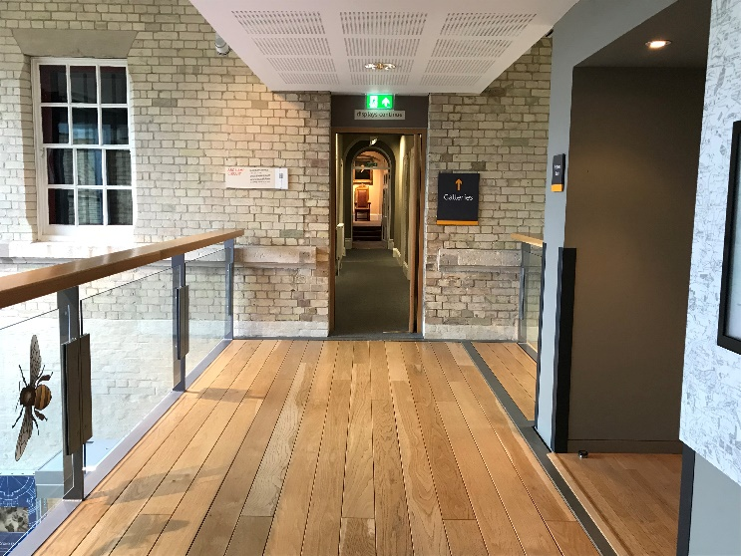
Through the doorway is a narrow corridor with a number of small rooms to explore..

Slide 16
On the left is the costume room. The lights will come on automatically when you go in.

Slide 17
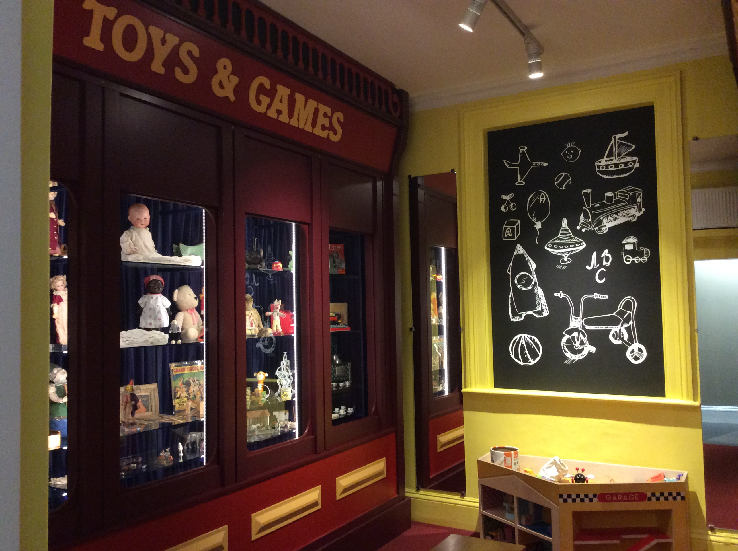
Next door is the Toy room. It is small and full of toys. There are some to play with.

Slide 18
On the right is the Stone Age to Iron Age room. It feels cooler in here.

Slide 19
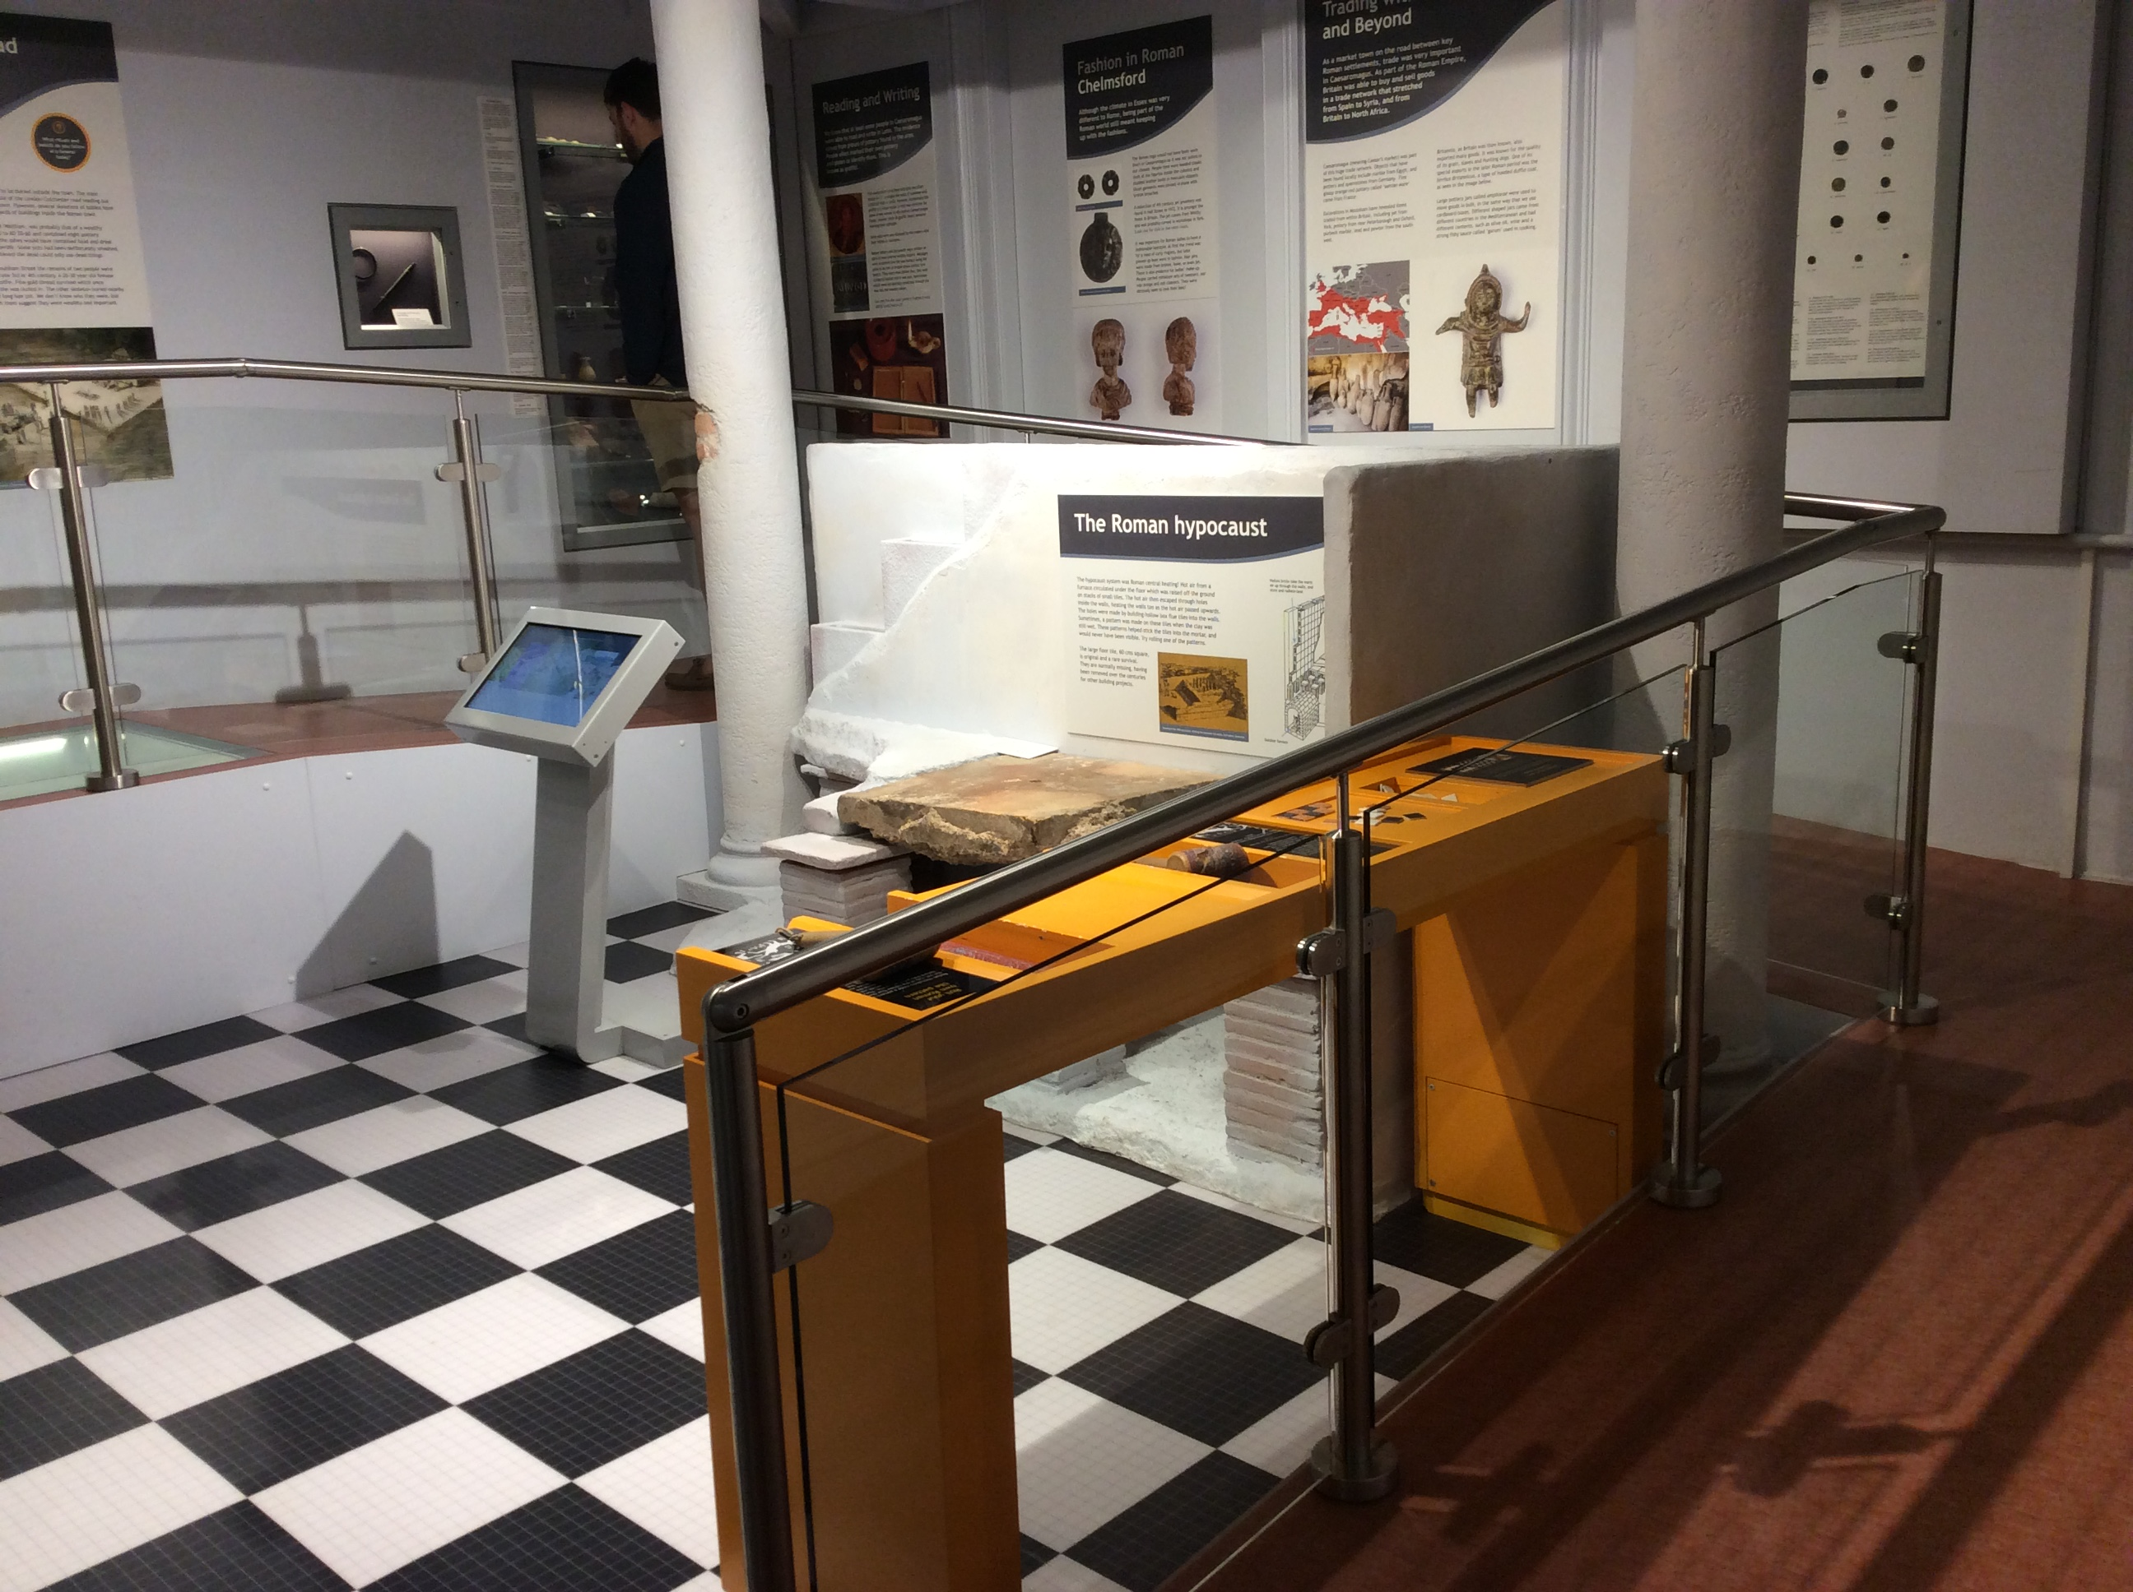
This is the Roman room. There is a ramp with a glass panel that leads to the next room.
If you don’t like the glass floor you can go along the corridor and up three steps instead.

Slide 20
This is the Anglo Saxon room. The wall in front of the bench has a model showing the
burial of an Anglo Saxon warrior. The scene slowly changes but there is no sound.

Slide 21
Cross the landing into the Tudor Life room. The films on the screen only play when
you press the button. The orange table has an interactive touch screen map.

Slide 22
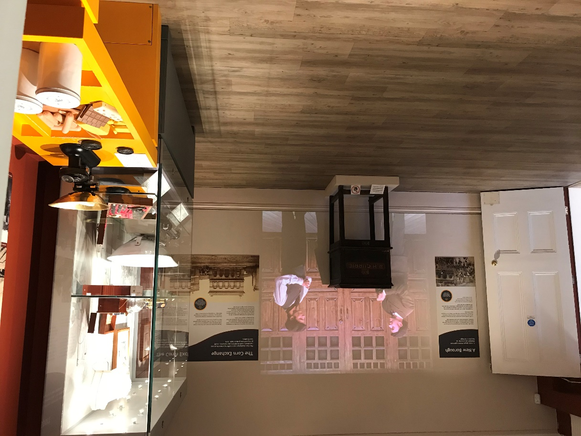
Through the arch is the Victorian Life room. The big film on the wall plays on a loop.
You can go along the landing if you want to avoid the room.

Slide 23
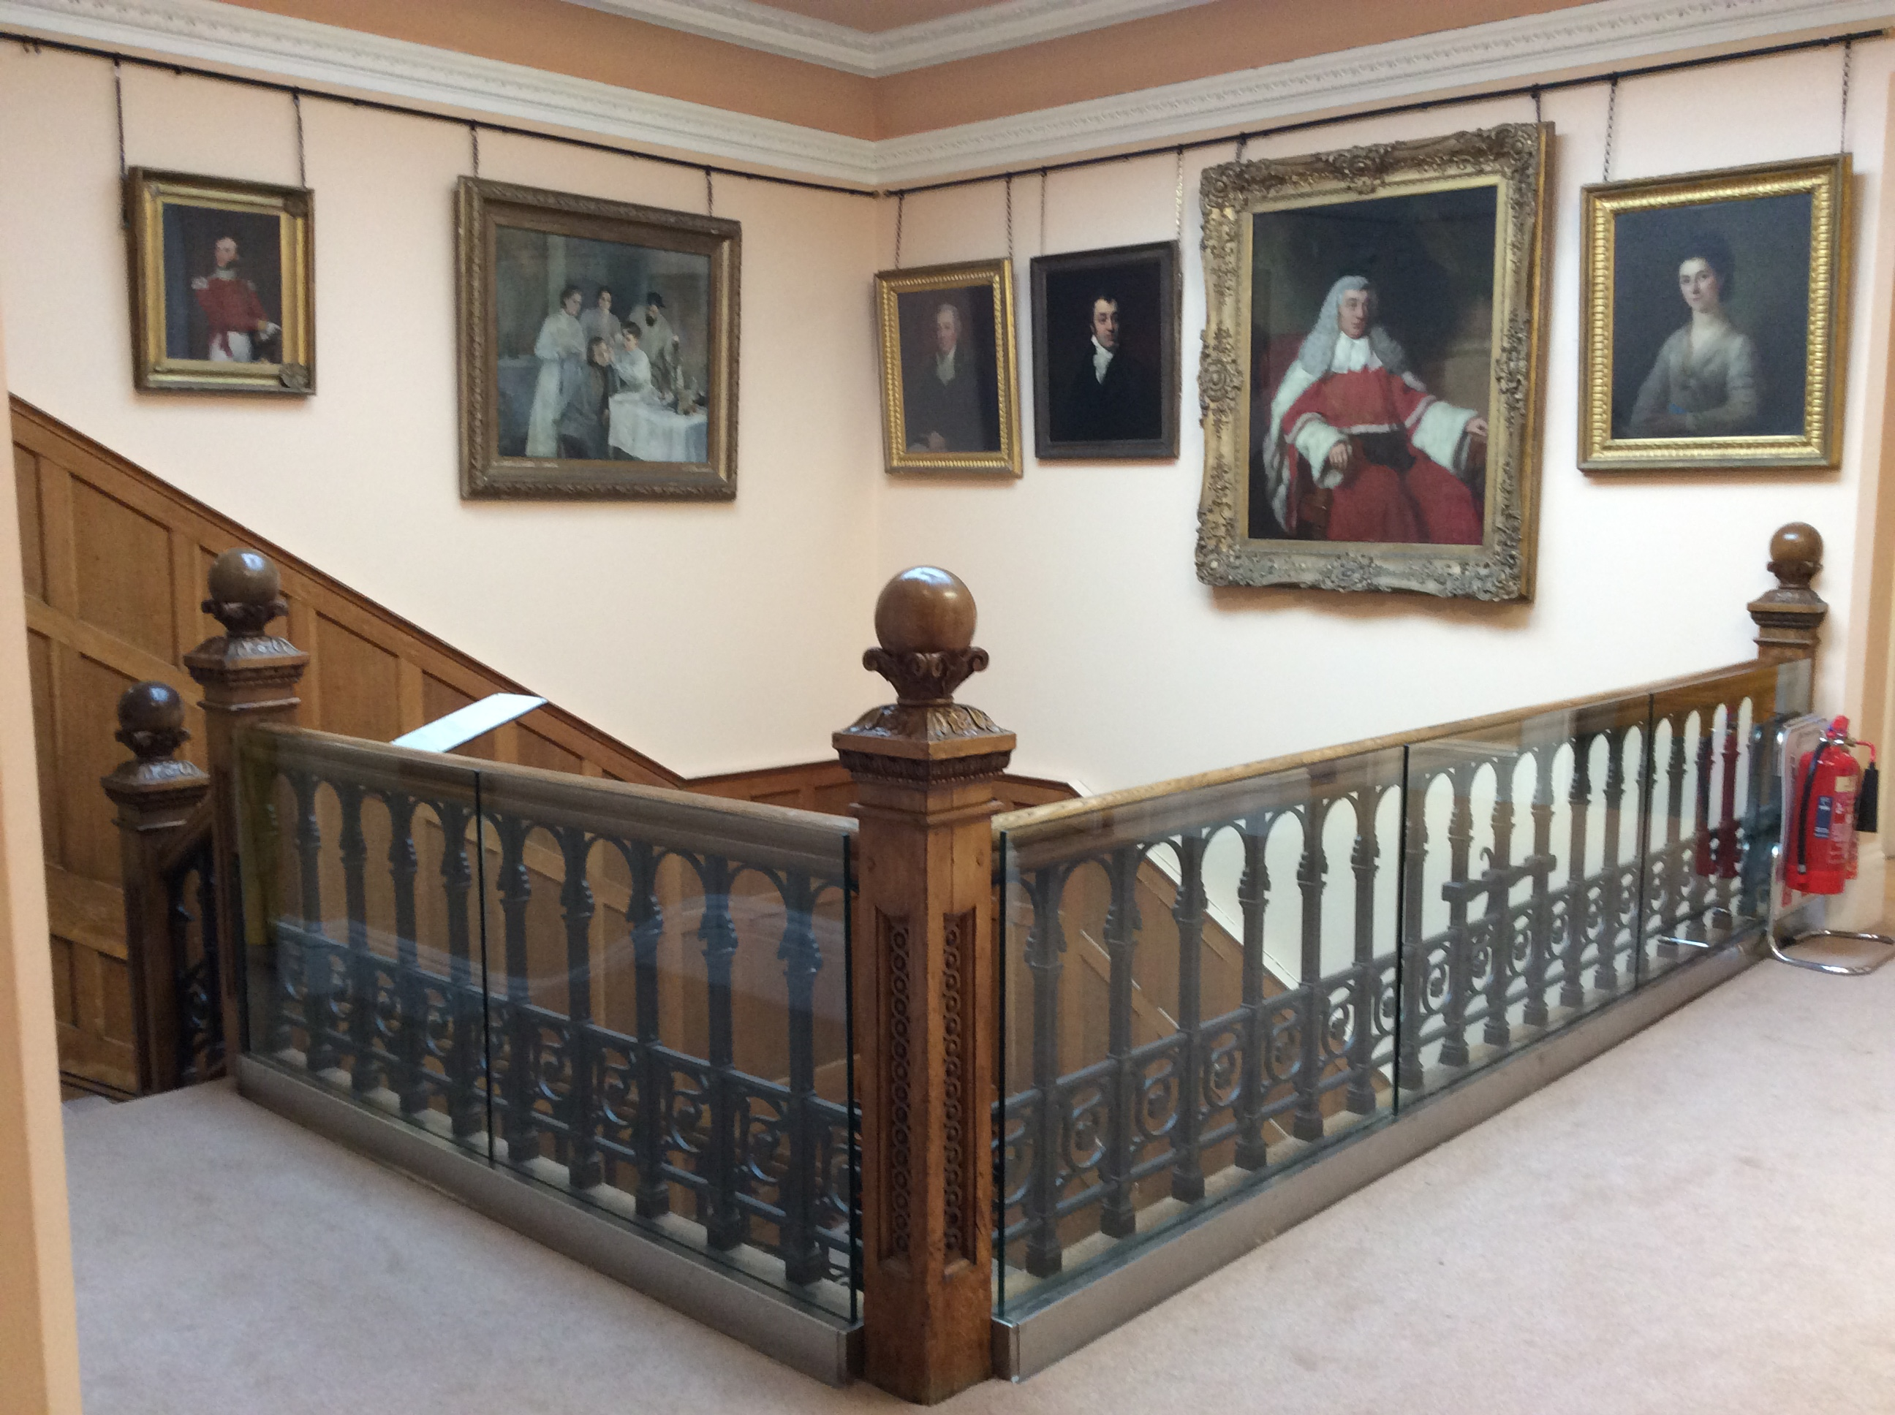
The landing

Slide 24
Life in the 20th Century room

Slide 25
This room is usually very quiet. It is a good ‘chill out’ space.

Slide 26
The main stairs take you down to the Victorian hall.

Slide 27
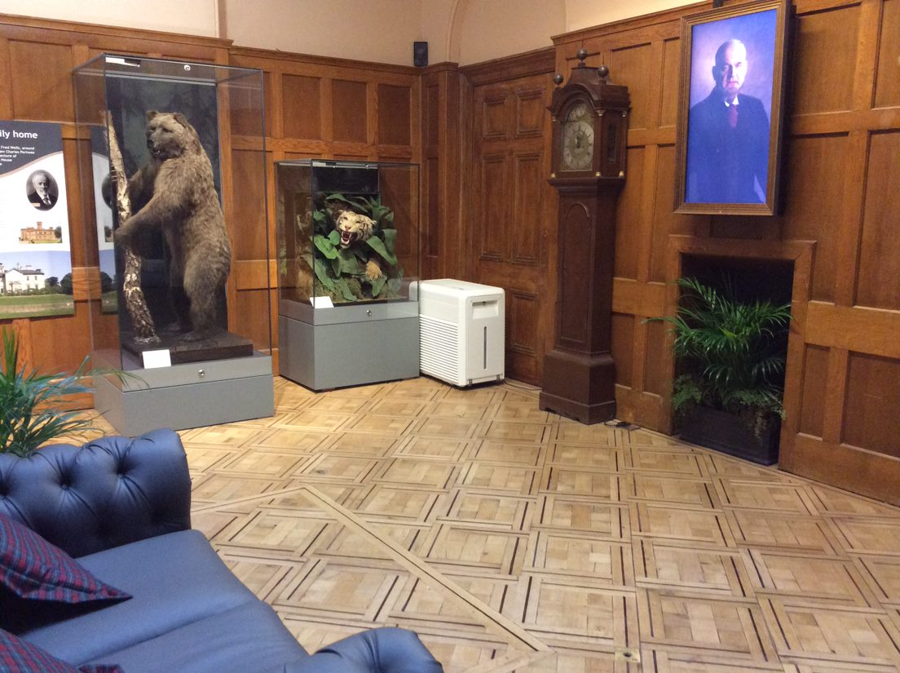
In the hall there is our bear ‘Boris’ and ‘talking portrait’ of Mr Wells, who owned the house.

Slide 28
The narrow corridor takes you back to the reception desk and shop.

Slide 29
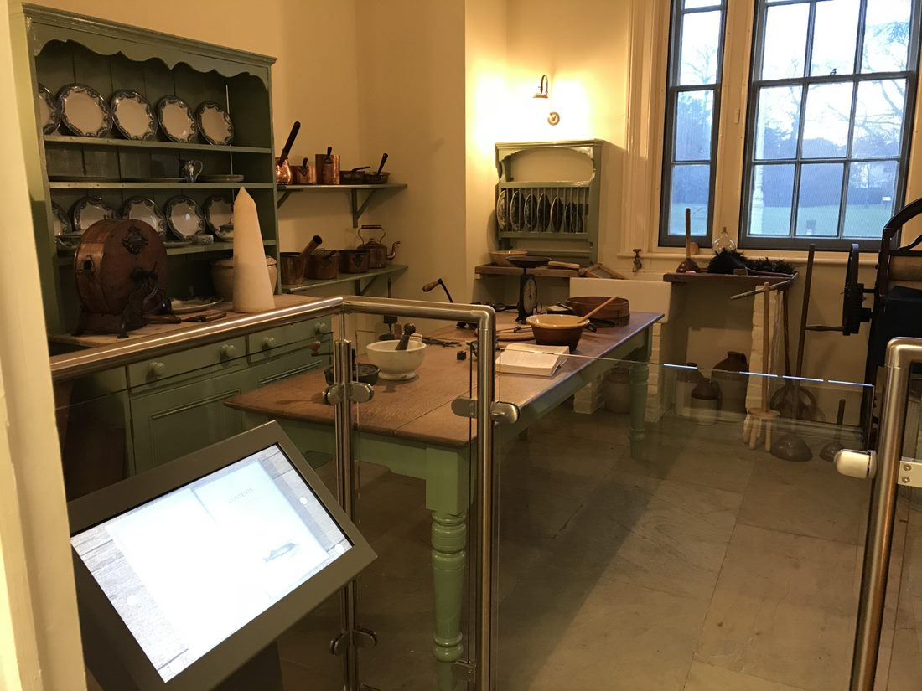
As you go down the corridor look into the Victorian kitchen

Slide 30
And the ceramics room.

Slide 31
There is a small shop by the reception desk.

Slide 32
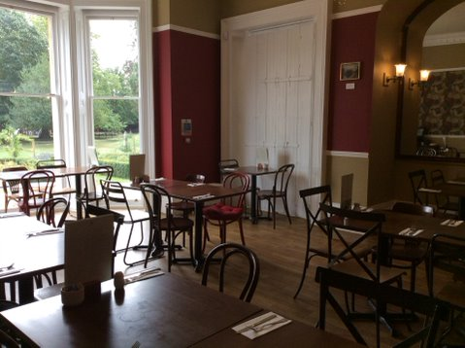
The Hive Café
The café is back along the corridor. The staff are very friendly and will take your order at
the table if you sitting inside. It can be busy and noisy in the café especially at lunchtime.
If it is warm enough you can sit outside or have a picnic in the park.

Slide 33
There is lots to find in the park.

Slide 34
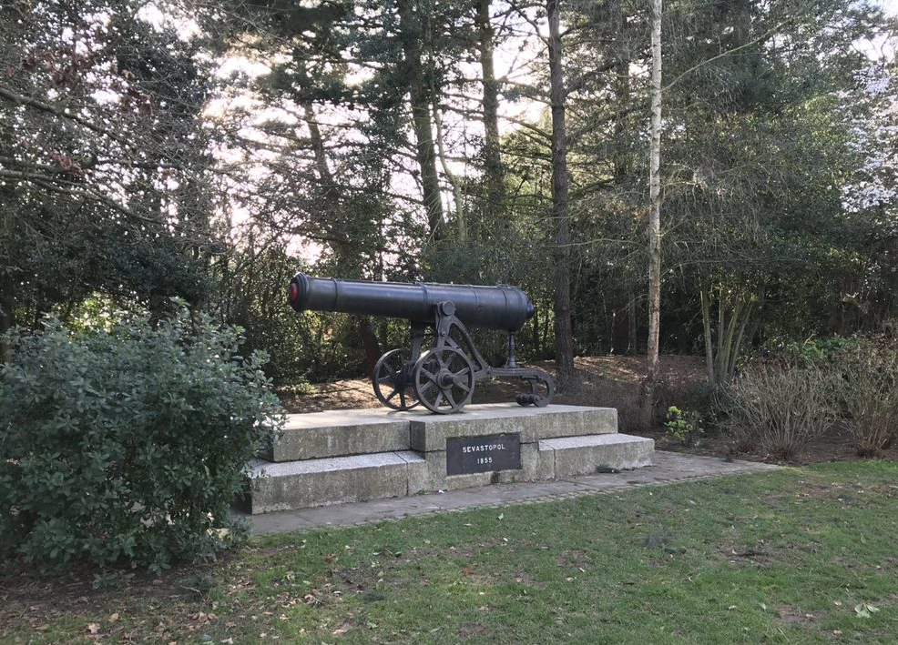
Look out for the cannon

Slide 35
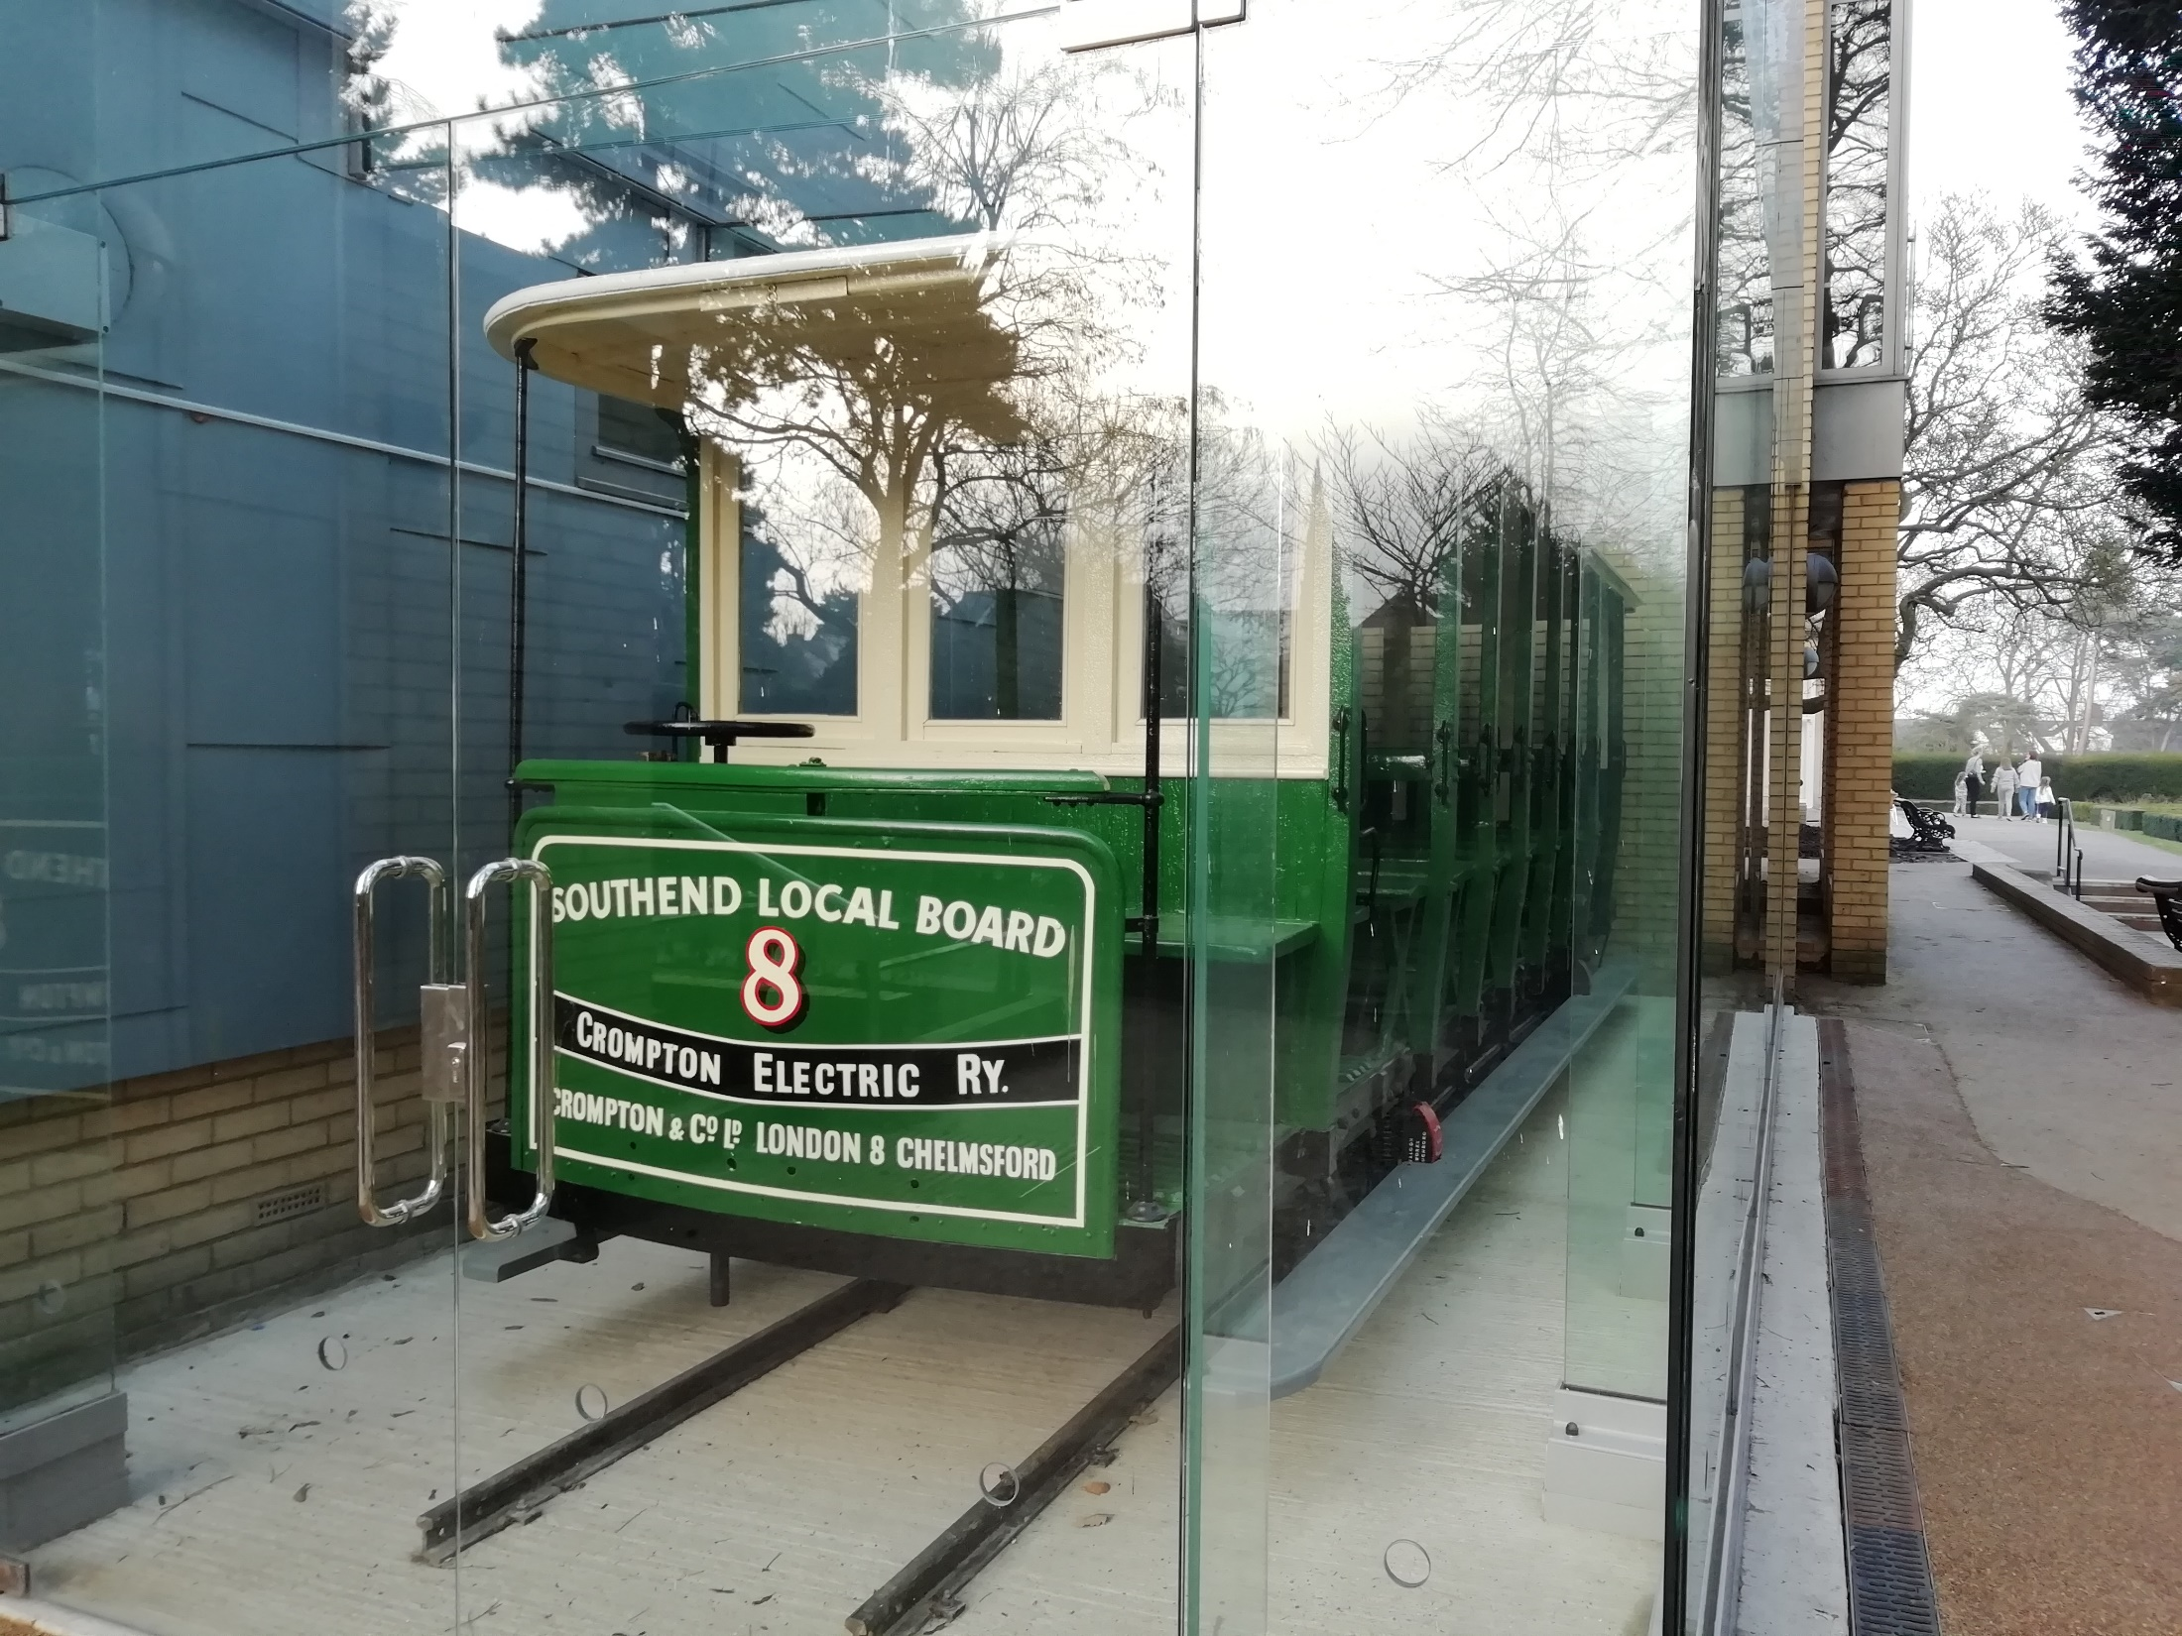
And the tram that was used on Southend Pier.

Slide 36
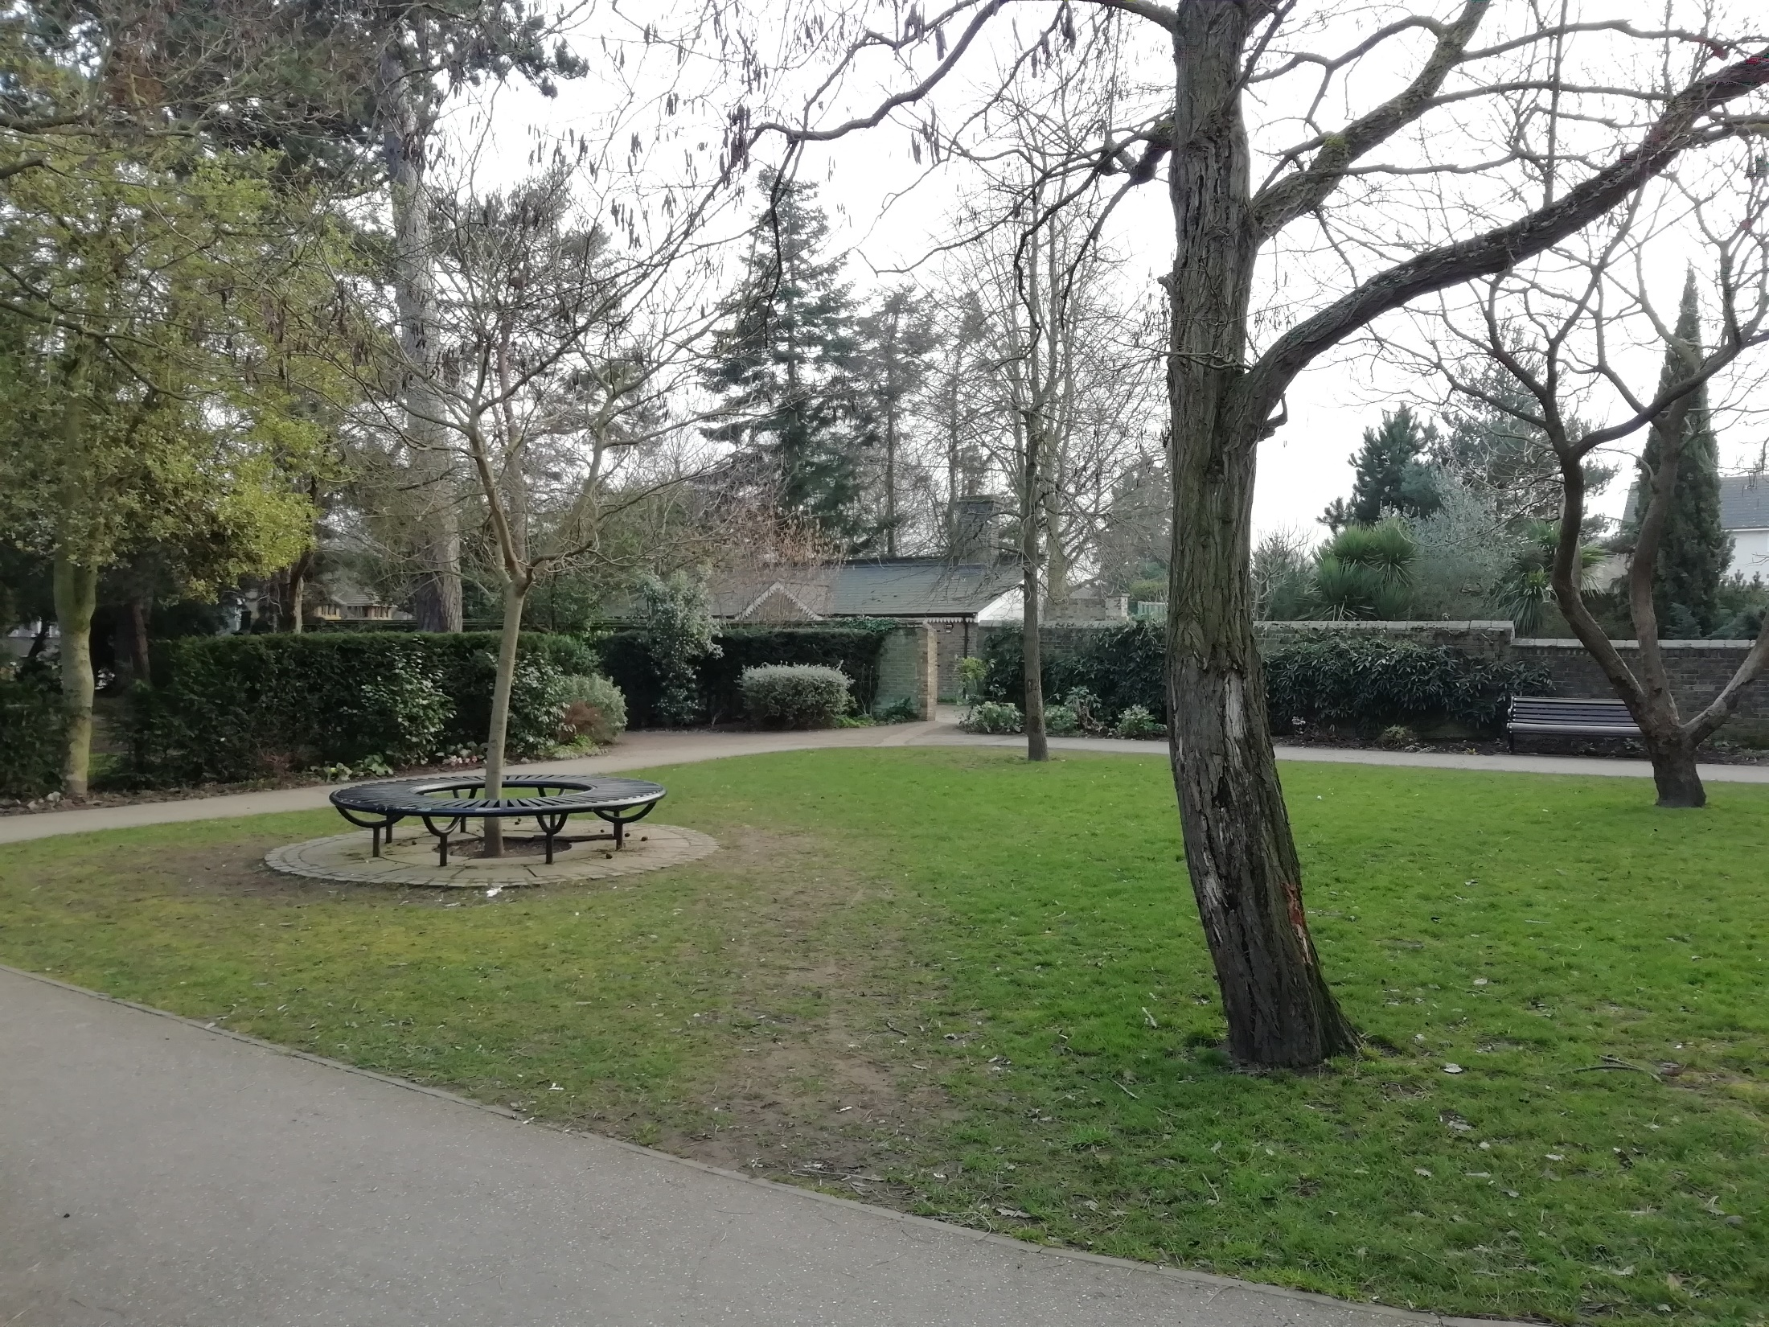
Lots of people walk dogs in the park. This walled garden though is often quieter. It is a good place to enjoy a picnic on a warm day.

Slide 37
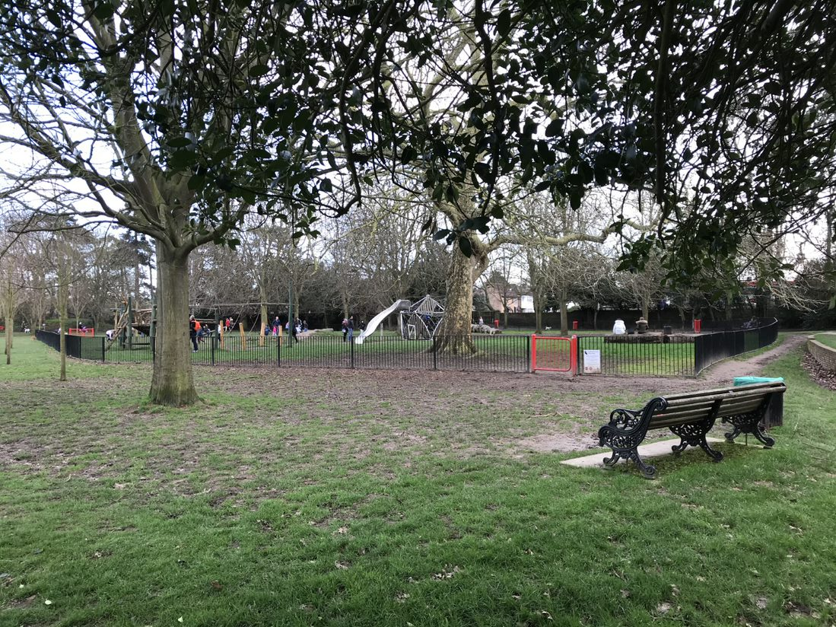
There are two playgrounds in the park and lots of open space.

