Slide 1
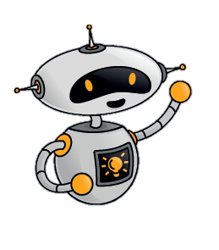
Toys Through Time session
at Chelmsford Museum
Before your visit to Chelmsford Museum for our ‘Toys Through Time’ session use this presentation with your children so they can gain the most from the trip.
As you go through the slides our robot ‘Sparky’ will pose questions that will encourage your children to start thinking about their own toys and introduce them to the museum which was once Wells family home. Enjoy

Slide 2
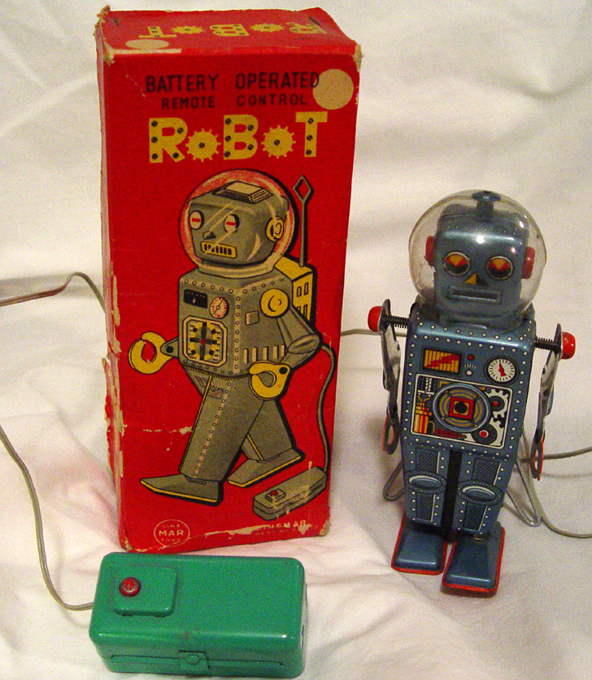
Hi, my name is Sparky. Welcome to Chelmsford Museum
We have lots of old toys in the museum. This one is my favourite.
It is made from metal.
When you press the controller the robot moves it’s arms and legs.
What do you think makes it move?

Slide 3

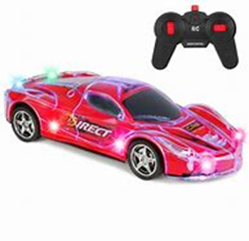
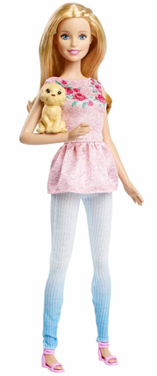
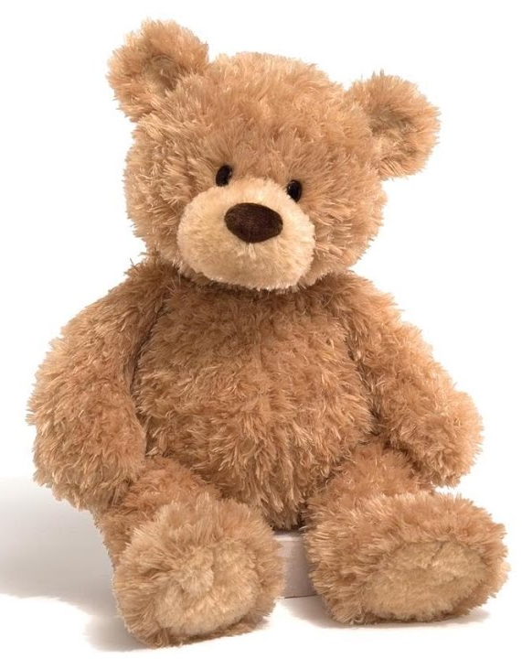
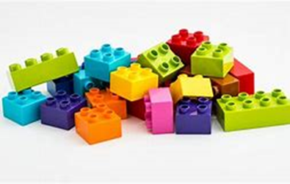
Think of your favourite toy
is your favourite toy?
What is it Why is this a g material for
What is your toy made from?
Why is this a good material for your toy to be made from?
Does your toy move?
How does it move?

Slide 4
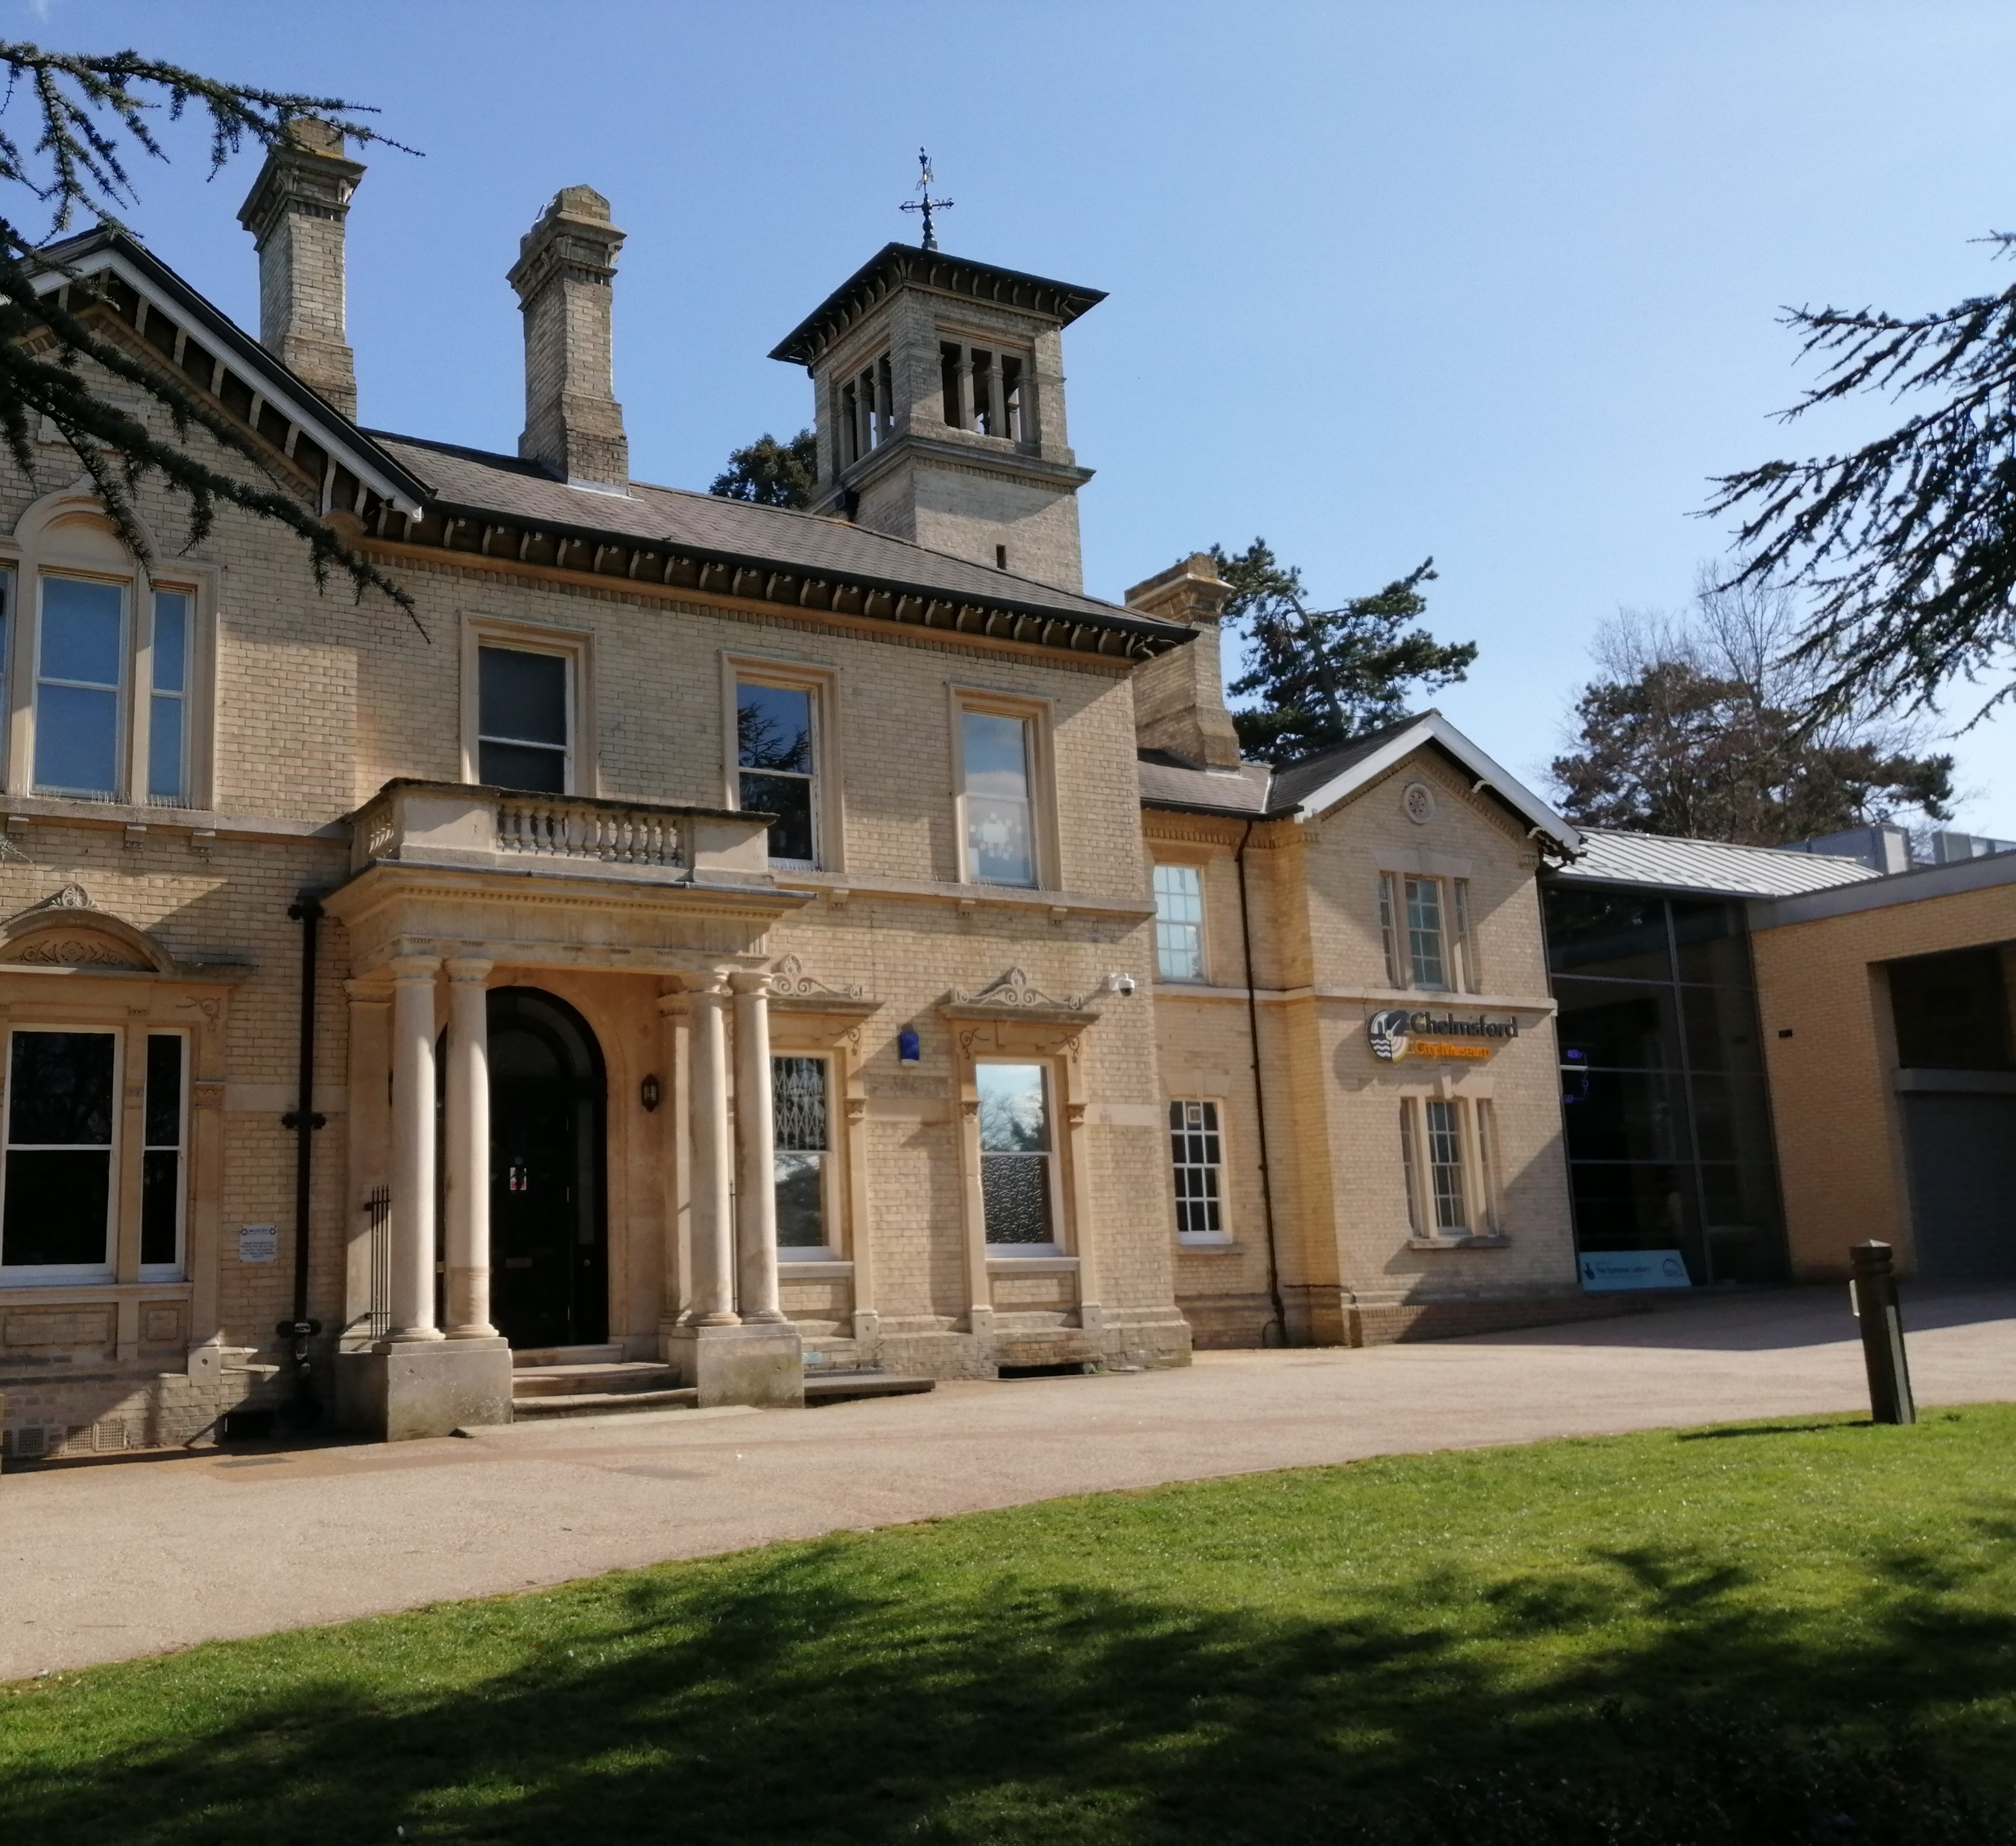
Chelmsford Museum
This is Chelmsford Museum. In Victorian times the old part of the building that you can see was a house where the Wells family lived.
Let’s see what can we find out about them from their house.

Slide 5
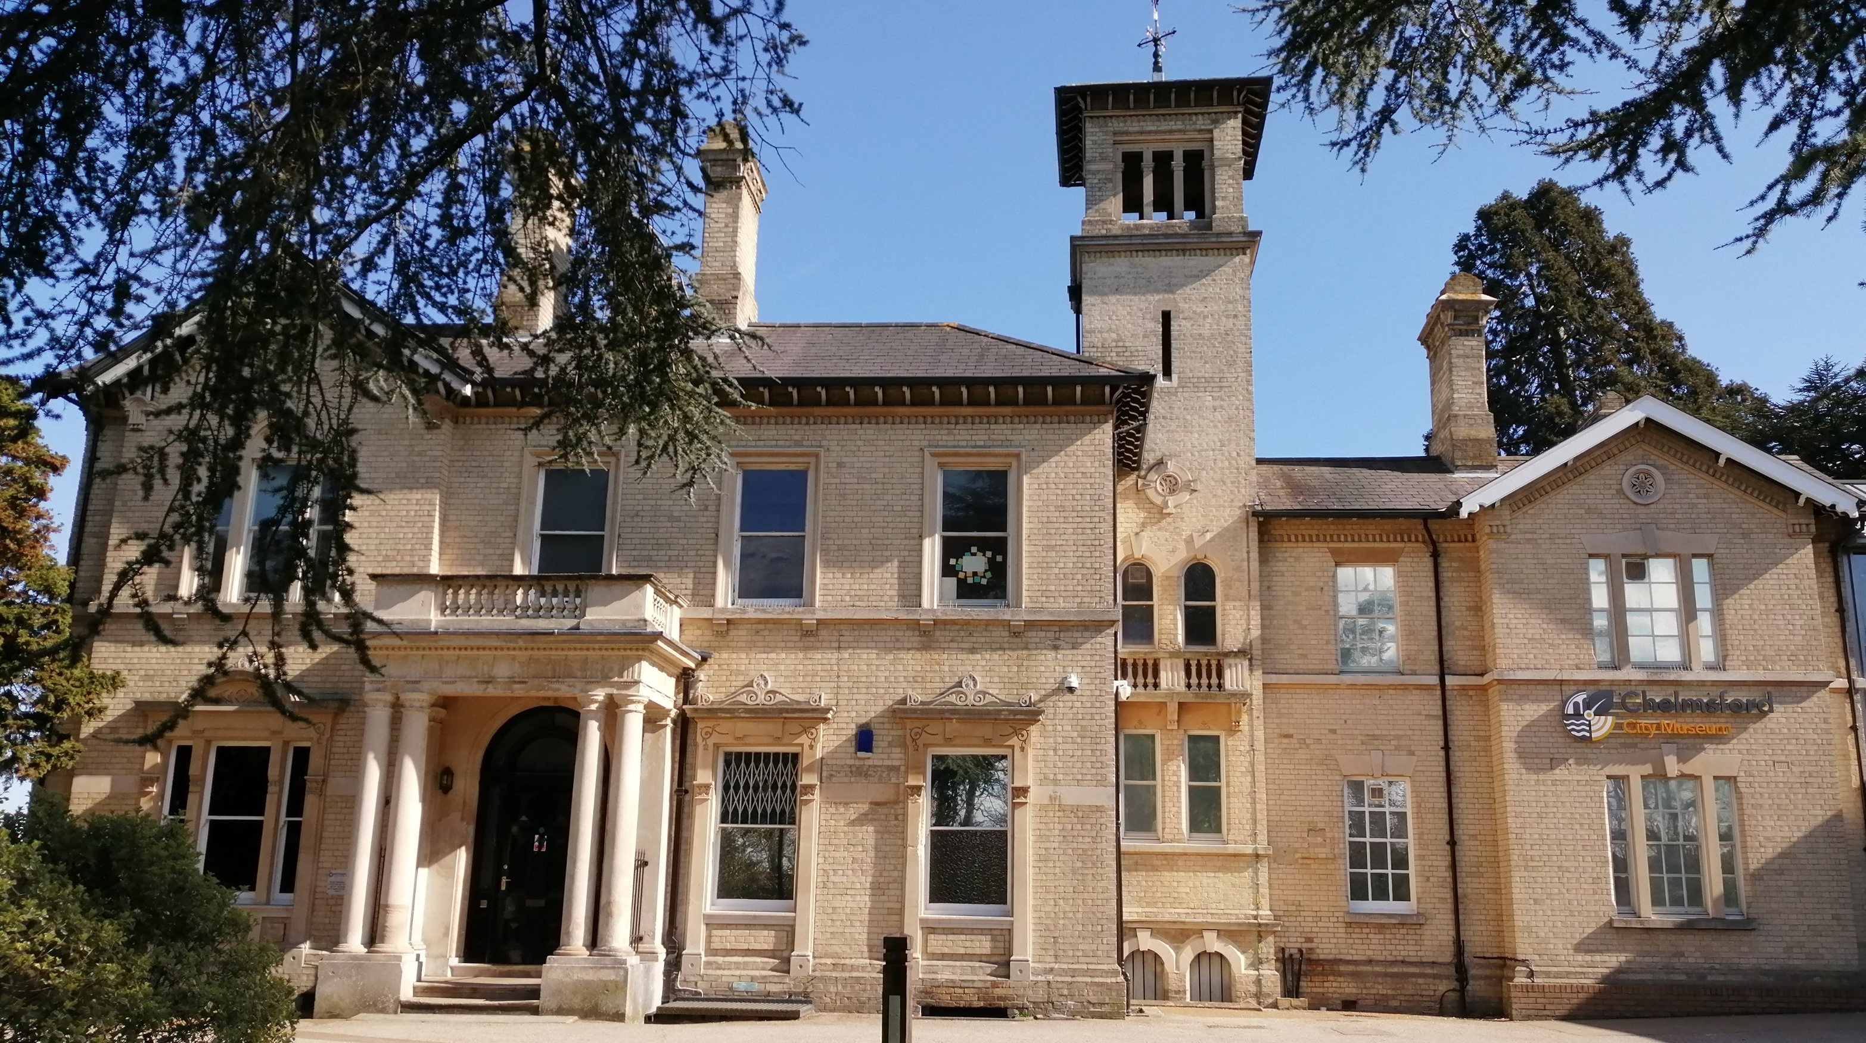
Do you think the Wells family were
rich or poor?
Why do you think there are so many?
Clue: what is at the bottom of a chimney?
What can you see around the front door?
How many chimneys can you see?
How many windows can you count?
Does Oaklands house look like your house?

Slide 6
See you soon…
Well done, you had lots of great ideas.
When you visit you will be able to
find out more about the Wells family and the toys they liked to play with.
You will be able to explore the inside their house too.

Slide 7
Post visit resources for Toys Through Time session
Use the ideas and activities on the next few slides to carry on investigating the toys your class looked at and played with when they visited the museum.
There are pages with large printable pictures of old toys from the museum at the end of the powerpoint.

Slide 8
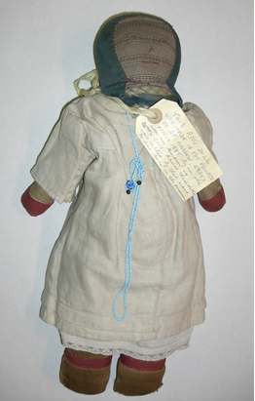
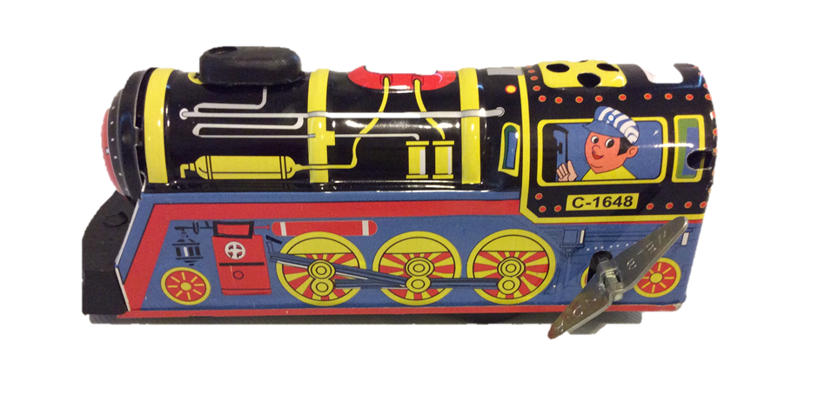
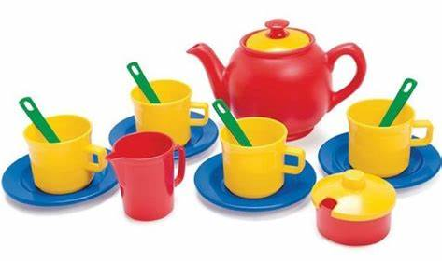
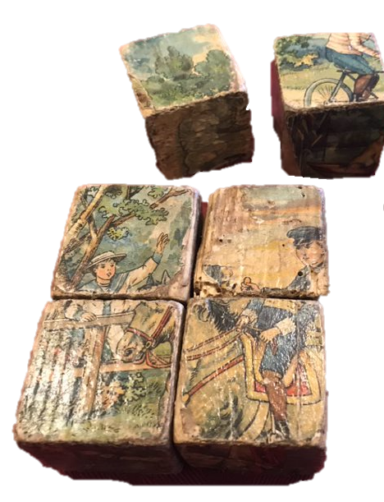
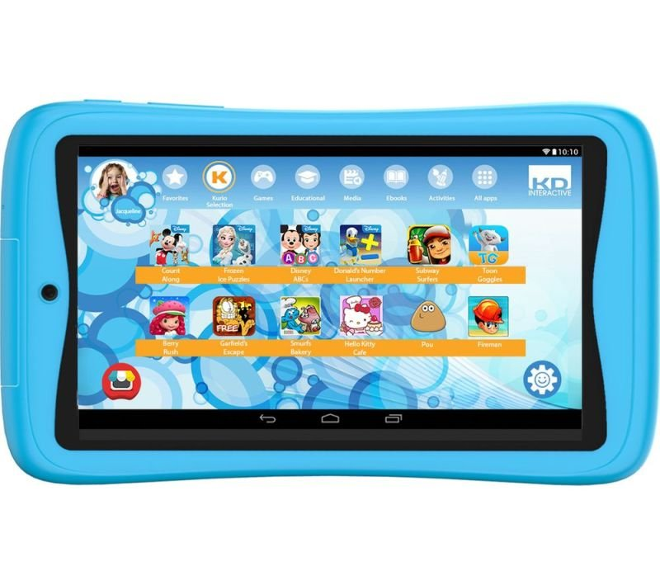
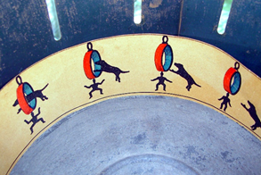
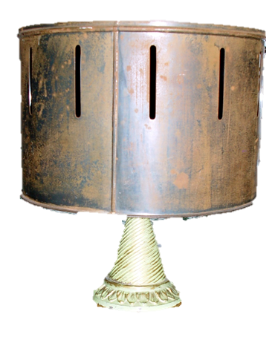
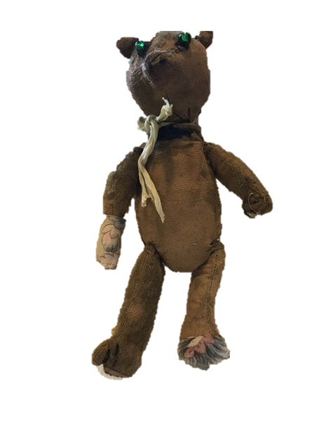
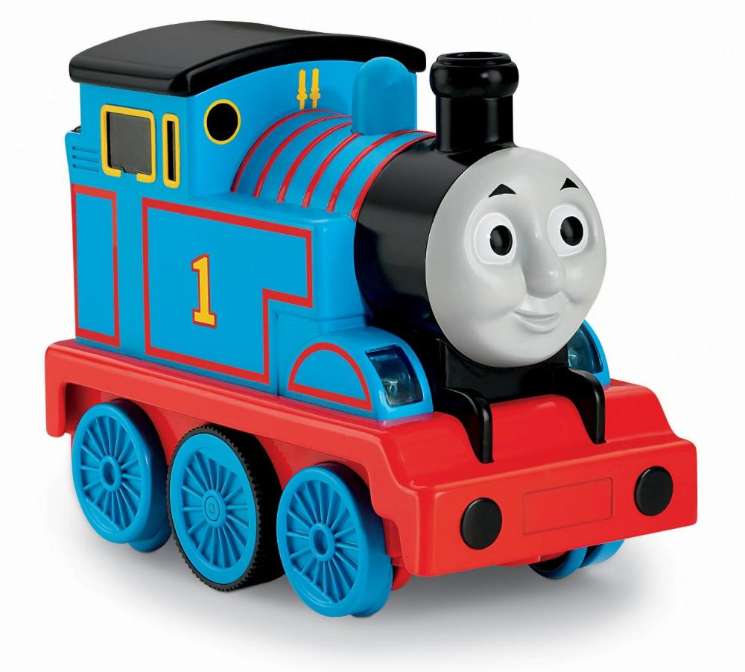
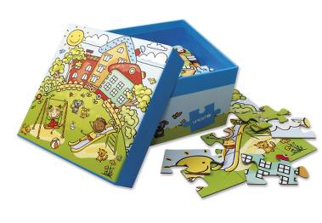
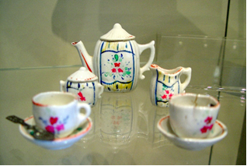
Can you find pairs of old and new toys?

Slide 9
How are the pairs of toys the same?
How are they different?

Slide 10
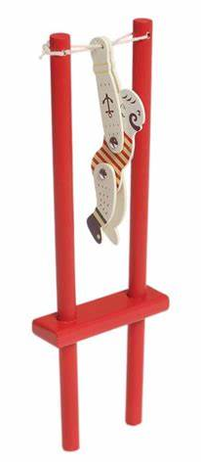
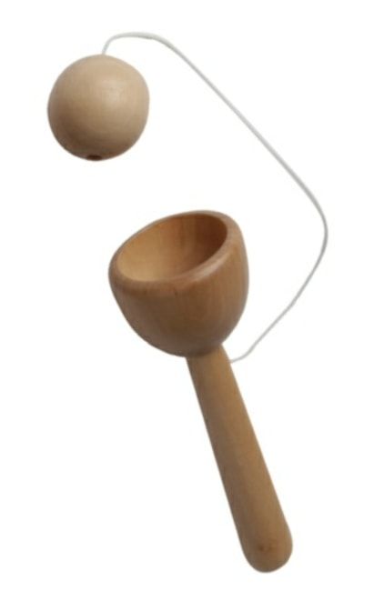
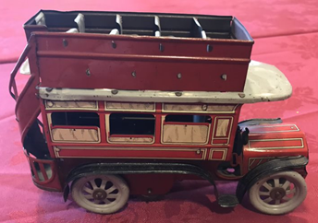
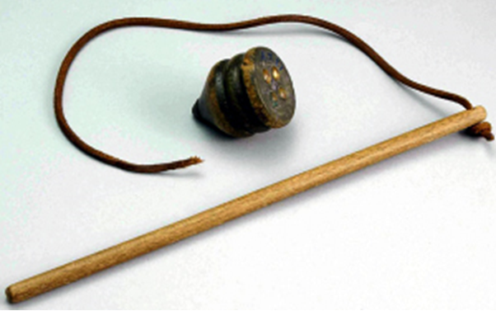
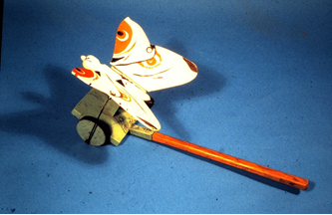
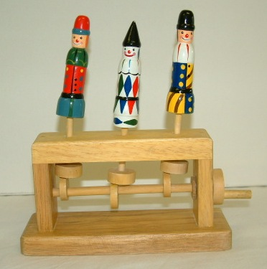
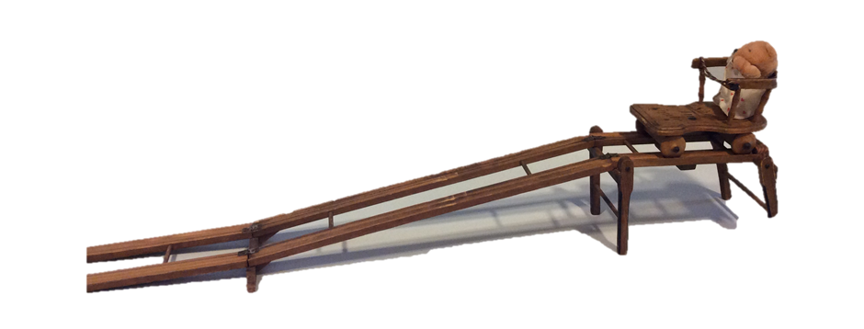
How do different toys move?
Match the words with these old toys.
How do your own toys move?
pull
push
twist
turn
spin
squeeze

Slide 11
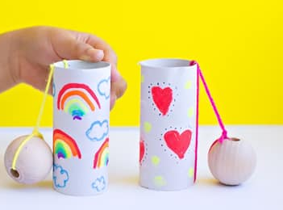
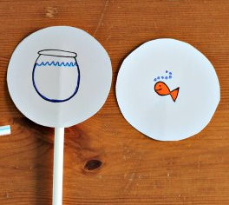
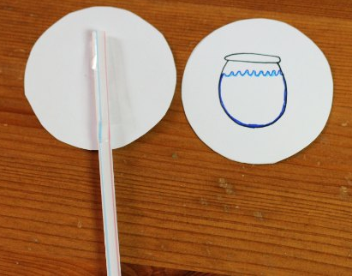
Make your
own toys
Thaumotrope
This is a great optical toy like the flickbooks and zoetrope. Spin the thaumotrope fast between your fingers and the pictures on both sides look like one – a goldfish in a bowl.
Cut out 2 card circles the same size.
Choose 2 pictures that go together and draw one on each piece of card. (eg: fish + bowl, face + hat)
Put double sided tape on the back of each circle.
Stick the pictures to the straw making sure they are they are both ‘upright’
Spin it fast between your fingers and see what happens..
Cup and ball
Tie a large bead onto the end of the string and use a cup or tube for the ‘cup’.

Slide 12
Tin plate clockwork bus China tea set for a dolls house

Slide 13
Wooden cup and ball toy Wooden acrobat toy

Slide 14
Rag doll Teddy bear

Slide 15
Wooden block puzzel Zoetrope

Slide 16
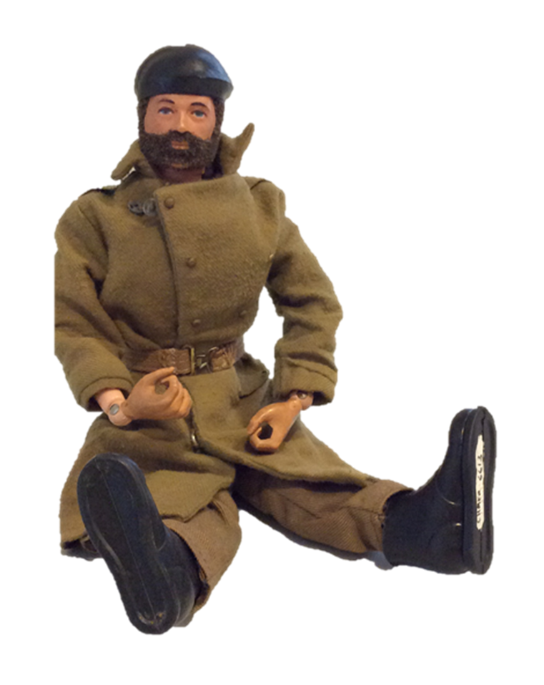
Action man Whip and top

Slide 17
Wooden cam toy – jumping clowns! Wimp

Slide 18
Tin plate clockwork train
Shoot the chute

Slide 19
